Slide 1
Maze-Pong
Tomi Liimatainen
Aapo Sormunen
Markus Häkkinen

Slide 2
Plan
Create a better version of the legendary game Pong
How we are going to do it: Add more functions and details
the game “evolves” harder the further it goes
special skills ( random items will appear randomly on game area → affecting on speed, bar size etc.)

Slide 3
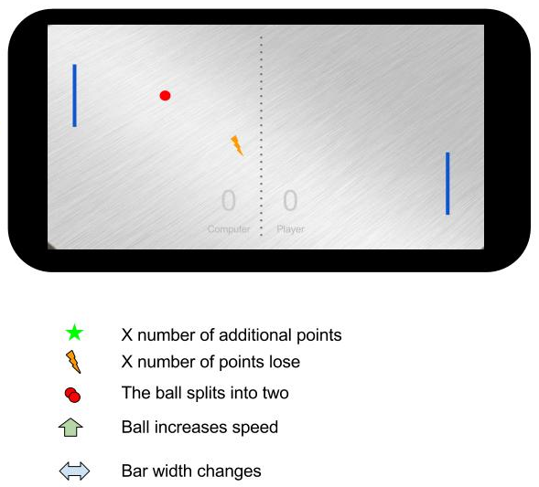

Slide 4
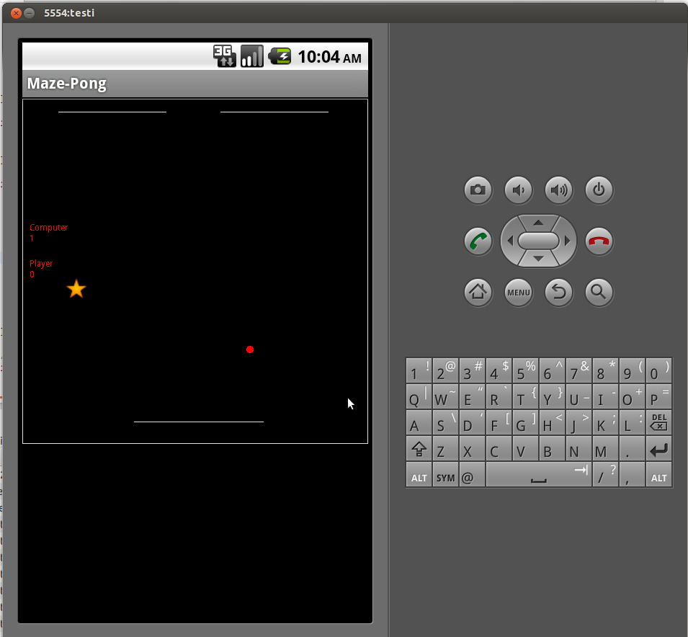
And what we made..
If you can get the star, you’ll get extra three points

Slide 5
Maze-Pong
Based on Maze game
Player can play against to the computer
Both of them can get points, when they ”score”
Extra three points will be get, when player or computer get the star figure
The star figure will appear suddenly on the playground!

Slide 6
Conclusion
This was our first time, when we’re ever coding and programming Java and Android.
The result was that game works fine
We reach the goal and learn a lot about Java programming!

