Slide 1
PILLOW NIGHTMARE
Coding Horror team:
Artem Suschev
Mihai Iusan
Alexandra Petrova

Slide 2
THE APPLICATION IDEA
The main idea is to create an arcade game with the use of different control and input types which android devices are able to provide: microphone, tilt, swipe, compass. The game unique style includes hand-drawn graphics and composed music.

Slide 3
APPLICATION FEATURES
In Pillow Nightmare, the player is able to:
Move the character
Kill the enemies by throwing the pillow
Play in slow motion mode

Slide 4
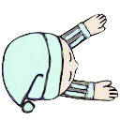
MOVING THE CHARACTER

Slide 5
SLOW MOTION MODE

Slide 6
KILL THE ENEMIES

Slide 7
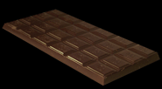
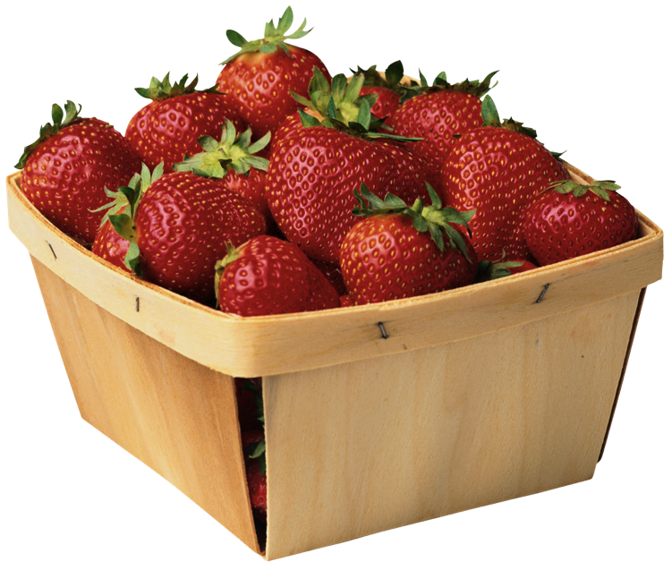
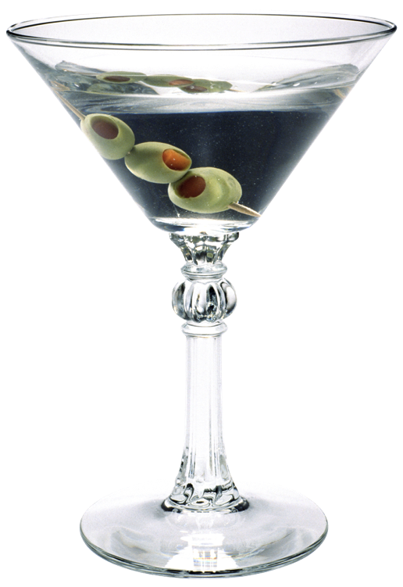
CODING WORK CONCLUSIONS
During the work, we have consumed:
x 17 x 7 x 2
x 12 x 15 x 1
x 10 x 6 x 0

Slide 8
CODING WORK CONCLUSIONS
And all this has been processed into:
x lines of code
7 music tracks
44 images
2 presentations

