Slide 1
ANDROID CODE CAMP
CAR LOCATOR
“Android, Where I Park My Car ?!
(parkMyCar!)”
Group :
0392591 Mehar Ullah
0406212 Norismiza Ismail
0406403 Wu Yongyi

Slide 2
Service Audience
Clients with handphones or Smartphones.
Type of clients :
All car users (drivers and passengers)
Example : A family go to Shopping Mall. The driver park the car at a location. Everyone has his/her shopping place and go separately. Later, the driver and family could find where their car by the apps…

Slide 3
Mobile/Wireless Devices & Communication Technologies
The Mobile/Wireless Devices for this service are:
a. GPS enabled devices
b. Android programming language
c. Android Samsung mobile phones/Galaxy tab/Nexus
The Communication technologies for the service are:
a. Global Positioning System (GPS)

Slide 4
Application Functionality
a. Obtain car current location
b. Display location GPS coordinate and address
c. Display map-based location (Google Map)
d. Direction to the Car from current location

Slide 5
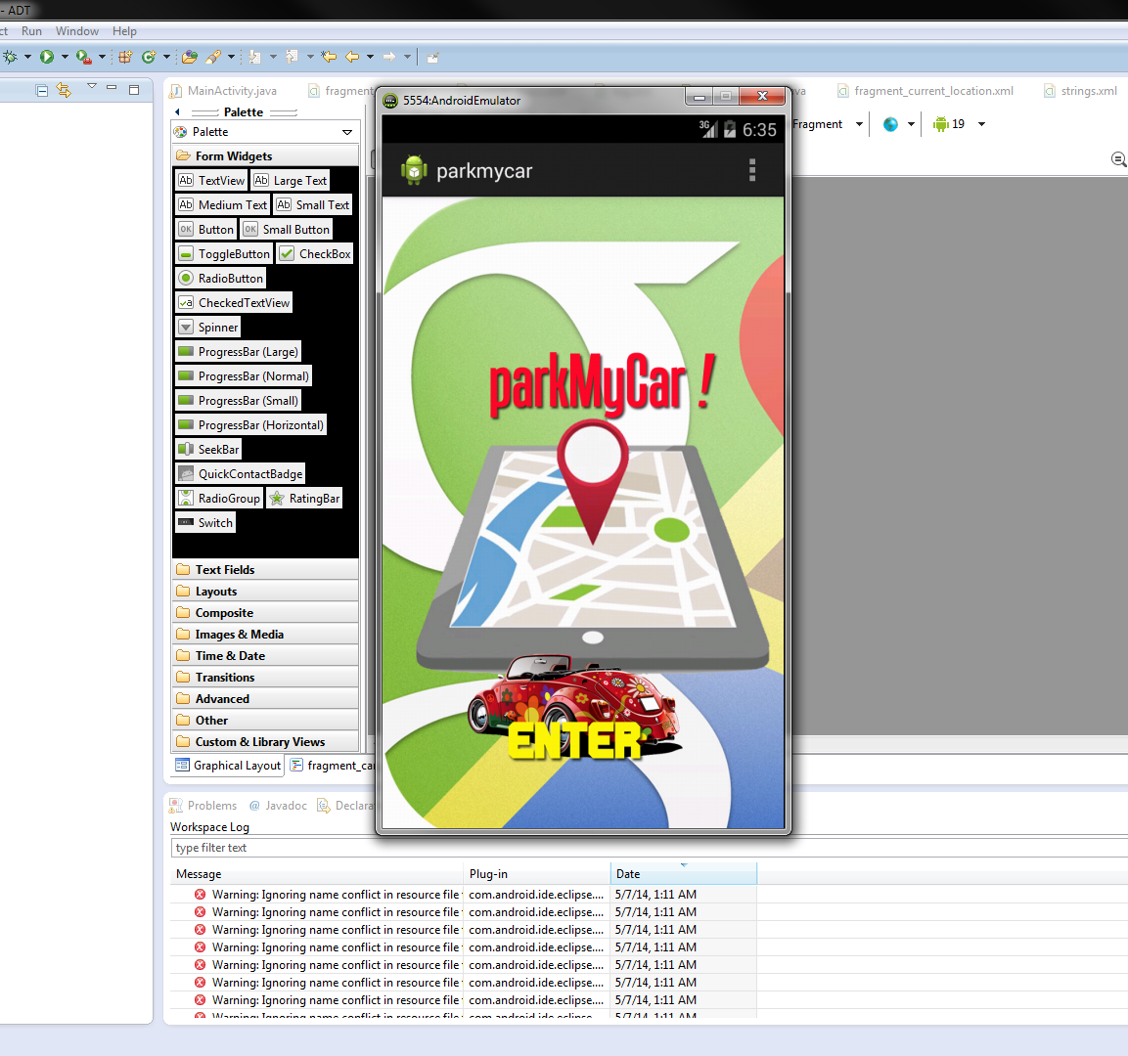
Application Prototype : Main Application Browser

Slide 6
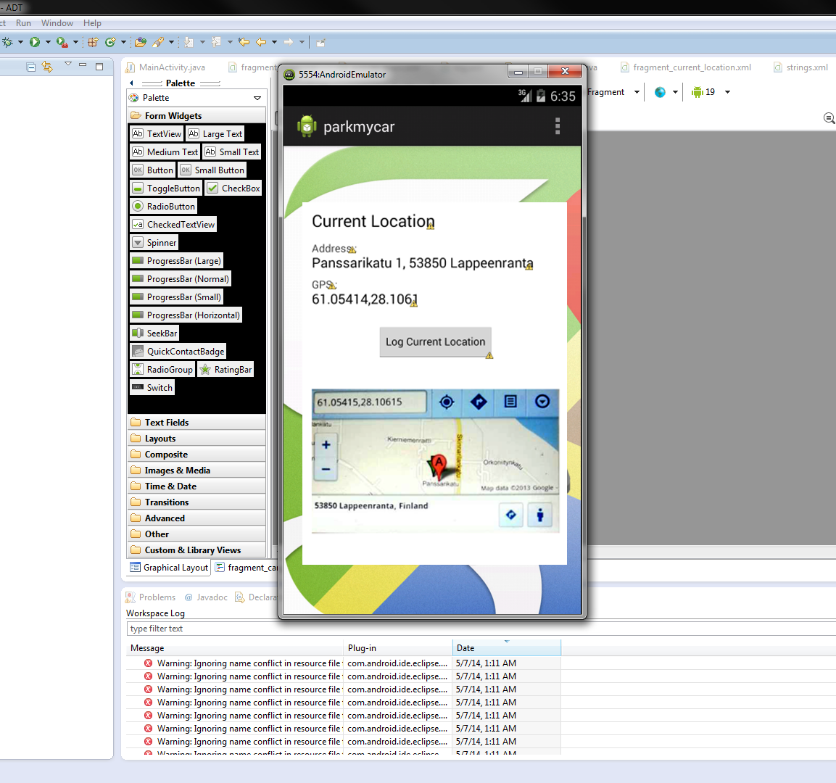
Current Location (Where the Car Parked) and Logged the Location (GPS Coordinate)

Slide 7
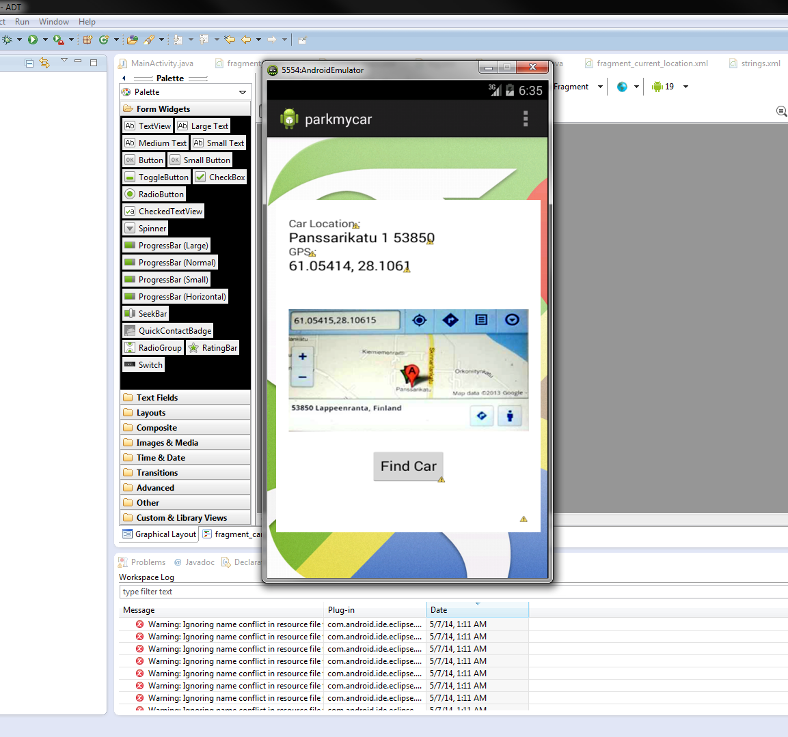
Find The Car Location from the Current Location

Slide 8
Thank you for your attention!

