Slide 1
.NET Code Camp 2011
WordCards
Team LUT6:
Joona-Pekka Kokko
Konstantin Koskelainen
Tomi Kosonen
Jalamadugu Ravitheja

Slide 2
Problem statement
Words are a fundamental part of any language. Knowing the meaning of individual words is an important aspect when learning a language.
This learning process should be made accessible through the use of interactive software that enables learners to associate words with descriptions or images.

Slide 3
Solution
WordCards is a learning game that helps children to learn new words by associating words with their meanings.
WordCards lets the learner guess words from different types of dictionary entries:
Textual dictionaries
Image dictionaries
Foreign word dictionaries

Slide 4
Implementation (1/5)
Abstraction for word and image associations (.NET 4.0, Silverlight 4 implementations)
Pluggable association model
Users can create association libraries and mappings
E.g. We created libraries that
Fetch words from REST WS
Fetch words from text file
Fetch images from folder
But the users could create
RDB or NoSQL solutions
Etc.

Slide 5
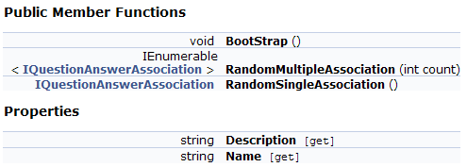
Implementation (2/5)

Slide 6
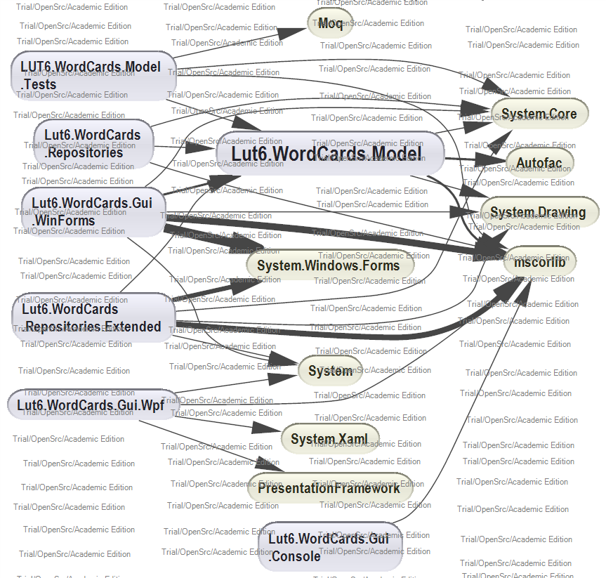
Implementation (3/5)

Slide 7
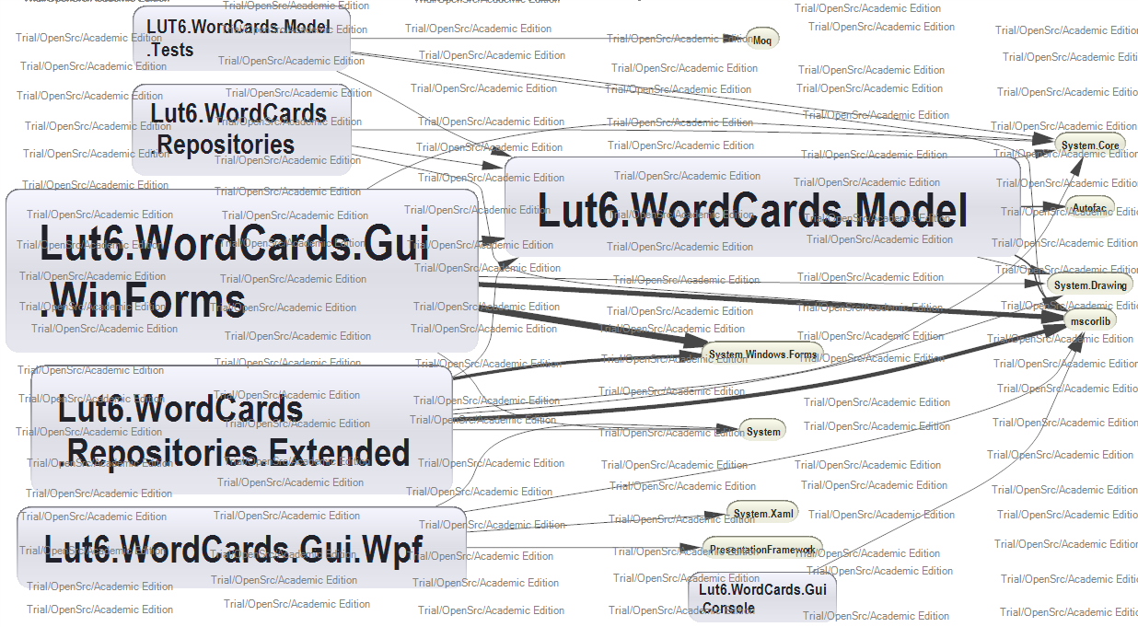
Implementation (4/5)

Slide 8
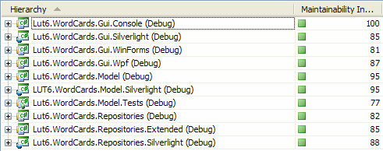
Implementation (5/5)
Initial client implementations in
WPF
WinForms
Silverlight

Slide 9
Demo
WordCards

Slide 10
Future Work & Goals
Enhance user experience
Finish & polish UIs
Create new association libraries and dictionary editors
E.g. RDB backed library with editor interface to DB

