Slide 1
Word Cards by Team 6
Problem: Learning new words and languages should be made accessible and enjoyable through the use of software
Enable learners to communicate
Enable learners to consume and produce written material
→ Build a solid ground for primary education

Slide 2
Word Cards by Team 6
Idea
Learn new words and languages by associating words with
Images
Descriptive texts
Foreign words

Slide 3
Word Cards by Team 6
Solution
Give the learner access to dictionaries
Textual dictionaries
Image dictionaries
Foreign word dictionaries
Let the learner guess and deduce words from dictionary entries

Slide 4
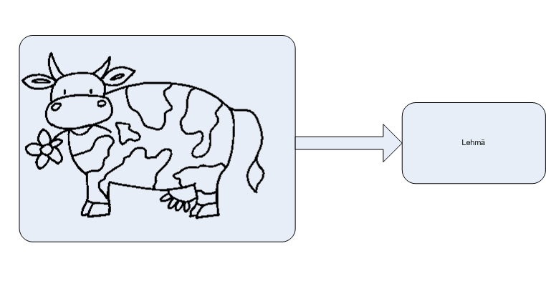
Word Cards by Team 6

Slide 5
Word Cards by Team 6
Implementation
Repositories for words
Explicit boundary through uniform interface
Local implementation, e.g. word database, XML-RPC word lookup
Silverlight GUI
Technologies:
.NET 4.0, Silverlight, Entity Framework, MSTest, Moq, Structuremap etc.

