Slide 1
Imagine
An old lady
Her cat caught up on a tree
No one around for miles
What possibly can the old lady
Do????

Slide 2
GALLERY
Shirley Qianting Liu
Tommi Zhihao Yu
Aoke Li

Slide 3
F
O
U
S
C
To allow everyone to contribute at
Anywhere
Anytime
Anyway

Slide 4
IDEAS
Micro-volunteer
Volunteer locally through small things
No limits
Volunteer globally at your own pace
Easy to contribute
Through passive or active ways
Increasing awareness
How do we contribute to things we do not know

Slide 5
Micro-Volunteer
Micro-volunteer is a new concept
Lacks a definite definition
Micro-Volunteer in our vision:
Convenient
small (bite-sized) work
A network
We can do no great things, only small things with great love. ~Mother Teresa

Slide 6
Not limited to Micro-Volunteers
Allows people to help each other across the globe
No Limits
Nobody can do everything, but everyone can do something.

Slide 7
Easy to contribute
Active
Contributing to see a change
Taking actions to physically change something
Making a donation
Organizing a group to help out
Passive
Contributing by making others aware of a problem
- Taking a photo
- Writing a short story
- Sharing a problem with others
I feel that my whole life is a contribution. - Pete Seeger

Slide 8
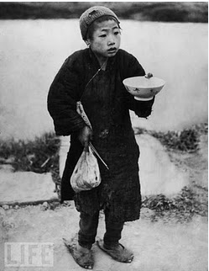
Increase Awareness
A picture is worth a thousand words
There is a hungry child
who is begging for food
Integrating to other social
networks like Windows live,
Facebook, twitter etc.
http://www.life.com/image/51163349
The first step toward change is awareness. The second step is acceptance.
- Nathaniel Branden

Slide 9
Solution
Gallery
Increase the awareness locally and globally
Allows access to different forms of volunteer work , even ones you would never have thought of
To show that volunteering can be fun and meaningful
Attracts different kind of people and not limited to one type or group
Power to choose what one wants to do

Slide 10
Increase Awareness
Wallpaper on desktop
Automatic update on wallpapers so that the newest photos are shown
Integrations
- Facebook
- Windows live
- Twitter
- Friendster
-….
Story
A story behind a photo to allow people to understand its meaning
Constant update
Automatic update on wallpapers so that the newest photos are shown
- PUSH notification to the phone(WP7 Dynamic tile)
- Wallpaper on desktop
- Gallery webpage with a specific spot only for newest updated photos

Slide 11
Ways to create
Timed photos
Photos with a limited time on Bing map that is only shown near your neighborhood
Time line
Allow people to see the progression of place before and after.
Adding a story
Either to a existing picture to make it more personal or creating one to show that areas problems
Using a Mobile
Easy to access at anywhere, and anytime
Allows GPS tracking when uploading a photo(WP7) to Bing map
Allows people to be aware of problems around their location
Through a camera and computer
Uploading a photo, writing a story, choosing the area you saw it happen

Slide 12
Ways to Contribute
Pictures and stories you like
Can be shared through Windows Live, Facebook, Friendster etc..
Rating system
Bad rated pictures will be deleted automatically
Creating solutions
To problems that exist

Slide 13
Encouraging contributions
Allowing people to feel their contributions are not wasted,
Introducing recognition(achievements)
Sending physical gifts with company’s support for encouragement I.e. favorite photos in physical form
Company logos to be shown on Bing map
Competition
Winners for most favorite(highest rated) photos, story, comments
Creating weekly themed events for photos

Slide 14
Attracting people
Creating different categories for leisure viewing like art, music et cetera..
Advertisements by companies support
Creating Gallery account on Windows Live, Facebook, twitter and other social networks to follow our updates

Slide 15
System Sustainability
Do not need human resource to manage
Only need technical support
Allow users to be in charge of spam photos (through rating system)
Is not dependent on a third party( but always welcome)
Company
Specialist like doctors
Government
Cloud feature
No physical hardware to support
Easy to scale with bandwidth

Slide 16
Technologies Used
SilverLight 4
Bing map
ASP.NET
SQL server 2008 R2
Windows Phone 7
Linq
WCF
WPF
Cloud Azure
Expression Blend 4
GPS Tracker
Live ID
Visual Studio 2010

Slide 17
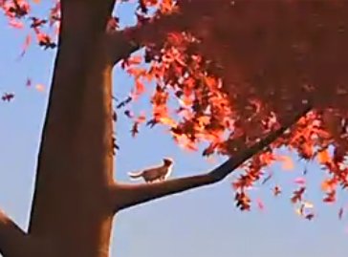
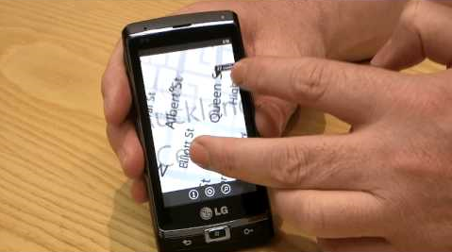
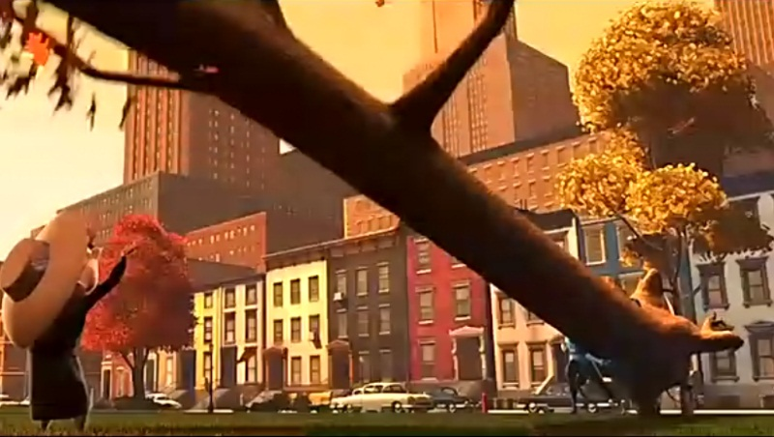
Gallery
At
Full
Power
http://club.6park.com/gz1/first1.shtml

Slide 18
Thank YOU

