Slide 1
SaleAssistant
Group 5.
Gergely Zachár, Saeed Mirzaeifar, Ville Arola, Yasir Ali

Slide 2
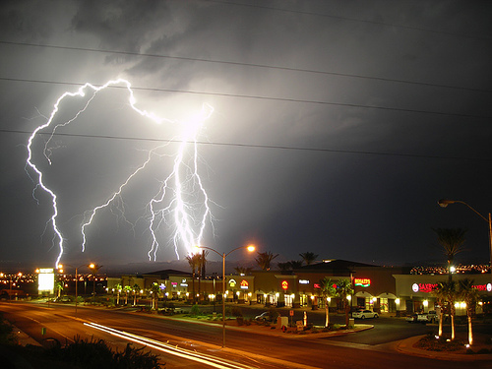
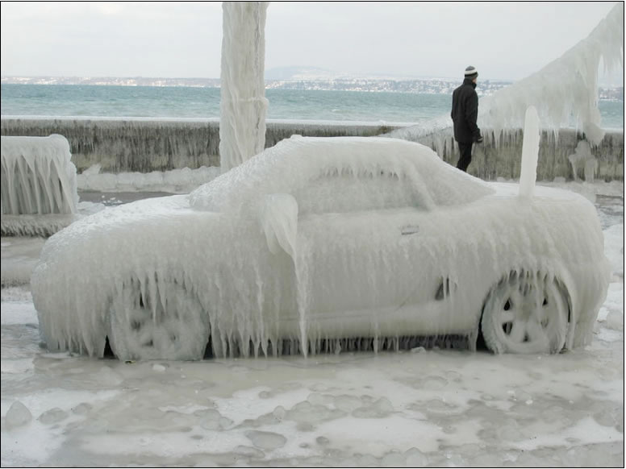
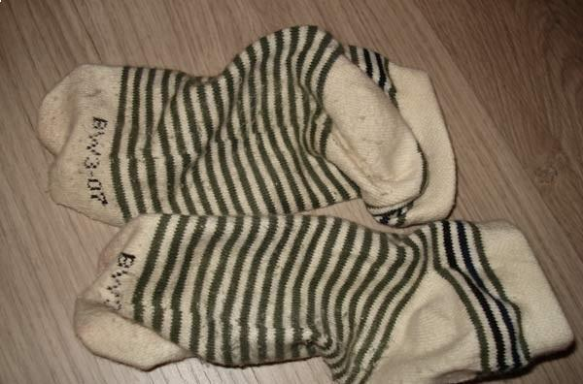
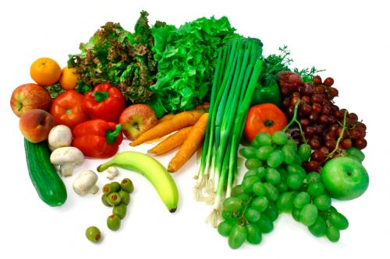
?
?
Bad weather outside? You are lazy and watching TV with your friends?
And you need some food and washingpowder for your clothes?

Slide 3
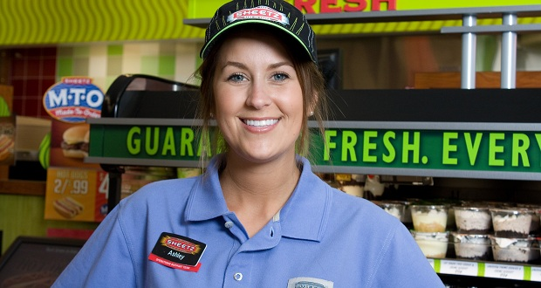
Your ultimate solution is
SaleAssistant

Slide 4
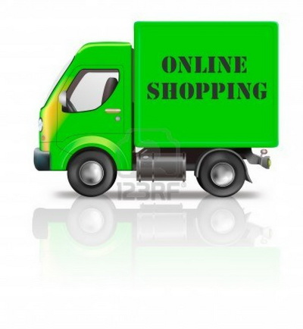
Basic ideas
Create a software for delivery service companies
Delegate a salesassistant for shopping
Collect and offer items from stores
Handle user request for items
Collect the orders
Planing and optimizing the trips
OPTIMIZE most of the things

Slide 5
Basic ideas

Slide 6
Strategy
Good optimization algorithm
Analyze the problem
Find specific technics and algorithms
Adopt modular approve for reusability
Web pages for user interface
Web services with various interfaces
The enduser company freely select and devellop specific frontends (custom web pages, phone app)
Each of the modules are customisable

Slide 7
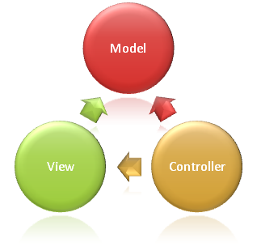
Technologies and tools
Windows Azure
ASP.NET
Web pages, web services
GPS
Delivery tracking, trip planning
MVC architecture
Modularity, reusabity, customization
sumoPaint.com

Slide 8
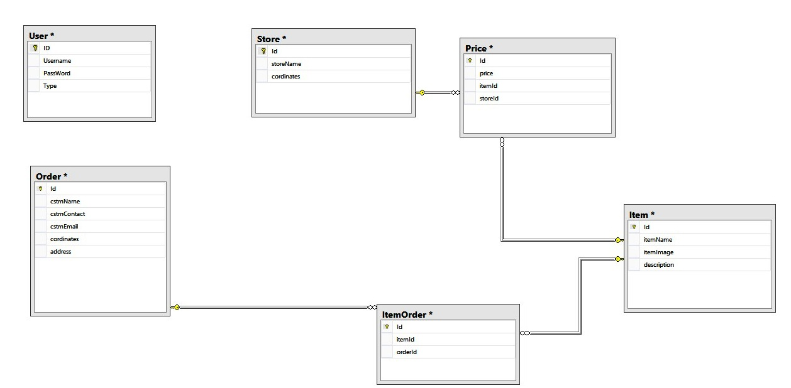
DataBase Design

Slide 9
Architecture
Delivery Service
Online Sopping applicant
Authentication Service
Third Party Organization (Optimization)
Cloud
Sale Assistant
Users
Admin

Slide 10
Optimization:

Slide 11
Application Demo!!

Slide 12
Thank you!

