Slide 1
UfoShotti
Kimmo Flykt, Julia Tasa, Elmer Häyrynen, Roman Hyvönen & Otso Lehtinen

Slide 2
Our Game
“Moon lander” game with 3 levels:
1. Laika Dog level (1957)
2. Moon level (1959)
3. Satellite level (2018)
The basic idea of the game is that the moonlander must land at certain points and at the same time the player should watch out for the enemies that are floating in space.
Moonlander can be controlled with ‘space’ -button.
Notes:
Tähä jotai shittii et mikä idea,plan,goal
“resources your group expexts to need to get from outside. data/people/skils/tools we need to have acces to succeed”

Slide 3
Finnish Game Jam Team
Kimmo Flykt - Senior developer
Julia Tasa - Graphic specialist
Elmer Häyrynen - Audio specialist
Roman Hyvönen - Back-end developer
Otso Lehtinen - Junior developer

Slide 4
Kimmo Flykt
Created main logic to game
Handling team tools(git etc…)
Handling asset integration process to game

Slide 5
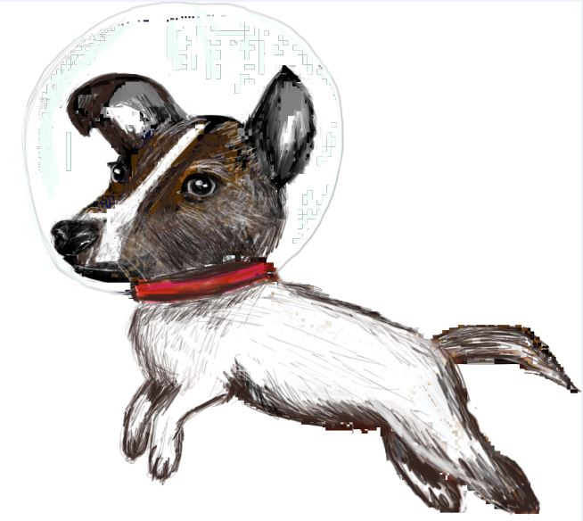
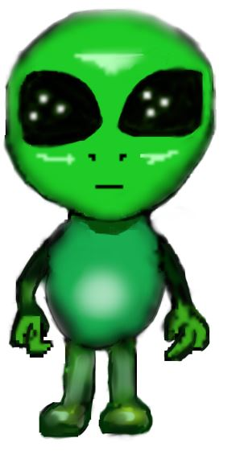
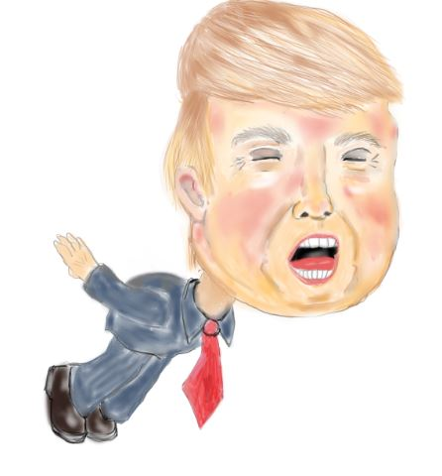
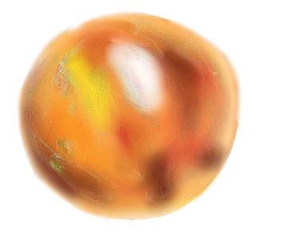
Julia Tasa
Graphic Designer
All the graphics are drawn except the game’s background
Made all the graphics of the game by using NoteBook and Sketchbook -application

Slide 6
Elmer Häyrynen
Audio specialist
Mainly focused in creating the soundtrack for the game with FL Studio
Eventually helped also in implementing the audio into the game code

Slide 7
Roman Hyvönen
Backend developer
Game server and “salting platform” for other users to affect the game challenge
Integration of game with server and level logic
Sauna warmer

Slide 8
Otso Lehtinen
Junior developer
Mainly added some game mechanics that are not part of the core game
Gameplay can be altered by the server
Others like in-game timer

Slide 9
Tasks
Tasks | Idea innovation | Food and supply | Coding | Reports | Fixes | Other | General help
Friday 26.1. | All | All | ⅗ meber | 0 | 0 | ⅖ member | 0
Saturday 27.1. | All | All | ⅗ meber | 0 | 0 | ⅖ member | 0
Sunday 28.1. | 0 | All | ⅗ meber | 0 | 0 | ⅖ member | All
After FJG | 0 | 0 | Not defined yet | ⅘ member | Not sure yet | 0 | 0
Notes:
Describe the way the team thiks to use time in main tasks use creativity to fill up the table if needed (alla esimerkki)

