Slide 1
FEBRUARY UPDATE REVEAL

Slide 2
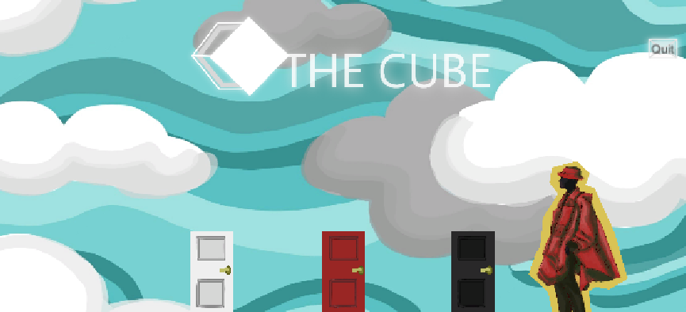
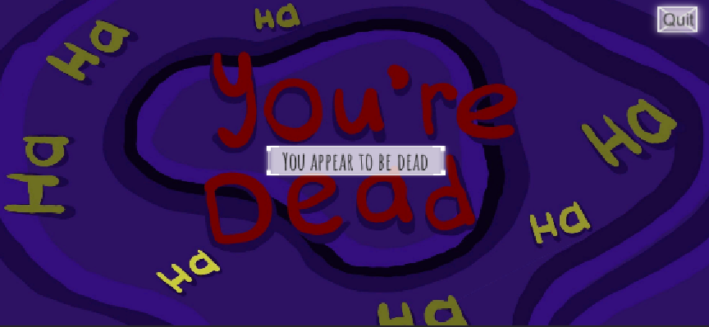
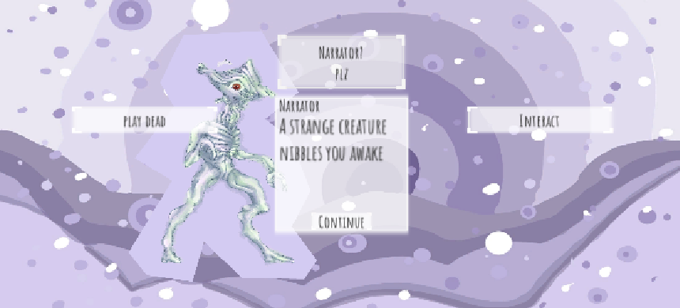
BEFORE

Slide 3
BEFORE THE UPDATE
The game is very messy and bare-bones, and has the minimum functionality for a visual novel. Multiple known glitches exist, and some assets were not implemented yet due to time running out (e.g. one story path was cut off).
Known issues:
The resolution and UI glitch File type issues Unsuitable UI Not all made assets in use yet Lacks saving and progress-tracking
ETC.

Slide 4
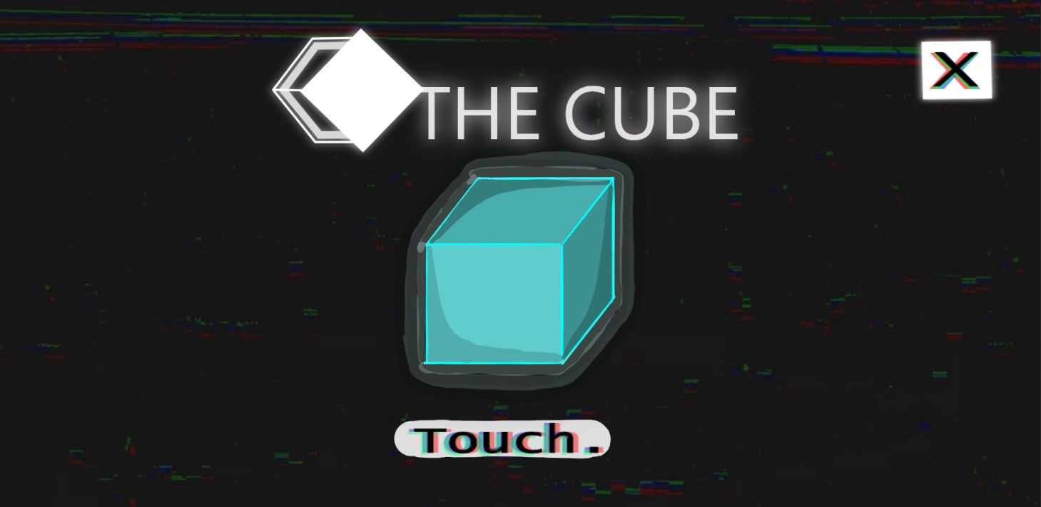
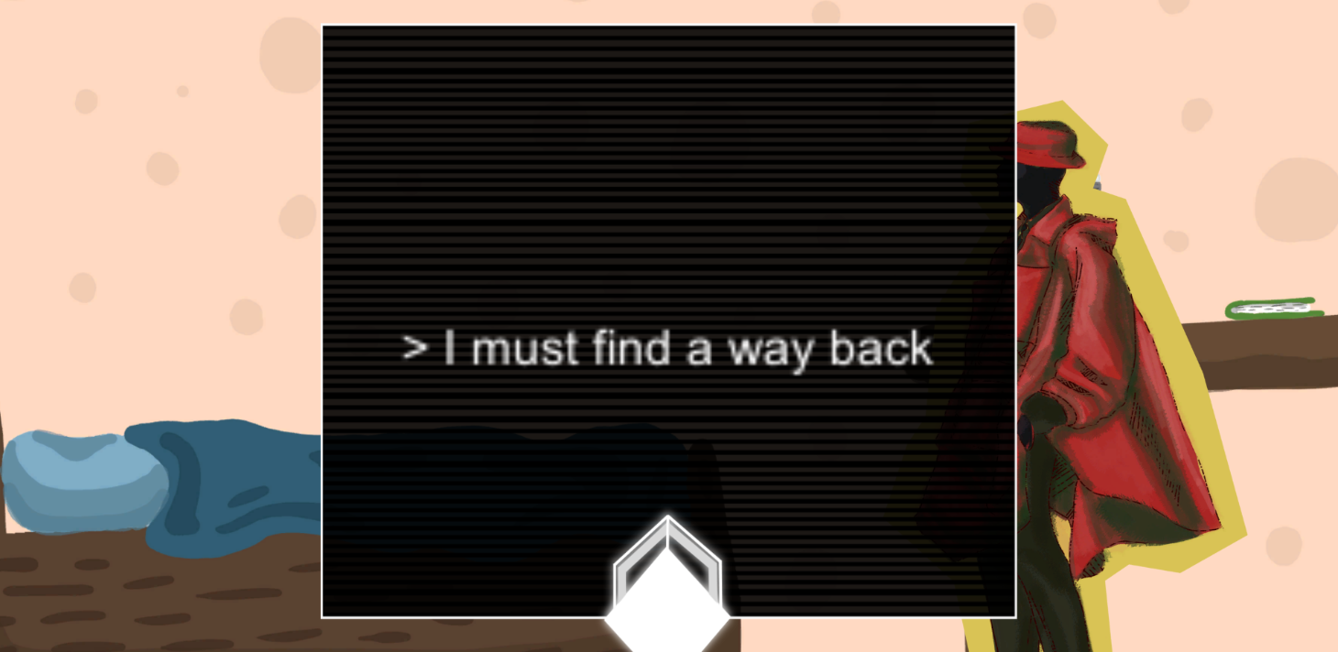
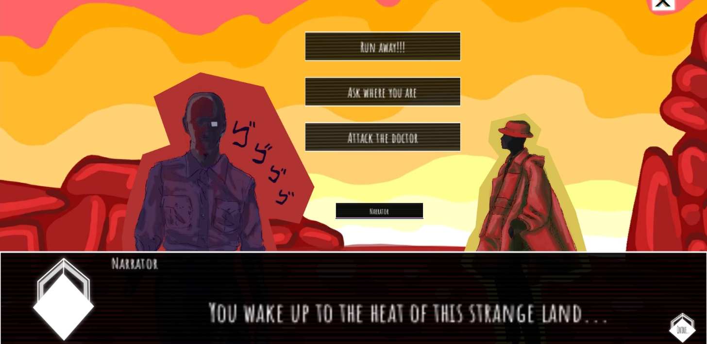
AFTER THE UPDATE
Current game can be seen in the screenshots. Resolution and UI glitch is fixed, and old items are implemented fully. New UI was developed with better methods, and implementation nearly follows the UI plan. This results in better gameplay experience as well. The game has all intended parts that were planned during FGJ2022. Saving and progress-tracking is almost implemented. Game has nearly full voice-acting for the story. The game is still a bit messy, and can be polished further during the next steps.

Slide 5
What was updated and how:
001: Rebuilding the game and fixing the UI glitches: This issue was caused by an unknown error where in Unity the starting scene’s resolution did not carry over to other scenes, causing many parts of the graphics to downgrade and the UI to reveal items that should not be revealed. Fixing this was attempted during the game jam, but after seeking help from other programmers around the jam site, no solution was found besides “rebuilding” the entire game from the start with the same assets. This process was too time-consuming to complete during the jam and was marked to be done with the new updated assets after the jam. However, the updated graphics and new scenes mean that parts of the code also need to be updated.
001-A: Rebuilding scenes: Rebuild the entire game from start in Unity, using the old assets. 001-B: Text animations: Adjusting the text animations scripts to fit new scene and graphics. 001-C: Element animations: Adjusting the element appearances scripts (buttons, sprites, etc) to match the new scene and UI.
002: Save function and progress-tracking: This was missing from the original game, and even though the game was short enough to not necessary need them, we decided that adding them is better game design and helps one to explore all endings better. This also allows us to create in-game achievements or a way for a player to track if they have found all the endings of the game.
002-A: Progress-tracking: Build a way for following which scenes and events the player has witnessed. 002-B: Saving and loading: Make the player able to save their progress and continue later, and load previous saves. 002-C: Achievements board (optional): mark all the endings, and show which ones the player has found, and show how many are still unexplored.
003: New UI: The old user interface does not suit the later developments of the game, and new updated functions require more UI elements as well. The old UI elements were slightly difficult to use in Unity, and the contrast was not always good with every background – the blending into the light elements of the background was common. As such, the UI will be updated or redesigned completely to match the current update, and to offer a better user experience.
003-A: UI redesign: Co-operate with others to create a better UI. Take time to explore different options and get more feedback. 003-B: UI examples: Create multiple high-fidelity examples of the UI in different views. Help guide the programmer to implement them in better detail. 003-C: Assets and file packages: Create new UI assets in the requested file type, and pack them for the programmer to use

Slide 6
What was updated and how:
004: Full voice acting: The narrator’s voice acting lines are missing, while the doctor and the creature are recorded. The current story should be as fully voice acted as possible, to offer more content in-game and to support the story’s experience. This includes both recording and sound processing of the lines. This task should be done by 27.02.2022 / the end of February.
004-A: Record: The voice lines should be recorded by the voice actor for the narrator. 004-B: Process: The sound engineering and other sound processing should be done for the new lines before implementation; cut out bad takes or pauses, reduce background sounds, hum, clicks and other low-quality microphone issues, etc. 004-C: Implement: Implement the lines in-game, to match the narration and text animation.
005: File type issue: Some files might not show in their original quality, and some pixelation is present. Some files may not be in optimal types, especially some visual assets. Check the source of the issue – e.g. recommended sizes and file types for each type of assets, and then make the changes (e.g. turn them into this type when possible). This issue is likely connected with the rebuilding and UI glitch in 001. Adapt to the changes that are required to fix 001.
005-A: Root of the cause: Check the root of the issue, and check all media assets for faults. 005-B: Rework old assets for better quality: E.g. use the correct resolution size or file type that is required by this update.
006: New backgrounds: Diversify the background selection – add new ones that exist in the current story. These may include e.g. scenes in the red door path, or in the introduction to the game. After these are finished, newer backgrounds can also be started, if they can be defined to exist in the future story updates and the writer can provide descriptions for them.
006-A: Create backgrounds to existing story: Find which story scenes would take place in settings not seen in our current backgrounds. 006-B: Create backgrounds for future story: Get descriptions for future backgrounds and work on them.

Slide 7
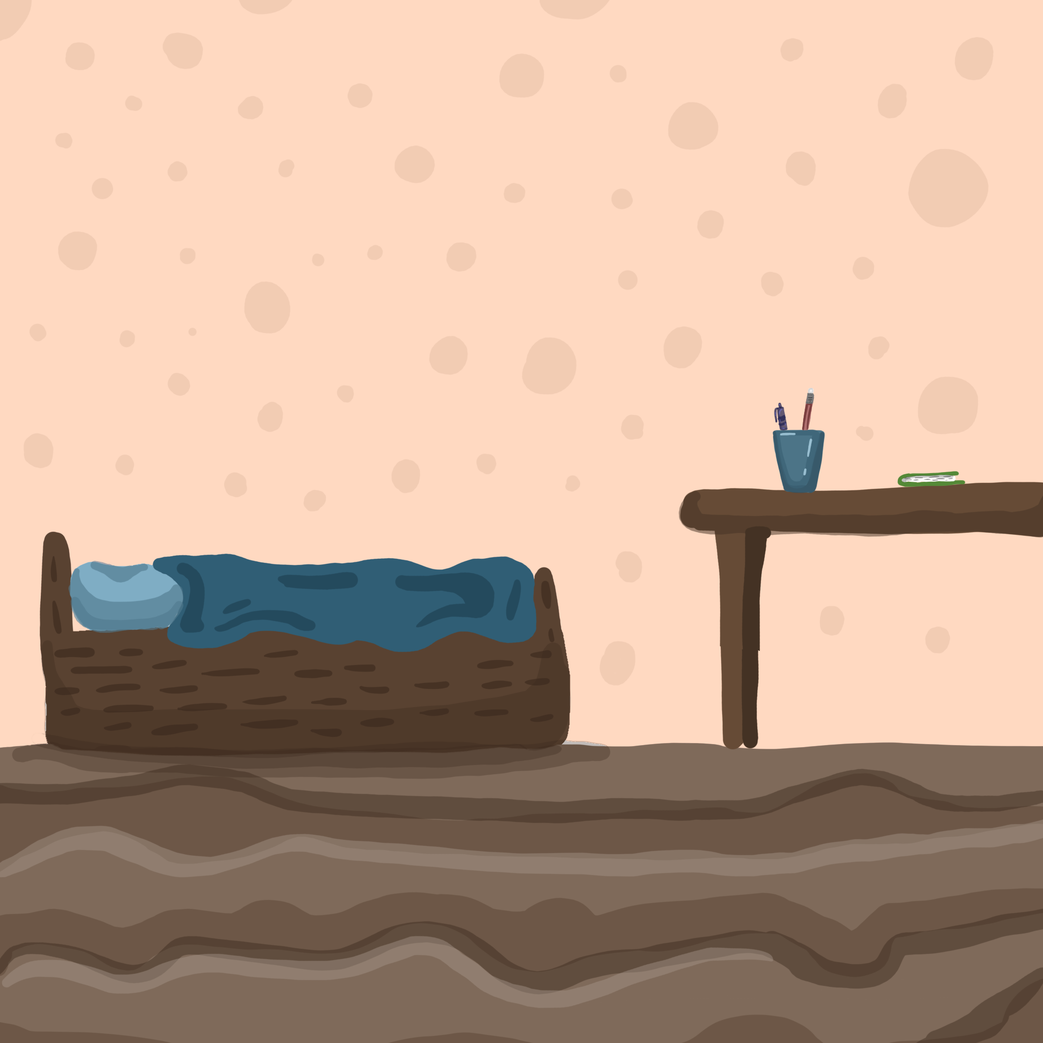
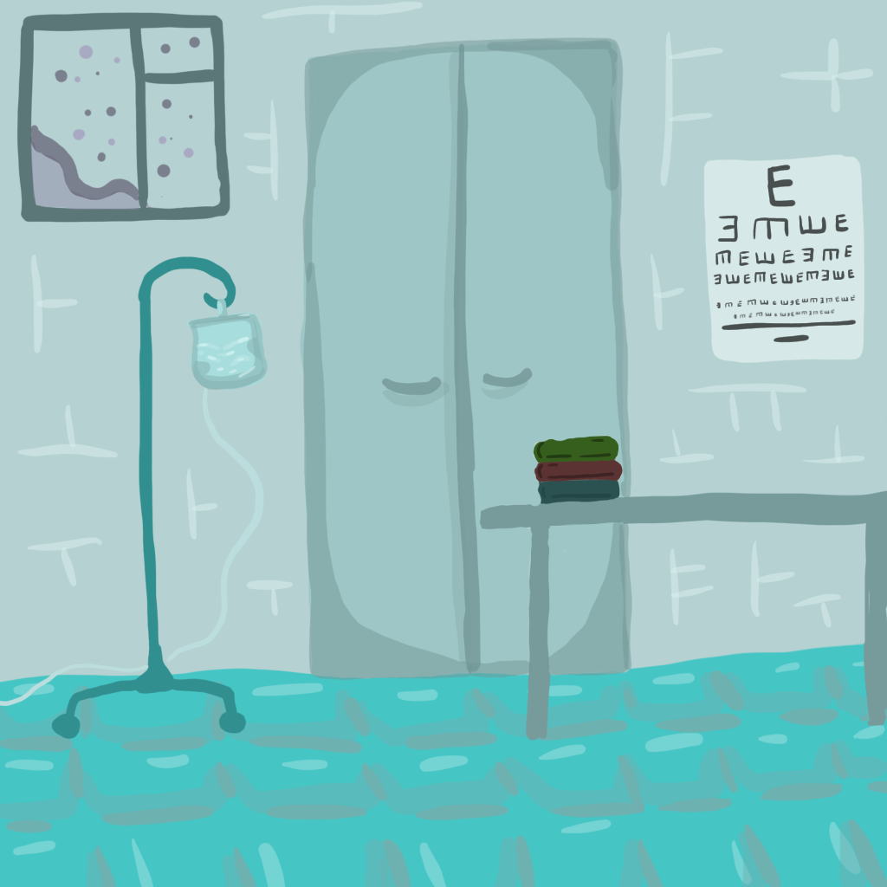
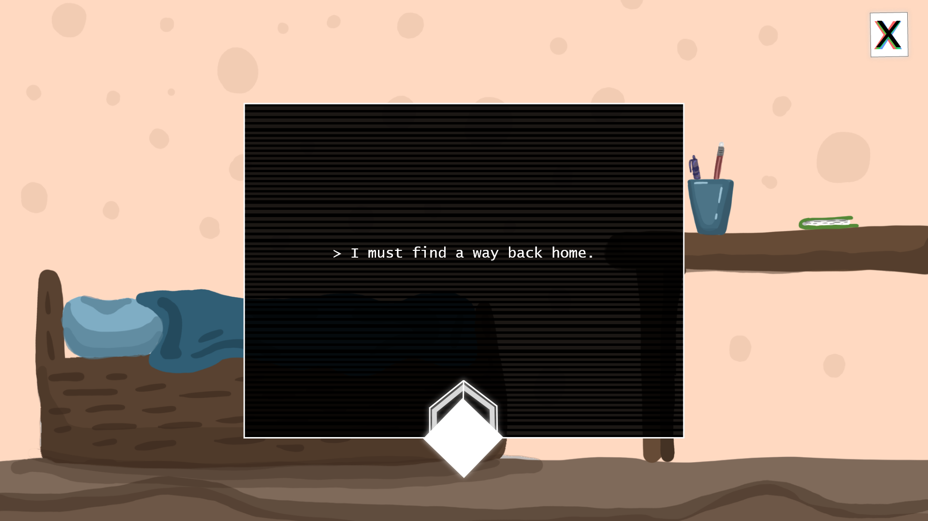
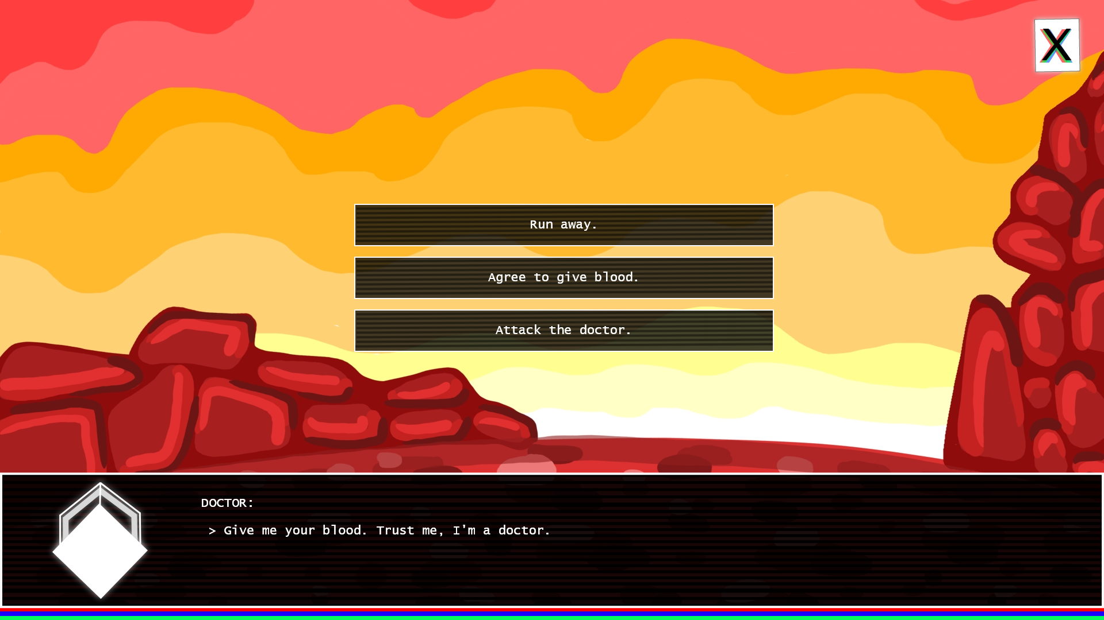

Slide 9
TASK and task ID | PERSON(S) mainly working on it | STATUS: Is it done by 27.02.2022? ✅ = completed ❌ = unfinished ✅❌ = partially completed
001: Rebuilding the game and fixing the UI glitches | J44karhunen/Kasperi Ammy/Axel | ✅?
002: Save function and progress-tracking | J44karhunen/Kasperi | ✅❌: Started and some functionality exists in-game, but not fully finished yet.
003: New UI | Ammy/Axel | ✅
004: Full voice acting | J44karhunen/Kasperi Ammy/Axel | ✅❌: Some narrator voice acting lines not recorded yet by the voice actor (J44karhunen). But most lines are recorded, and all recorded ones are processed (by Axel); resulting in a nearly fully voice-acted game.
005: File type issue | Taiisia/Taiisia | ✅
006-A: Create backgrounds to existing story | Taiisia/Taiisia | ✅

Slide 10
NEW ISSUES
One of the team members dropped out of the project, story-writing tasks need reassigning
Some implementation issues still exist in the UI, more polish needed for implementing it
Couple voice acting lines missing, must still be added – not noticeable, though
Saving and progress-tracking are barely functional, need more time
Generally more attention to details and polish needed to the basics before relaunch
→ As they are mainly technical issues, these can be worked on during new story creation phase. These will be moved on to phase 2: “Creating New” (see the last slide).

Slide 11
UPDATE SCHEDULE
FEBRUARY
FIXING OLD: 001: Rebuilding the game and fixing the UI glitches
MARCH-JULY
CREATING NEW: 006-B: Create backgrounds for future story
AUGUST
RELAUNCH:
Testing and polishing for the aforementioned tasks should be finished
002: Save function and progress-tracking
003: New UI
004: Full voice acting
005: File type issue
006-A: Create backgrounds to existing story
007: Marketing materials
008: New Story
Game “relaunch”; updated version uploaded to itch.io
YOU ARE HERE

Slide 12
UPDATE GOALS
Fixing (February): The February update is aimed at fixing the game, and providing it all intended functionality at the time of the game jam. These fixes will elevate the game to a more pleasant playing experience, as the bare minimum of functions often results to a rather iffy playing experience for most. After this fix, ideally, the game is more playable and does not have any of the known gameplay glitches (such as the resolution and UI glitch), and playing it is more intuitive for the player as it shows more basics of a visual novel. The base of the game should be now at better quality, so more story can be continued later.
“Creating new” (March-July): This period is used to create a longer story with more content. As the bare bones of the game are now reliable and running, we can focus on creating more content and make the story more in-depth, longer, and better quality. We will be making more story, and all assets for the new story will be created and added to the game. The length of the gameplay is ideally at least tripled from the original game; which takes less than 10 minutes to play to completion. Little to no known bugs exist in the mechanics of the game. We will also be creating more marketing assets to be able to make more comprehensive description on future platforms, where the game will ideally reside after it has been worked on for a little bit.
“Re-launch” (August): At this time the planned marketing updates should be ready and a re-launch is performed, as the game is uploaded to itch.io or similar platforms. The game is finished, and is upgraded beyond the vision we had during FGJ2022. The game is expected to remain there; if feedback about any major issues arises after the launch, bug fixes can and will still be made.

