Slide 1
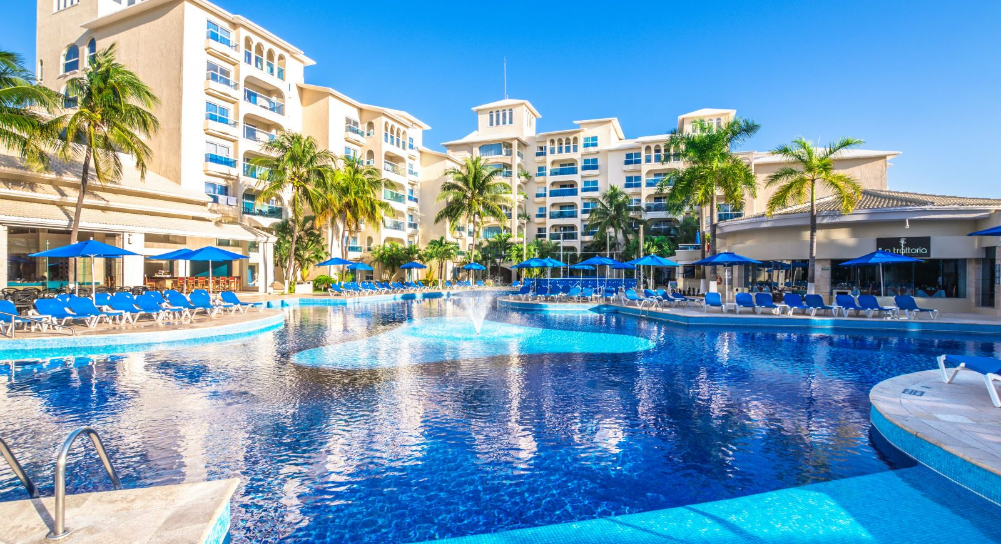
GreenInn
Group 4: Anastasiia, Florian, Ijlal, José

Slide 2
Outline
Problem & Vision
Concept & features
Implementation
Monetization
Poster

Slide 3
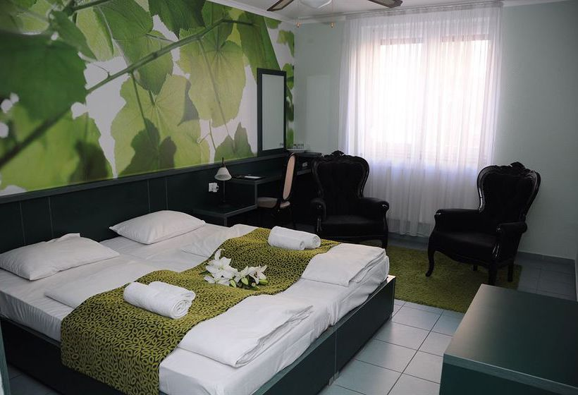
Problem & Vision
Problem
Hotel guest rooms account for 40 to 80 percent of energy use in the hospitality industry, with high-end guest rooms consuming 50 to 70 kW and luxury guest rooms consuming more than 80 kW per day [1]
Vision:
*To pave the way towards a smart hotel industry which cuts costs, is greener and provides comfort and leisure with the technology of the future* Reducing the energy consumption and emissions by efficient use of resource maintaining the guests’ comfort level

Slide 4
GreenInn Concept
Notes:
Considere la posibilidad de hablar acerca de:
Primera temporada

Slide 5
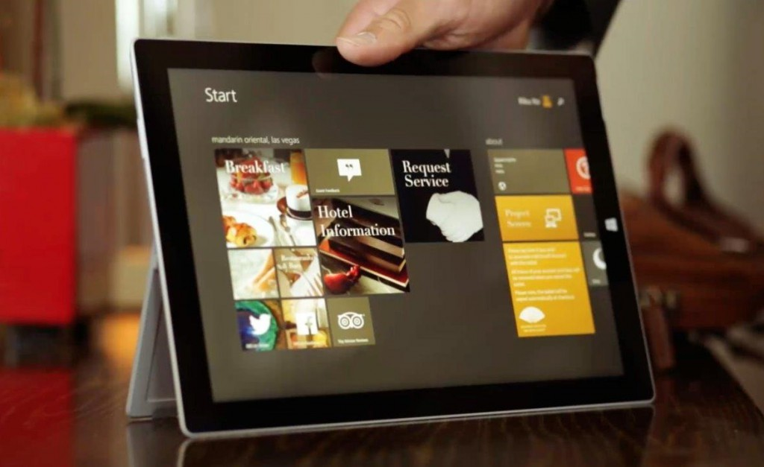
Short-term scenario
Manage your environment from tablet/phone
5 cents for each kWh less than average
10 % savings
= 71 kWh
= 3,5 €/h for the greenest guest
Hotel
Information
Door:
Locked
My bonuses
Air
Water use
Energy use
Food waste
Hotel
Statistics
Contact
Assistant
Help
Light
Water use
Energy use
Suggestions on electricity use
Room
Statistics
Curtains
Explore the Hotel
GreenInn
Feedback

Slide 6
Futuristic scenario
Flexible Walls
Adjust rooms to different groups of guest by moving the walls and reshaping the rooms
3D Printing of the Wardrobe
1 bag 23 kg
=
21 kg airplane fuel
=
22 € added for a ticket
=
5 T-shirts, 1 suite on a 3D printer
Virtual Travel
10km in a car
=
1.37kg CO2
VS
5 hours of HTC Vive
=
211g CO2
Advanced Air Sensing
Aromatherapy in every room
Saving space used for spa facilities
Systematic Green Audit
Independent measurements will rate hotels from one chain according to their

Slide 7
Implementation
Notes:
Considere la posibilidad de hablar acerca de:
Primera temporada

Slide 8
Implementation
2 scenarios realized
Temperature based ventilation and signal
Consumption based “psychological persuasion”
Components used
FHEM Server
HomeMatic protocol
RF PowerPlug Actuator
Electronic Fan
Philips HueBridge with HueGo and LightStrip
Temperature Sensor

Slide 9
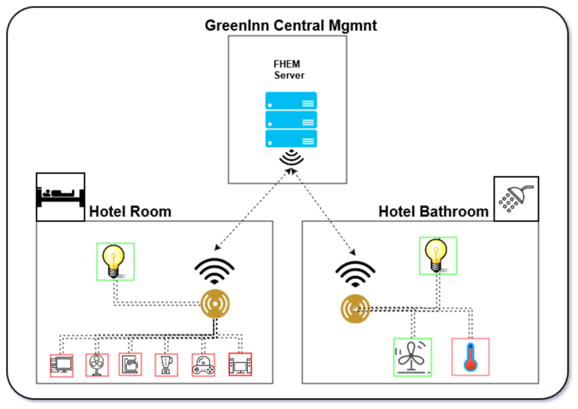

Slide 10
Monetization
Notes:
Considere la posibilidad de hablar acerca de:
Primera temporada

Slide 11
Monetization
Direct Savings: 10% energy savings for a 1000 room hotel with room square 15 m2 daily results in 50 million €/year
Market Value: Act as advertisers for equipment manufacturers and provide discounts for guests
Marketing Image: The first “Green Enabler” hotel where guests can control their environmental impact and get incentives for being green

Slide 12
EnOcean
Notes:
Considere la posibilidad de hablar acerca de:
Primera temporada

Slide 13
Technology
Based on Energy Harvesting
Motion, Light, Temperature
Uses micro energy converters to power devices
Ultra-low Power Management
Standby current of order 100 nA
Low Power Wireless Communication
A signal can be transmitted to a distance of 30 meters indoors with 50 µW

Slide 14
Features
Simple radio transmission system
Use of Frequency Shift Keying (FSK) modulation to enhance efficiency of amplifiers
Use of frequency ranges with highest air time availability
868MHz, 902MHz, 928MHz
High data rate of 125kbps
Highly reliable communication with very low collision probability
Interoperability b/w a variety of devices

Slide 15
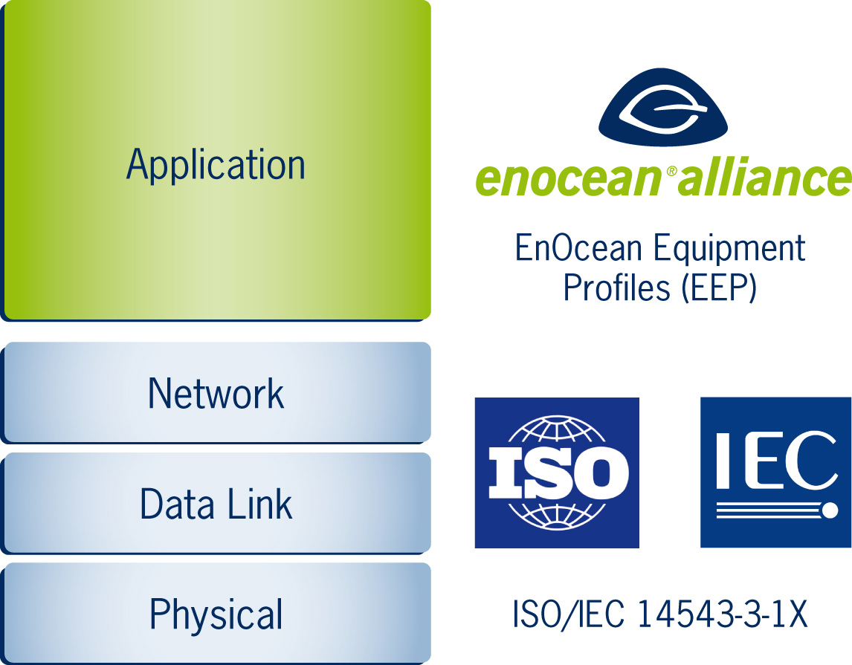
Standardization
EnOcean wireless standard developed for interoperability of devices and ratified as international standard ISO/IEC 14543-3-10 in 2012
The standard covers 1 - 3 layers of OSI model

Slide 16
EnOcean Alliance
A spin-off of Siemens founded in 2001 currently based in Oberhaching
To promote the technology an alliance was formed initially by EnOcean, Texas Instruments, Omnio, Sylvania, Masco, and MK Electric
The alliance aimed to create an international wireless standard for seamlessly interoperable products
Currently with more than 250 members

Slide 17
Thank you for your attention!
Any questions?

