Slide 1
K.S.I ImpactXchange hackathon - Offline digital Payment
Kavi
Stephen
Irfan Lutfi

Slide 2
Background
Malaysia has achieved 96% 4G broadband coverage of its populated areas as at 2022. Over 90% of households have internet access, and there are more mobile internet subscriptions than there are people.
Nonetheless, user experience in many areas is poor and rural and remote communities face challenges obtaining internet access in their homes, even when they have an internet-ready device such as a smartphone.
Rural and remote areas with uneven terrain and low population density are a challenge for connective infrastructure, from roads to electricity wires to data cables. Simply put, it is expensive to lay fiber optics cables through hills and jungle to reach the interior.
Khazanah Research Institute, Connecting the Last Mile: Solutions for Rural and Remote Communities https://www.krinstitute.org/Discussion_Papers-@-Connecting_the_Last_Mile-;_Solutions_for_Rural_and_Remote_Communities.aspx

Slide 3
General challenge
Unstable internet prevents people from using digital payment systems, which requires a stable internet connection to carry out transactions
Causes a digital divide between those who have good internet and those who have limited internet

Slide 4
Reasons for the challenge
Poor/Lack of infrastructure
Limited internet coverage
Slow internet speeds

Slide 5
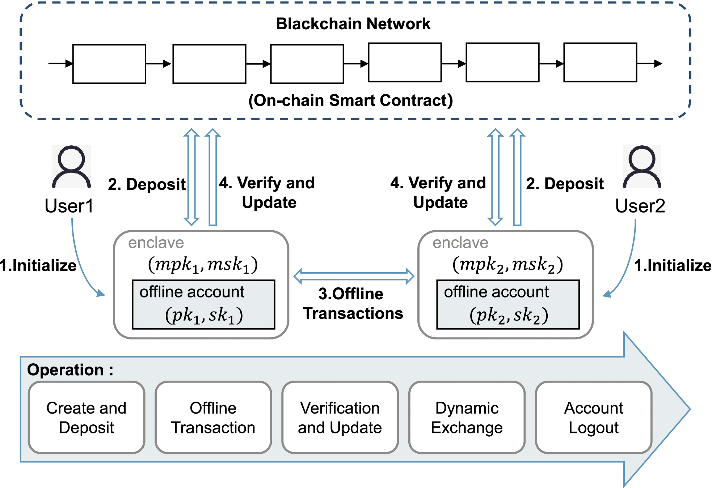
Team focus on the challenge
Facilitate transfer of funds offline without Internet Access
W. Jie et al., “A secure and flexible blockchain-based offline payment protocol,” IEEE Transactions on Computers, vol. 73, no. 2, pp. 408–421, Feb. 2024, doi: 10.1109/tc.2023.3331823.

Slide 6
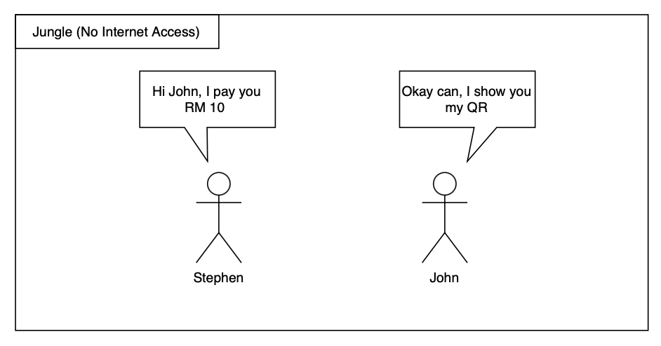
User Story

Slide 7
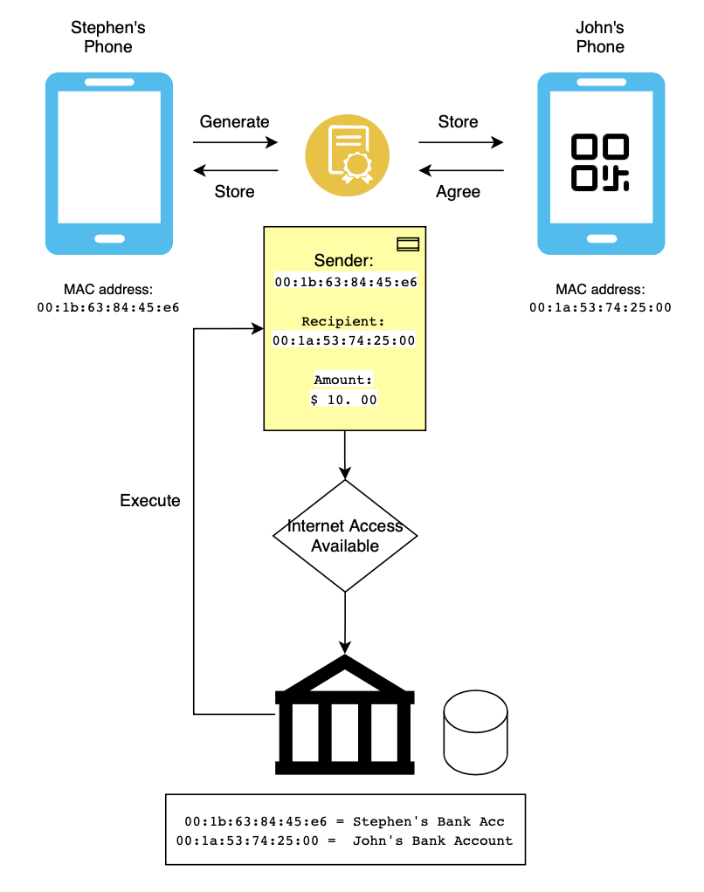
Solution

Slide 8
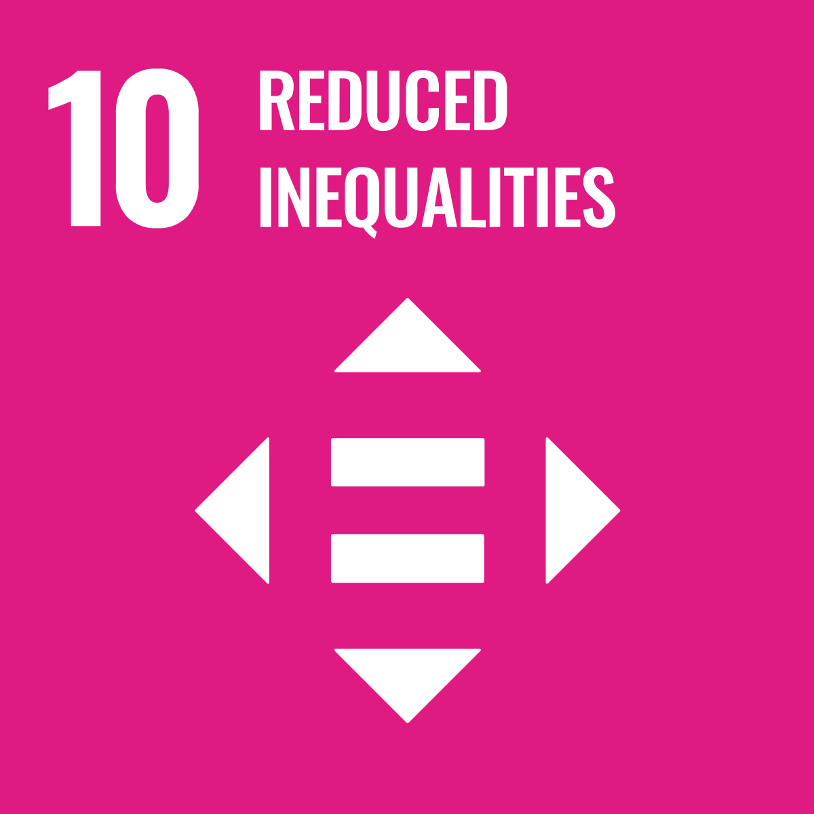
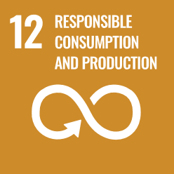
Impacts
Financial Inclusion: Provides access to financial services for SDG 10
Efficiency: Streamlines payments, reducing costs and time, which can contribute to SDG 9
Environmental Impact: Reduces reliance on physical cash and related logistical operations, potentially lowering the environmental footprint, supporting SDG 12

