Slide 1
OFFLINE DIGTAL PAYMENTS
Progress Update
Thursday, 22 August 2024
Kavi
Stephen
Irfan Lutfi

Slide 2
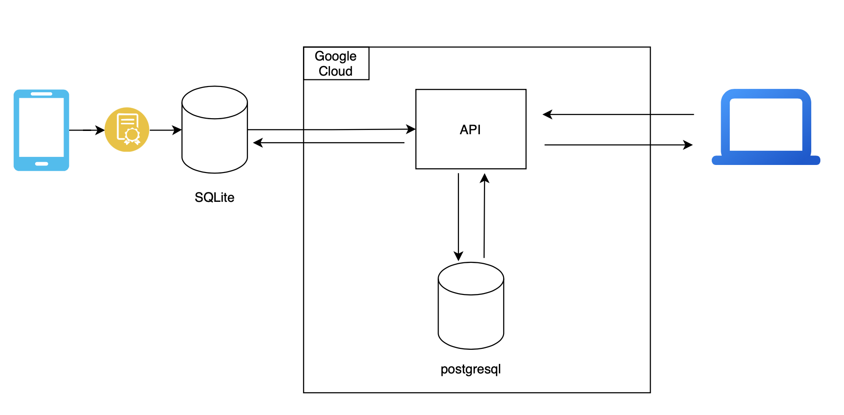
Visualizing System Flow: Logic Diagram for Backend-Frontend Integration

Slide 3
Frontend: Website user interface with Wallet Balance and Transaction History
Thursday, 22 Aug 2024
K.S.I

Slide 4
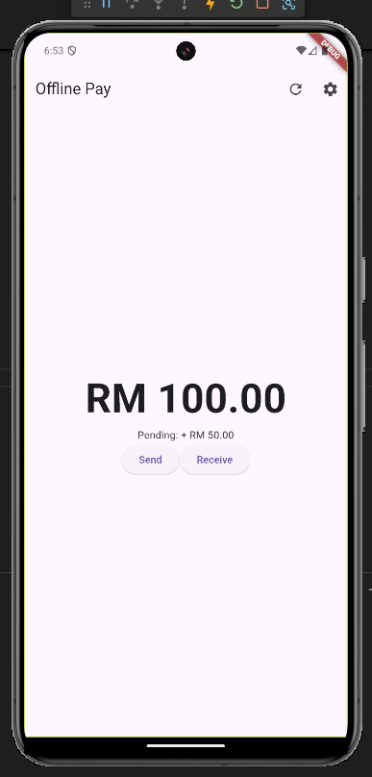
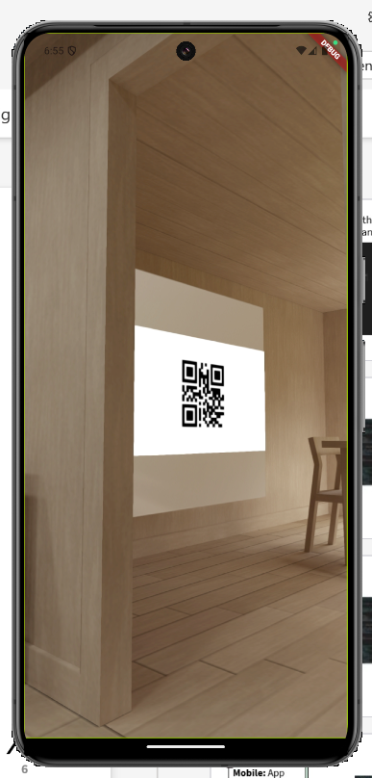
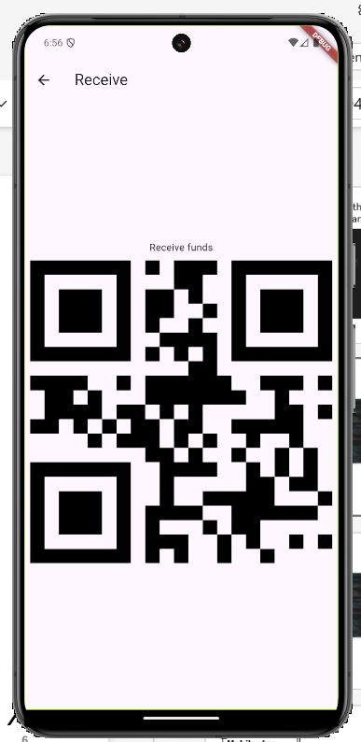
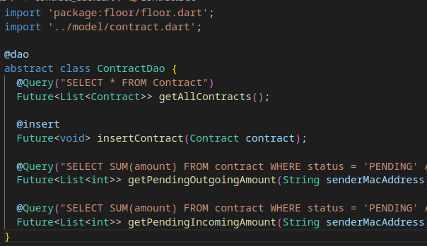
Mobile: App functionality with wallet balance, send and receive money options, and QR code scanning
User Interface
User Interface
MVVM Design Pattern
User Interface
Database
Thursday, 22 Aug 2024
K.S.I

Slide 5
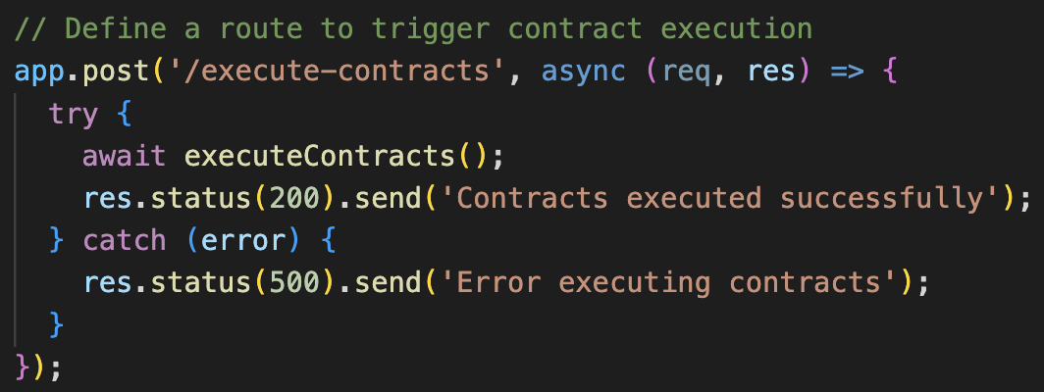
Backend: Trigger executeContracts()
Thursday, 22 Aug 2024
K.S.I

Slide 6
Backend: Implementing Smart Contracts for Offline Wallet Transactions with Unique Identifiers
Thursday, 22 Aug 2024
K.S.I

Slide 7
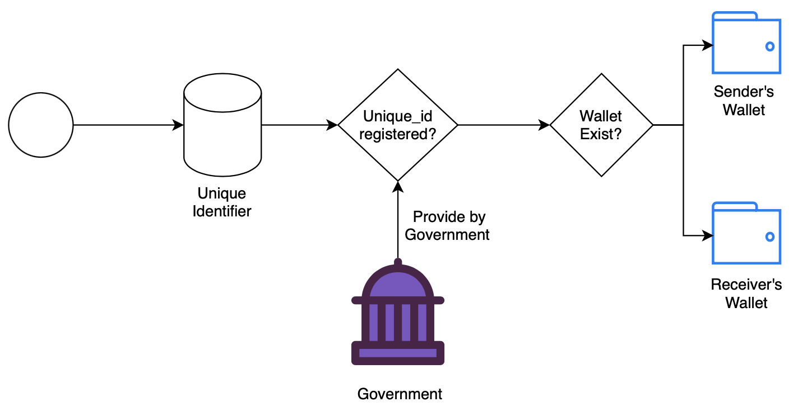
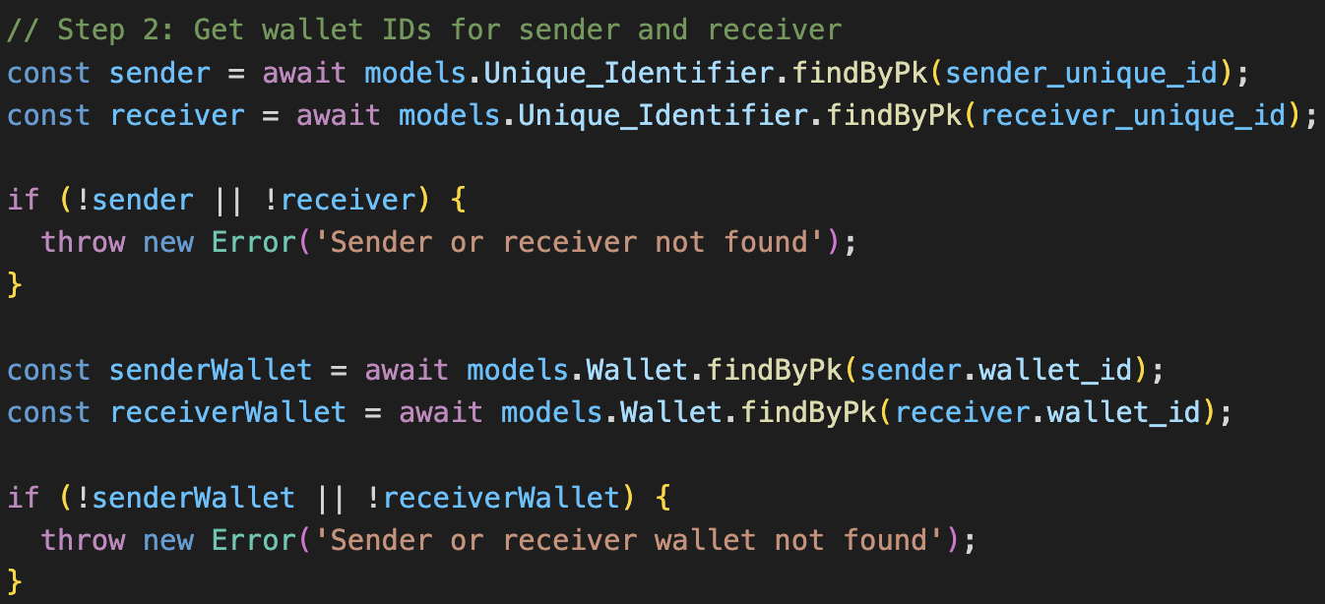
Backend: Validating Sender and Receiver Availability with Error Handling
Thursday, 22 Aug 2024
K.S.I

Slide 8
Backend: Insufficient Balance Checks for Each Transaction
Thursday, 22 Aug 2024
K.S.I

Slide 9
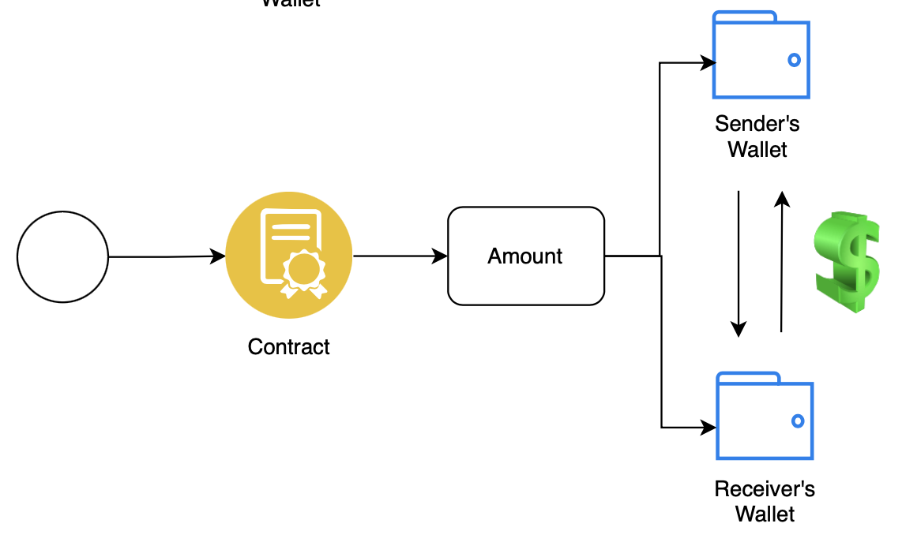
Backend: Updating Wallets and Smart Contract Status
Thursday, 22 Aug 2024
K.S.I

Slide 10
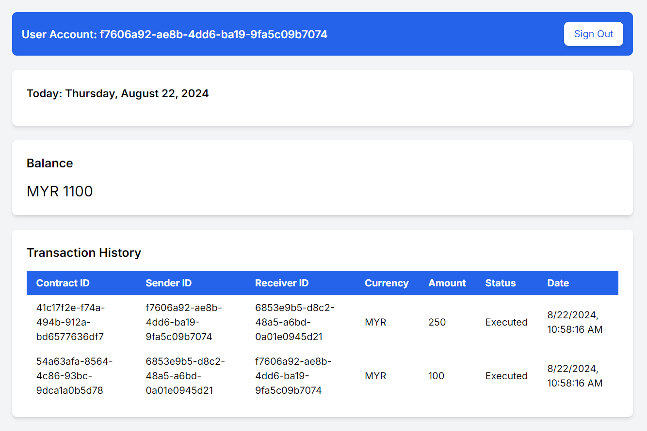
Dynamic Data Retrieval: Populating the Dashboard with Real-Time Backend Data
Thursday, 22 Aug 2024
K.S.I

Slide 11
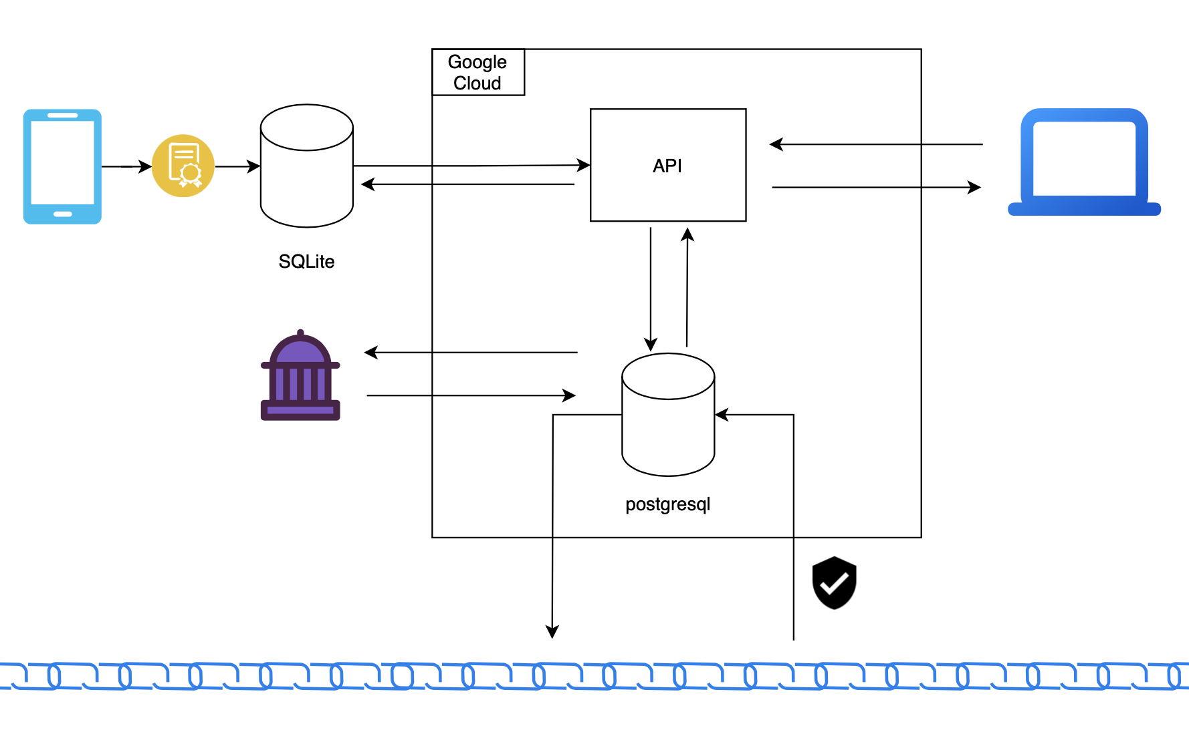
Roadmap Ahead: Planning for Future Enhancements

