Slide 1
IXC Wallet
(Offline Digital Payments)
Final Presentation
Thursday, 29 August 2024
Kavi
Stephen
Irfan Lutfi

Slide 2
Recap: Our Theme and Solution
Digital Divide:
The gap between individuals who have access to modern information and communication technology (ICT) and those who do not.
Unstable internet prevents people from using digital payment systems, which requires a stable internet connection to carry out transactions
Our Solution:
An app to facilitate offline digital transactions on mobile devices using smart contracts.

Slide 3
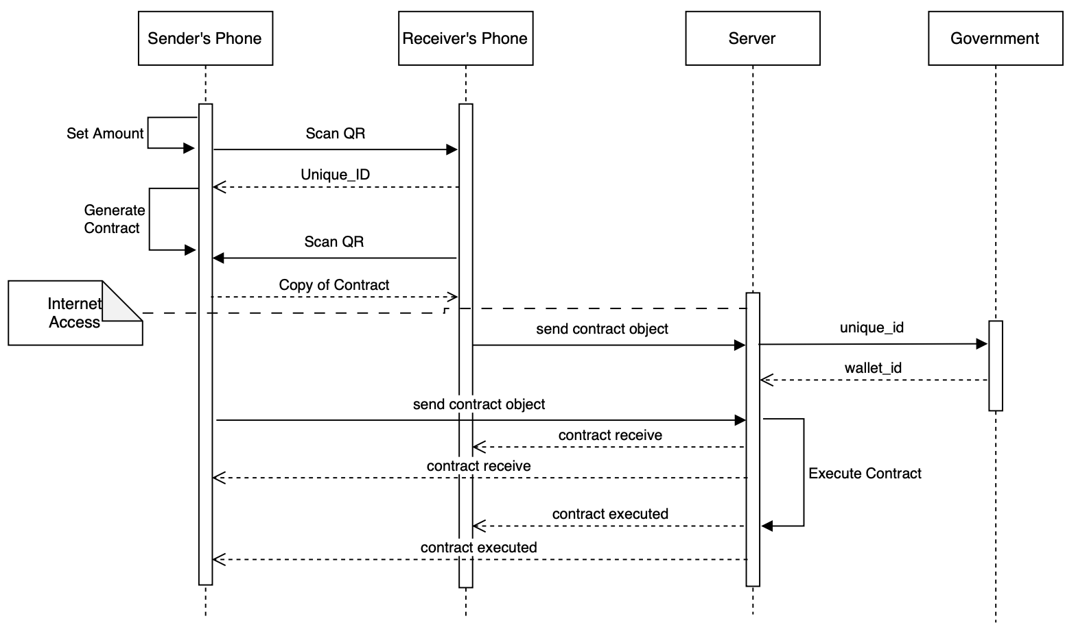
Recap: User Sequence Diagram

Slide 4
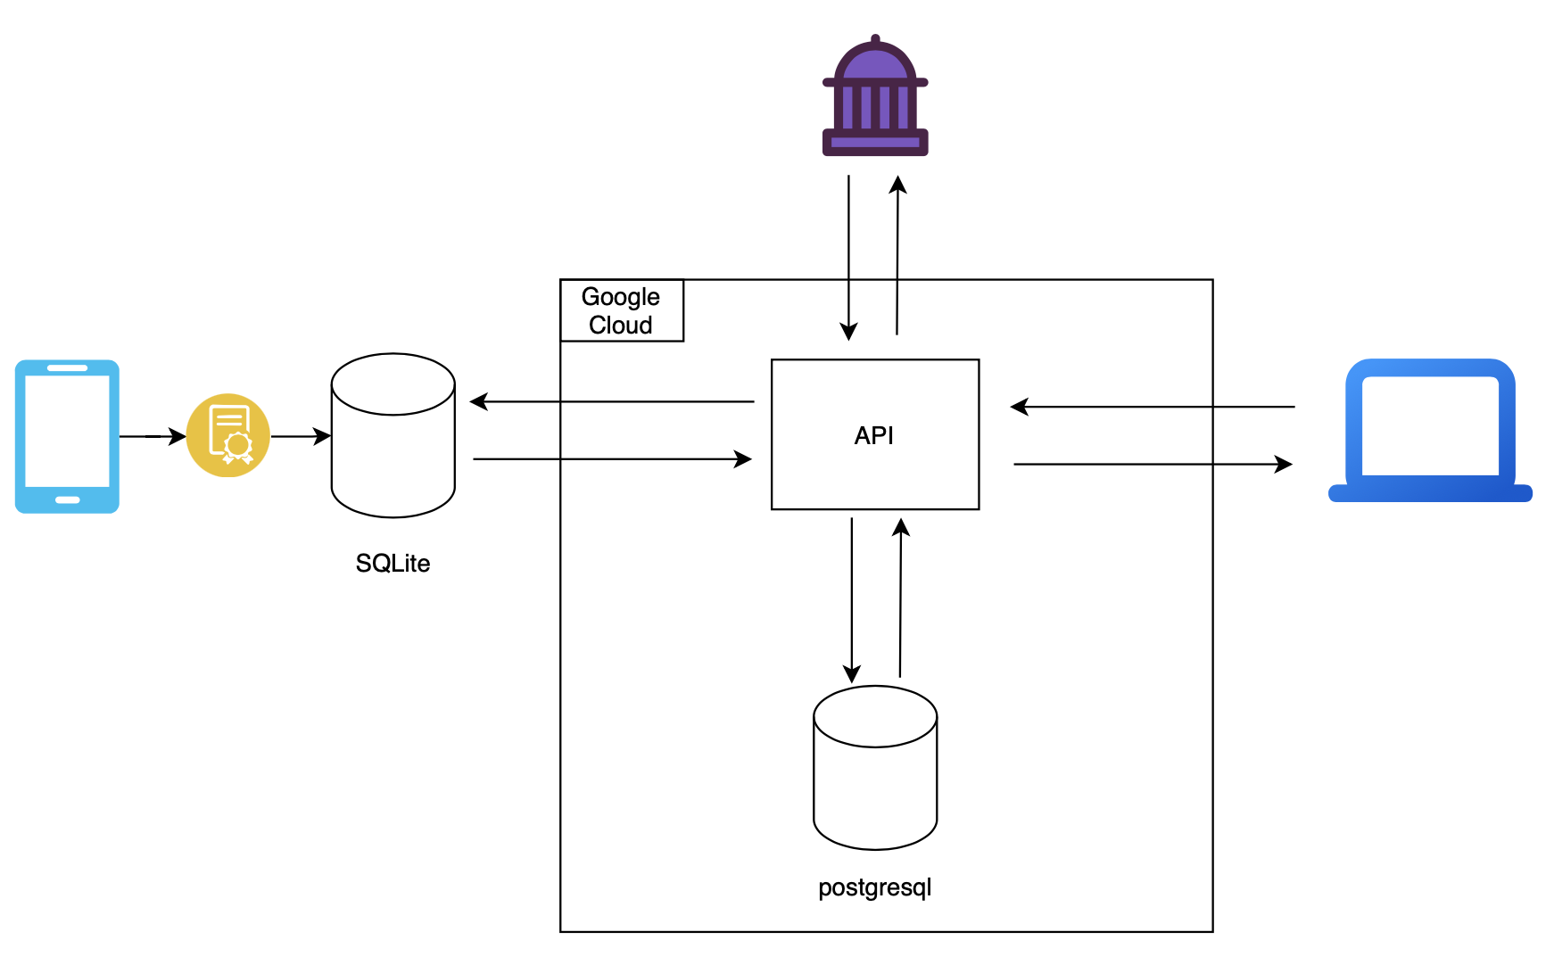
Recap: System Architecture

Slide 5
DEMO TIME !!!

Slide 6
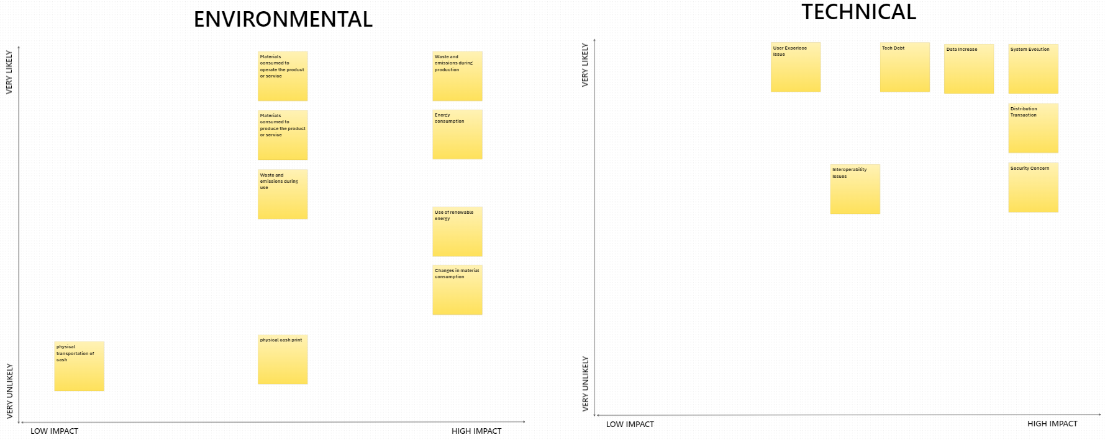
SusAF: Classification of Likelihood and Impact

Slide 7
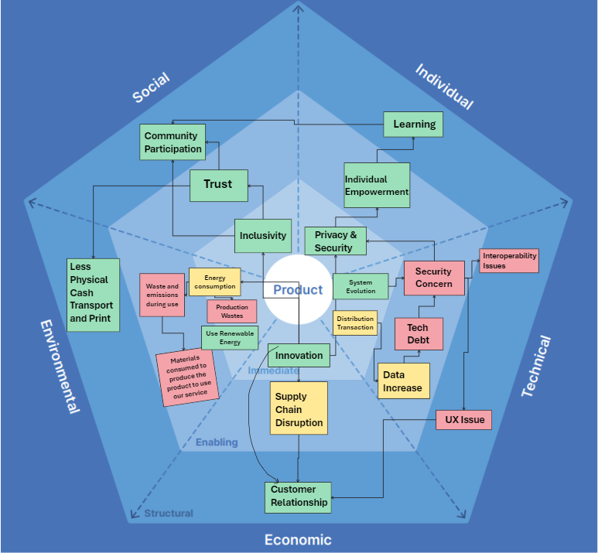
SusAF: Sustainability Awareness Diagram

Slide 8
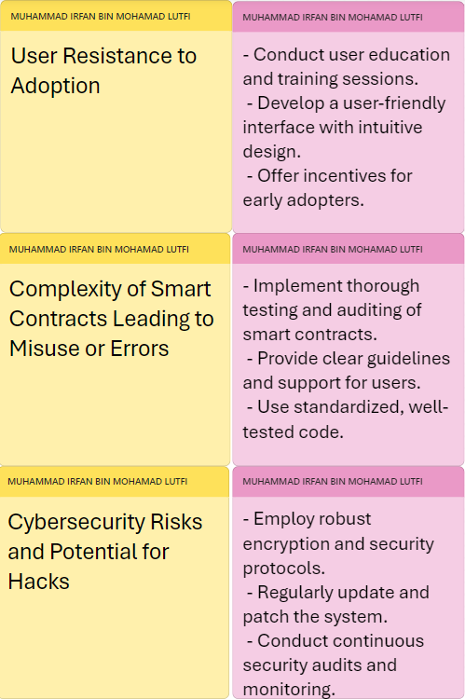
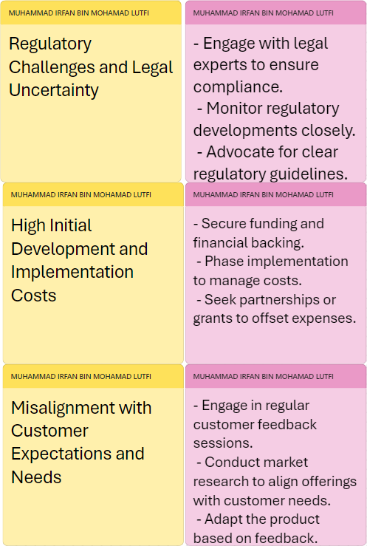
SusAF: Threats and Actions

Slide 9
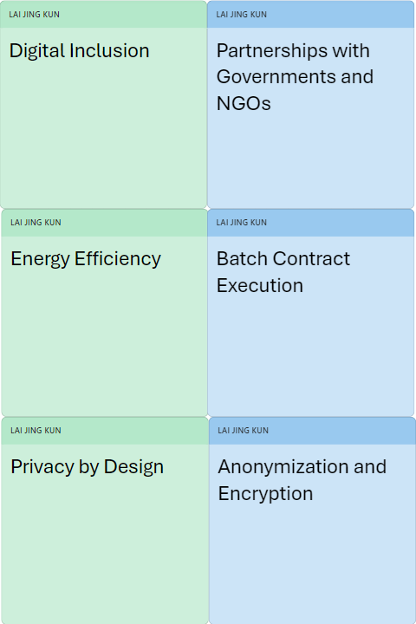
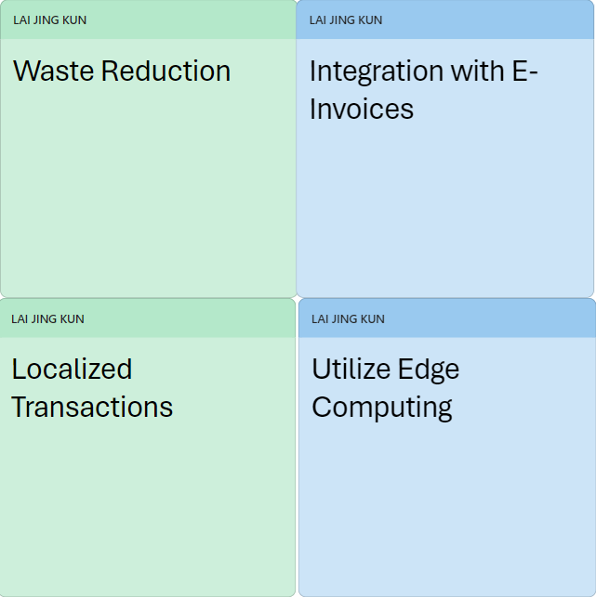
SusAF: Opportunities and Actions

Slide 10
Baseline Testing: Frontend 7 Contracts: 3 Sent, 4 Received
Frontend Web on Chrome 128.0.6613.85 (Official Build) (64-bit), no extensions
Tuesday, 27 August 2024

Slide 11
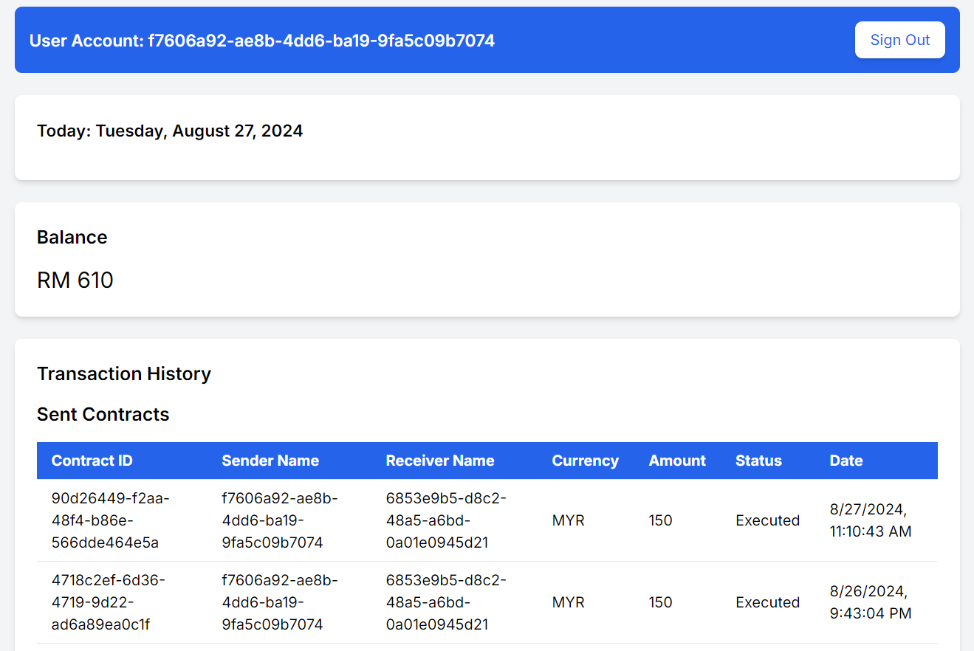
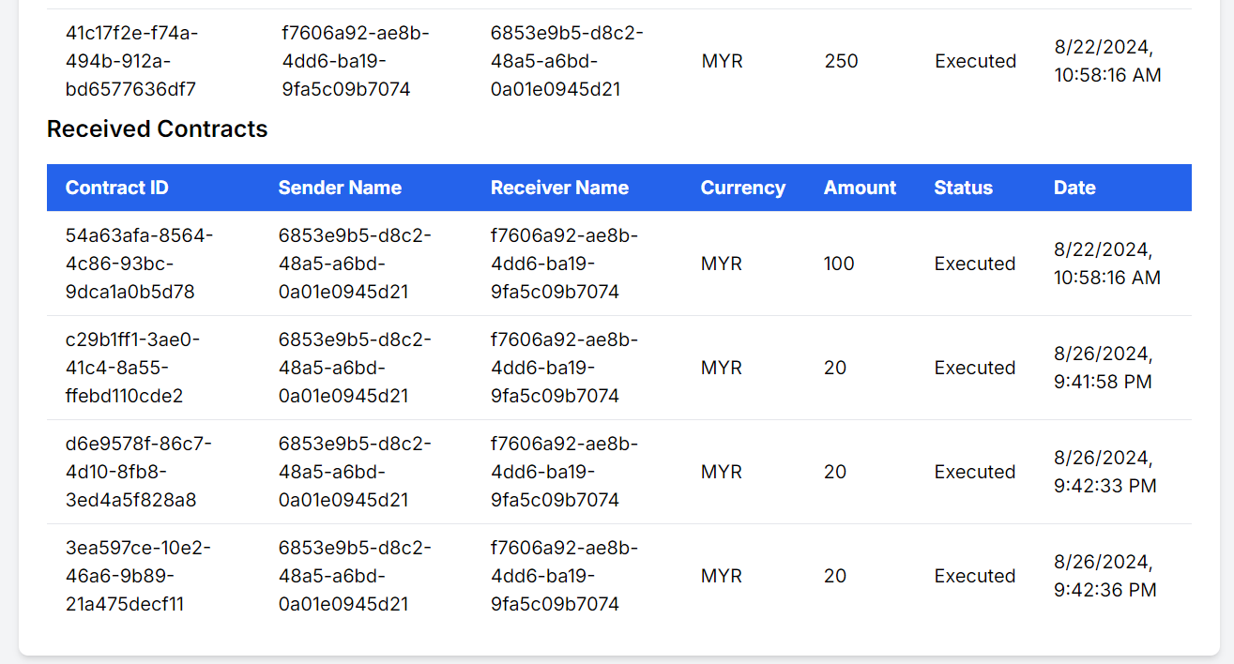
Frontend Web: Wallet Balance and Transaction History

Slide 12
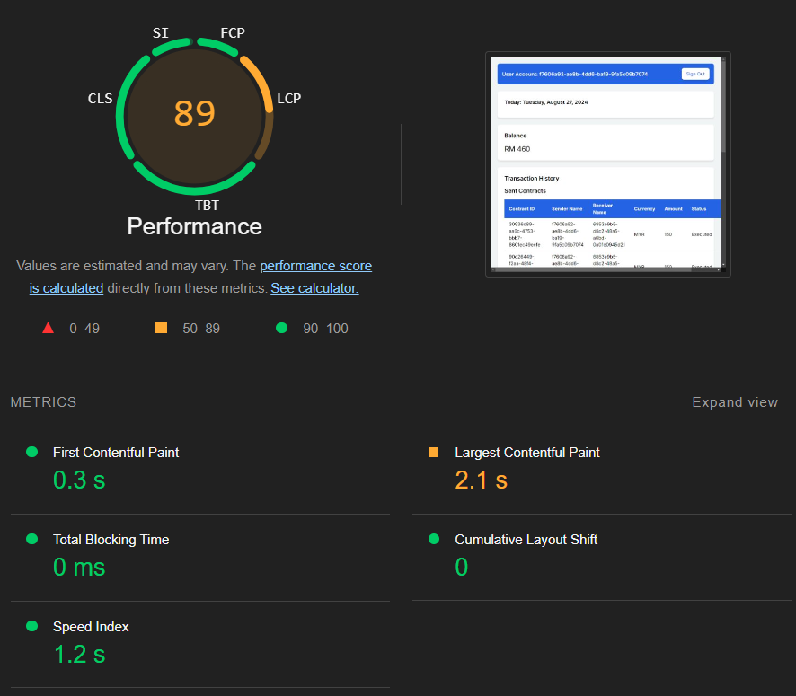
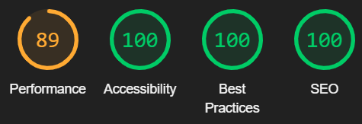
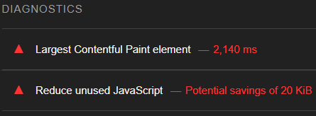
Lighthouse: Mostly Green

Slide 13
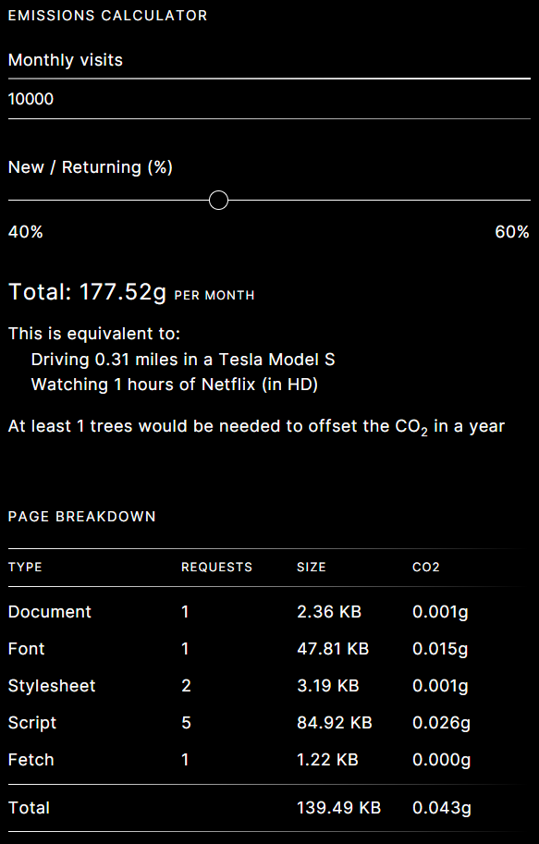
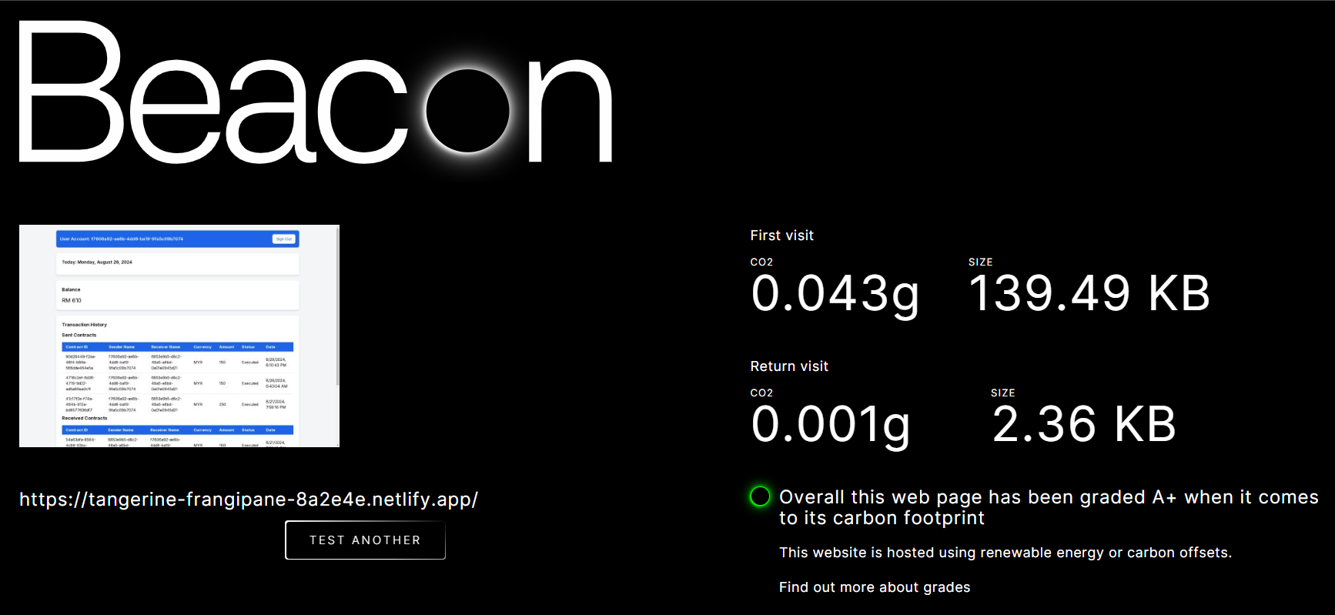
Digital Beacon: A+ Carbon Footprint

Slide 14
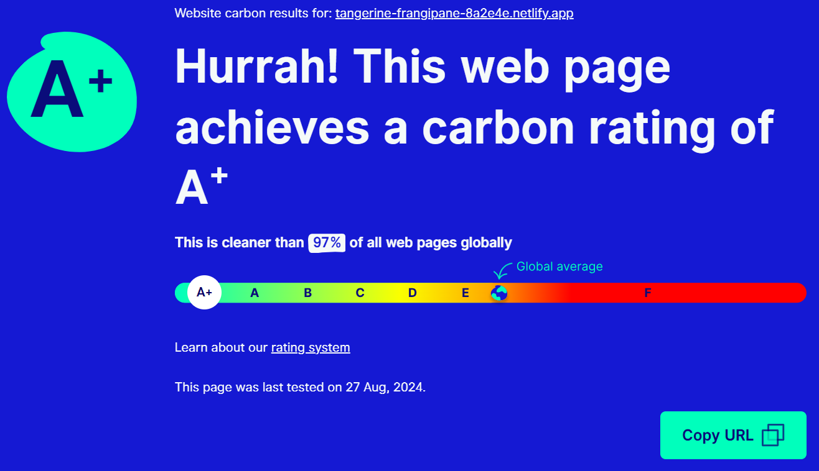
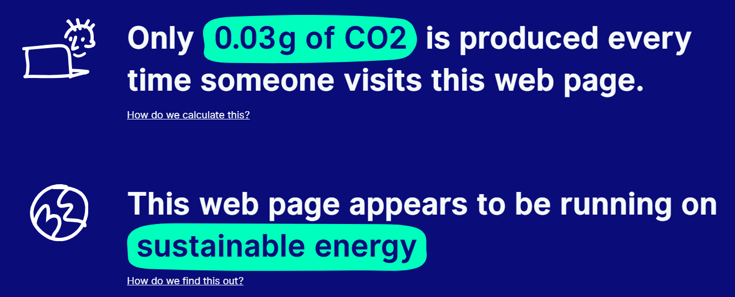
Website Carbon Calculator: A+ Carbon Rating

Slide 15
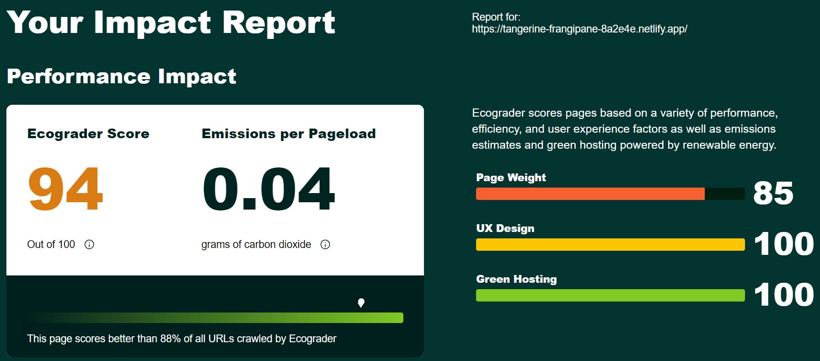
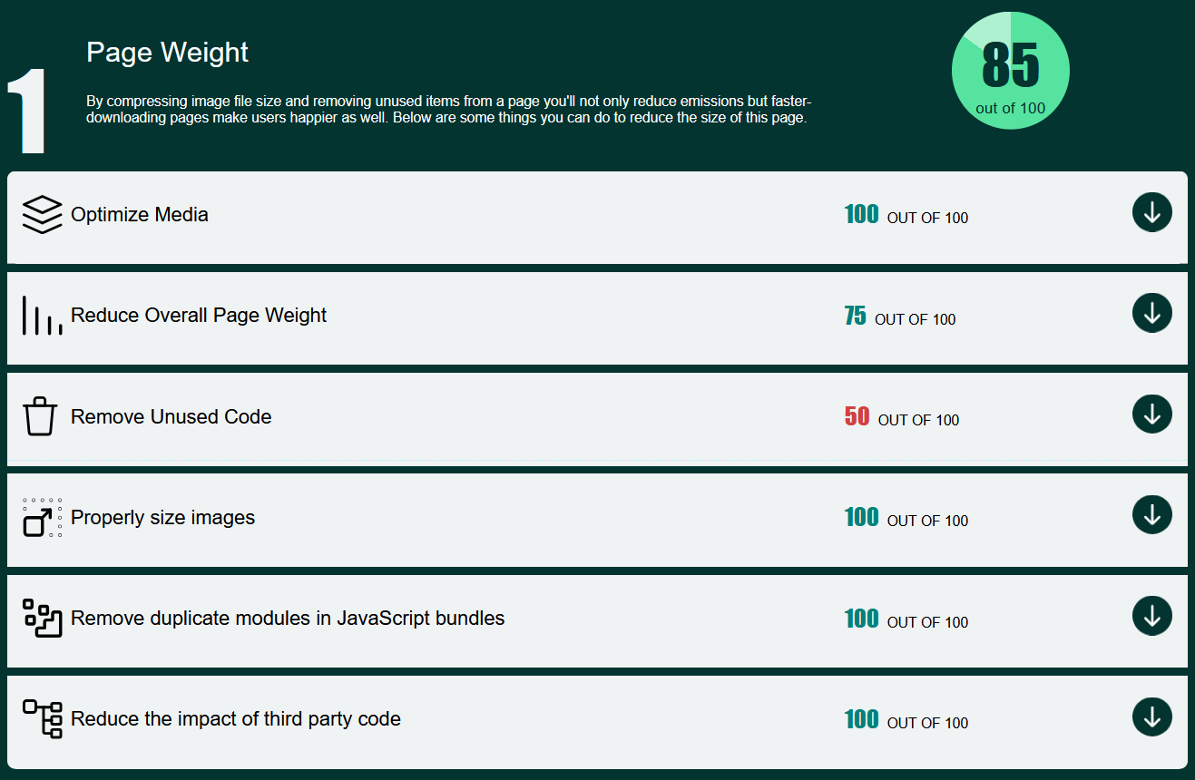
Ecograder: 94 out of 100

Slide 16
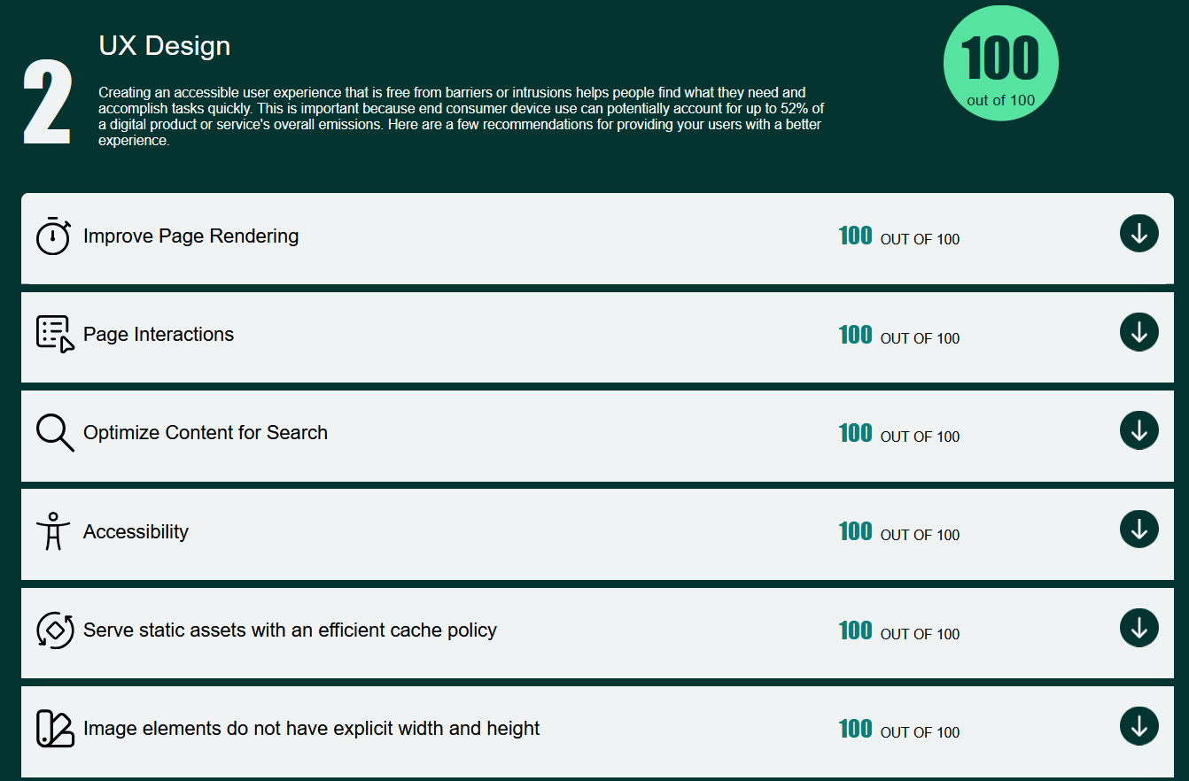
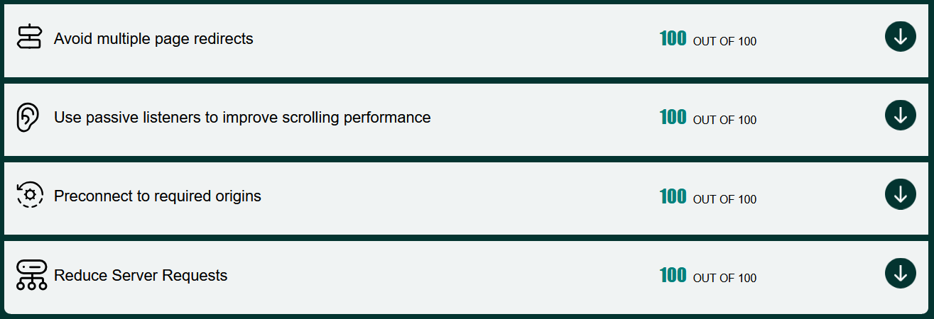
Ecograder: 94 out of 100

Slide 17
Summary: Baseline Testing Frontend
Beacon:
Score: A+
Size (1st Visit): 139.49 KB
Size (2nd Visit): 2.36 KB
0.043g Carbon 1st visit
0.001g Carbon 2nd visit
Website Carbon Calculator:
Score: A+
0.03g Carbon / visit
EcoGrader:
Score: 94/100
Page Weight: 142.93 KB
0.04g Carbon / visit
Lighthouse:
Performance: 89/100
Others: 100/100
Conclusion: Generally green across all testing tools. 2 tools suggested to remove unused JavaScript, which we did not remove since it came with our next.js installation.

Slide 18
Second Testing: Frontend 10 Contracts: 4 Sent, 6 Received [Increased by 3 Contracts]
Frontend Web on Chrome 128.0.6613.85 (Official Build) (64-bit), no extensions
Wednesday, 28 August 2024

Slide 19
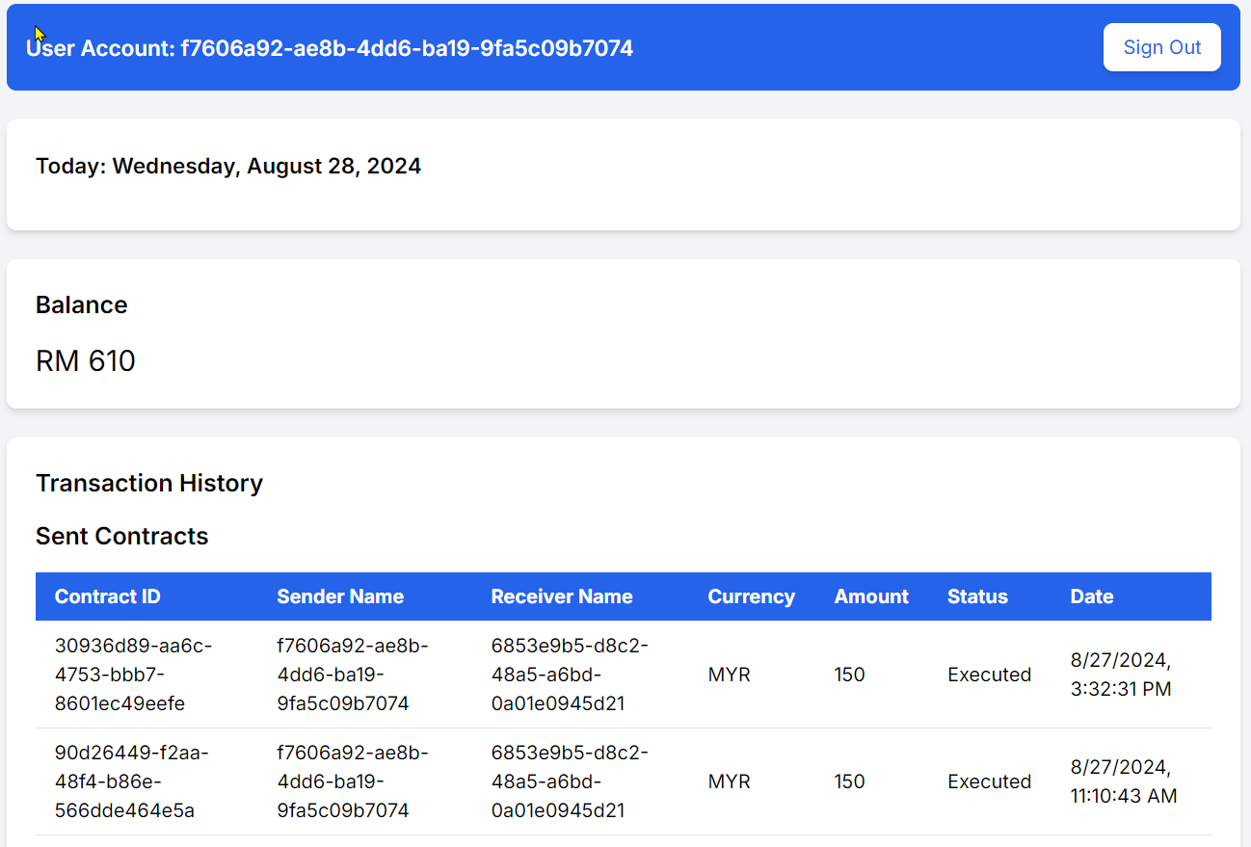
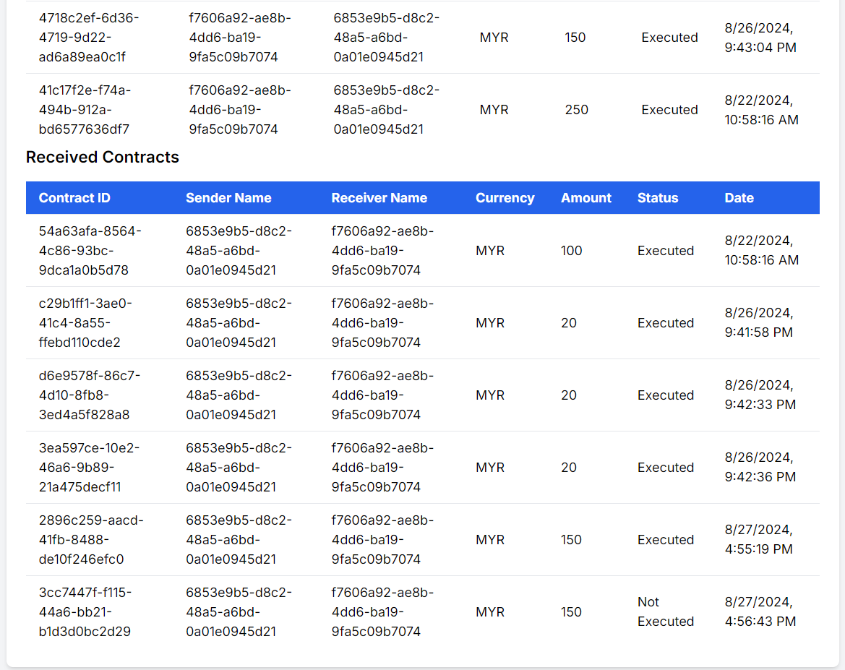
Frontend Web: Wallet Balance and Transaction History

Slide 20
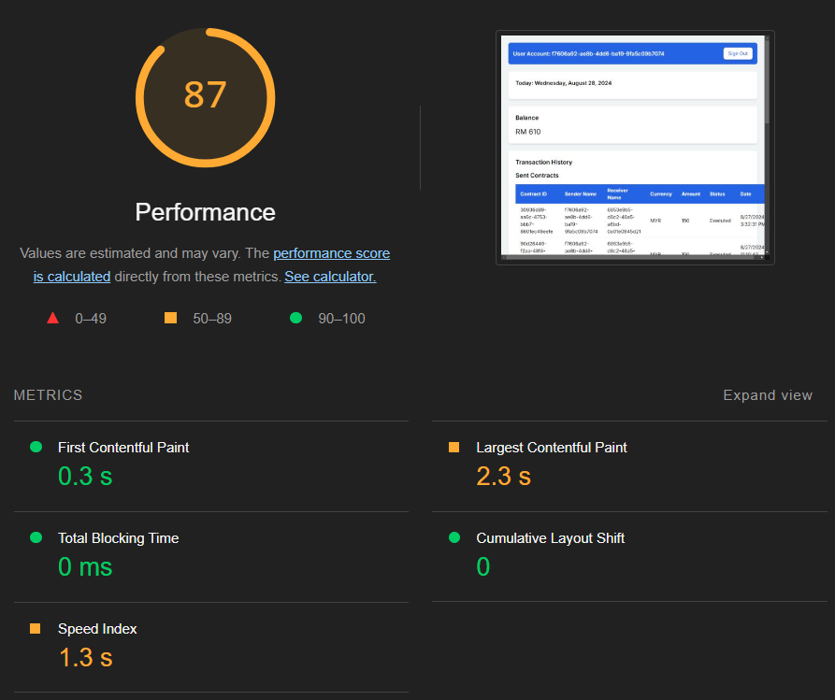
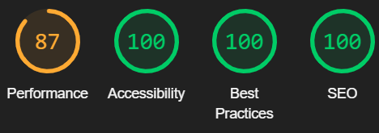
Lighthouse: Mostly Green

Slide 21
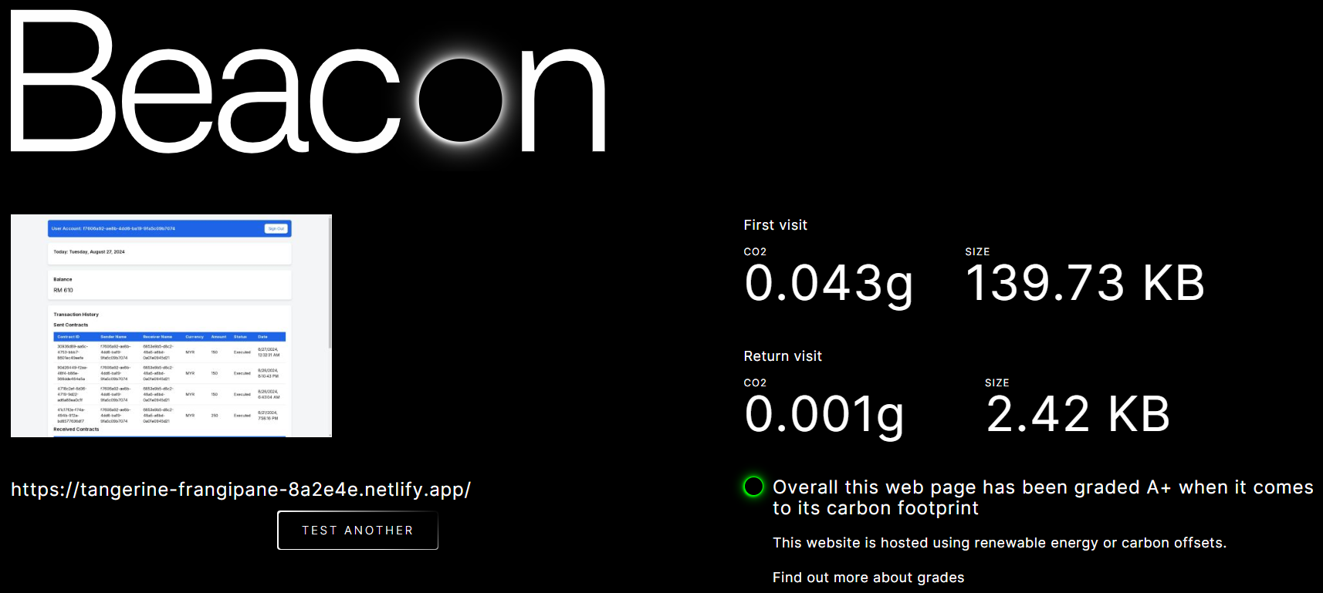
Digital Beacon: A+ Carbon Footprint

Slide 22
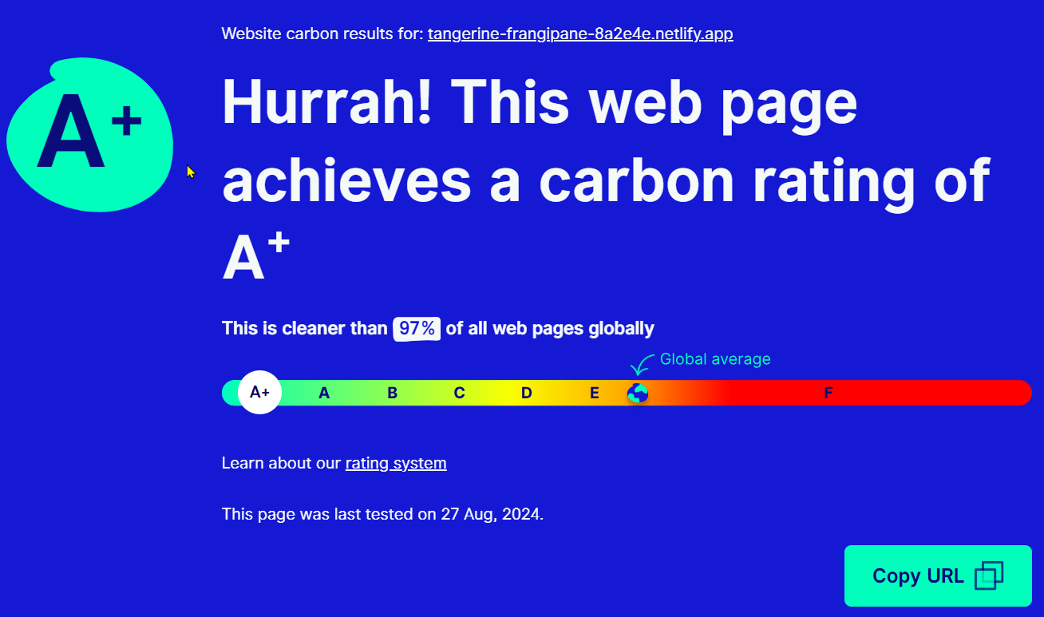
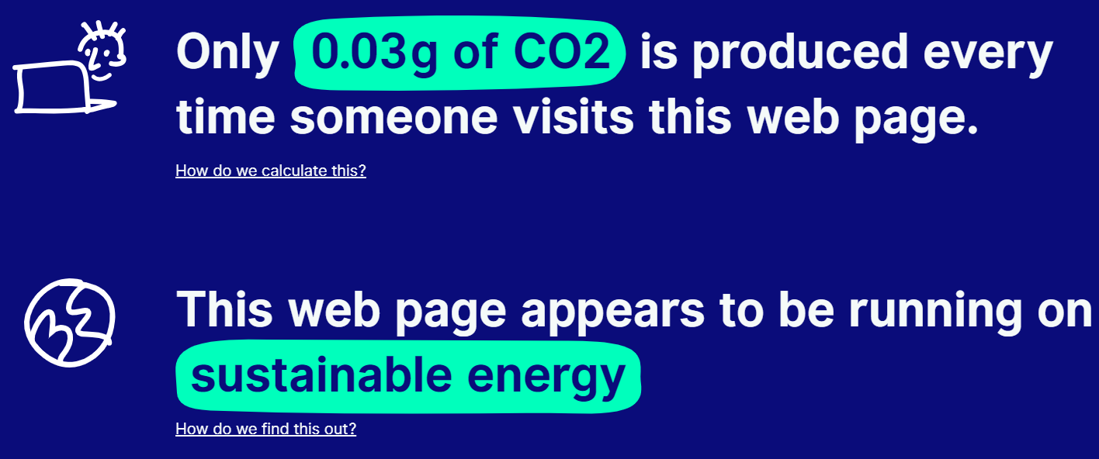
Website Carbon Calculator: A+ Carbon Rating

Slide 23
Ecograder: 94 out of 100

Slide 24
Ecograder: 94 out of 100

Slide 25
Summary: Carbon Footprint Testing Frontend
1st Test
2nd Test
Beacon:
Score: A+
Size (1st Visit): 139.49 KB
Size (2nd Visit): 2.36 KB
0.043g Carbon 1st visit
0.001g Carbon 2nd visit
Website Carbon Calculator:
Score: A+
0.03g Carbon / visit
Ecograder:
Score: 94/100
Page Weight: 142.93 KB
0.04g Carbon / visit
Lighthouse:
Performance: 89/100
Others: 100/100
Beacon:
Score: A+
Size (1st Visit): 139.73 KB
Size (2nd Visit): 2.42 KB
0.043g Carbon 1st visit
0.001g Carbon 2nd visit
Website Carbon Calculator:
Score: A+
0.03g Carbon / visit
Ecograder:
Score: 94/100
Page Weight: 142.93 KB
0.04g Carbon / visit
Lighthouse:
Performance: 87/100
Others: 100/100
Conclusion: With more contracts, the website is now larger, with worse performance in Lighthouse. This is expected behavior.

Slide 26
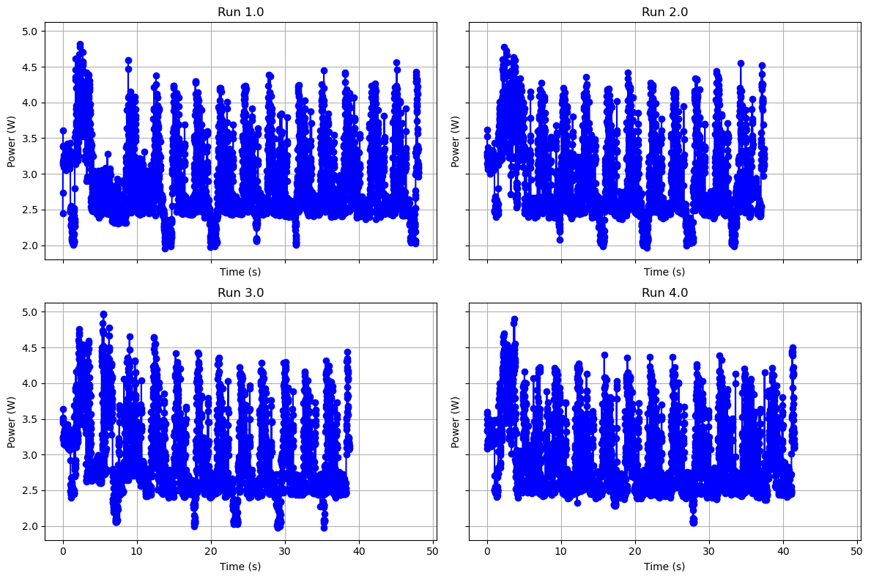
Power Consumption: Reload website 11 times in <40 seconds

Slide 27
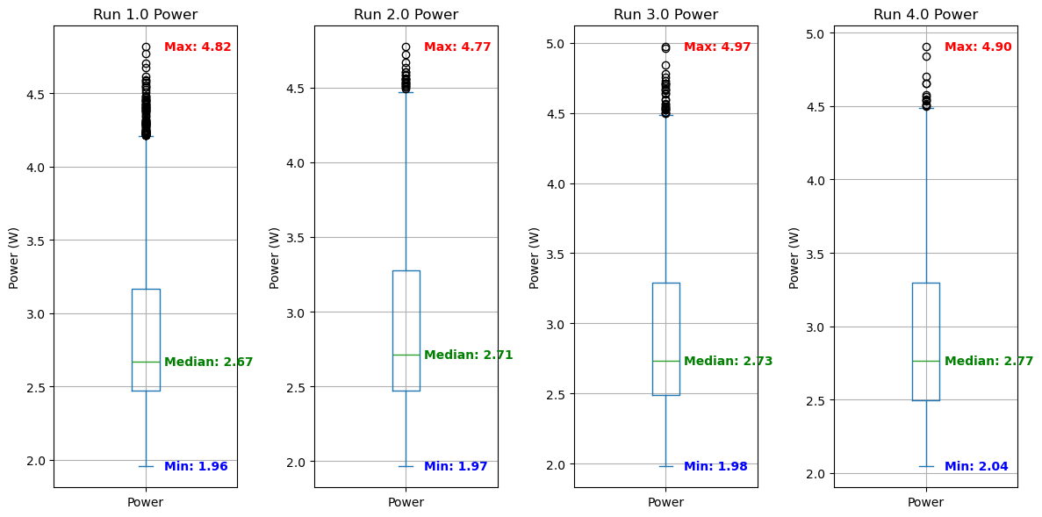
Power Consumption: Min 1.96 W, Max 4.97 W

Slide 28
3rd Testing: Frontend 13 Contracts: 5 Sent, 8 Received [Changed Frontend Display, Backend Processing]
Frontend Web on Chrome 128.0.6613.85 (Official Build) (64-bit), no extensions
Wednesday, 28 August 2024

Slide 29
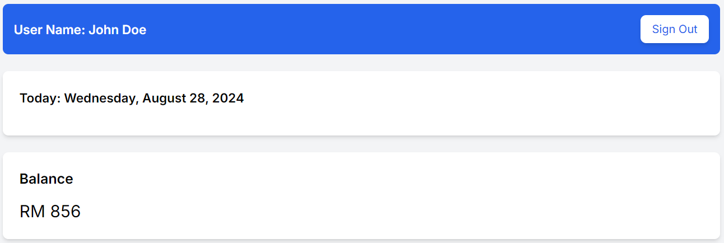
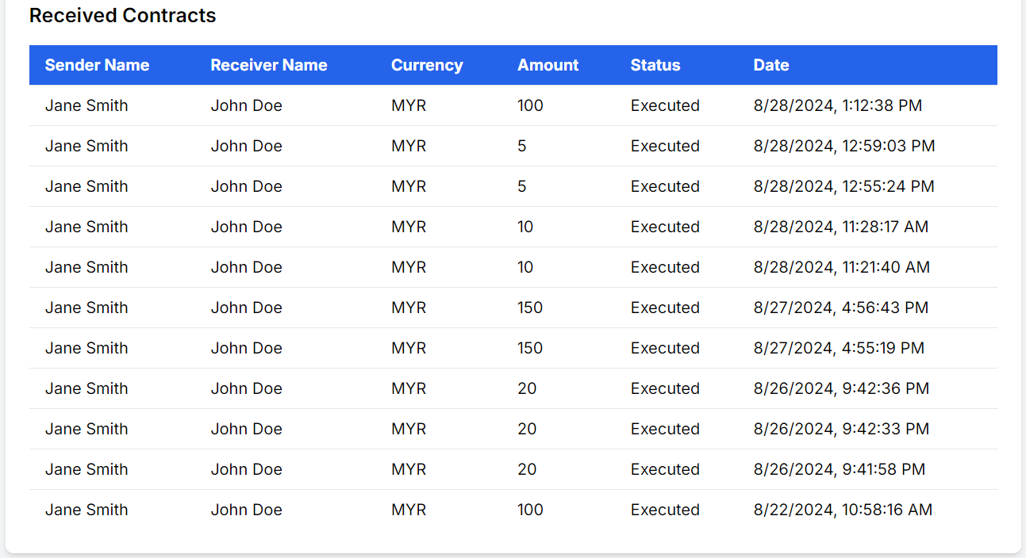
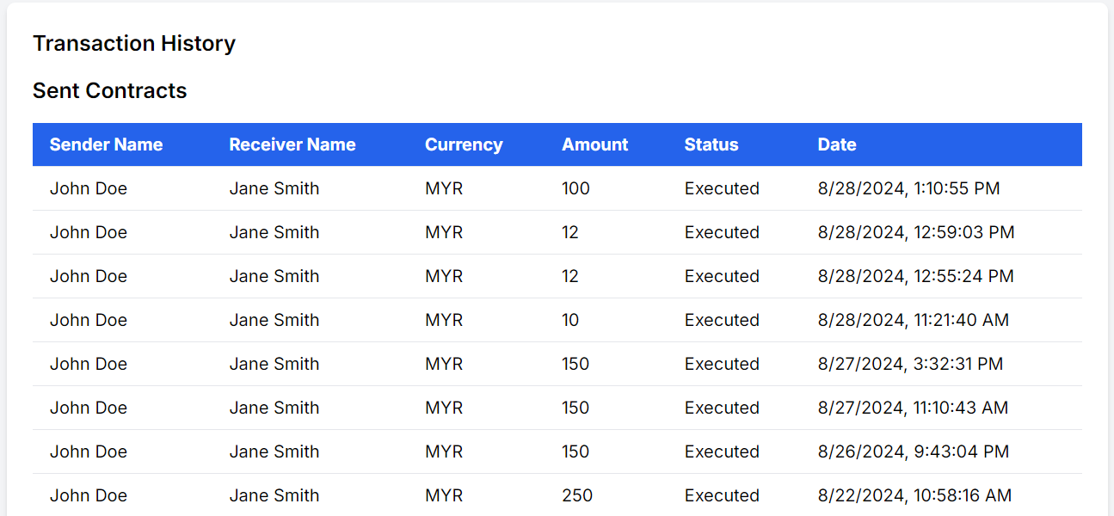
Frontend Web: Wallet Balance and Transaction History

Slide 30
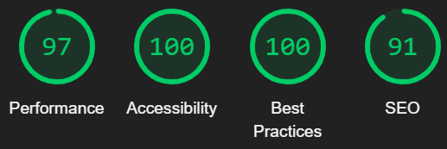
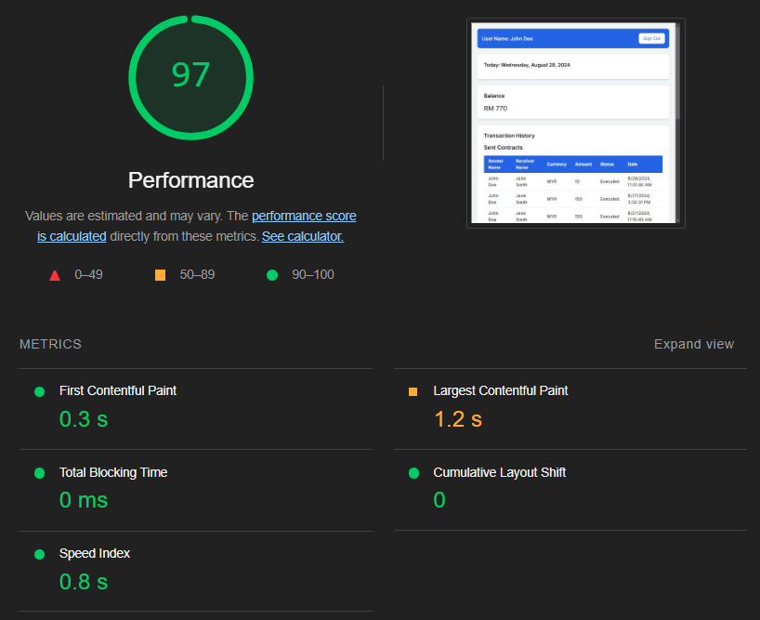
Lighthouse: Mostly Green

Slide 31
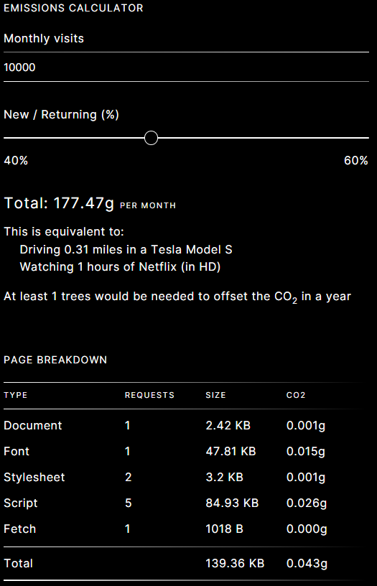
Digital Beacon: A+ Carbon Footprint

Slide 32
Website Carbon Calculator: A+ Carbon Rating

Slide 33
Ecograder: 94 out of 100

Slide 34
Ecograder: 94 out of 100

Slide 35
Summary: Carbon Footprint Testing Frontend
2nd Test
3rd Test
Beacon:
Score: A+
Size (1st Visit): 139.73 KB
Size (2nd Visit): 2.42 KB
0.043g Carbon 1st visit
0.001g Carbon 2nd visit
Website Carbon Calculator:
Score: A+
0.03g Carbon / visit
Ecograder:
Score: 94/100
Page Weight: 142.93 KB
0.04g Carbon / visit
Lighthouse:
Performance: 87/100
Others: 100/100
Beacon:
Score: A+
Size (1st Visit): 139.36 KB
Size (2nd Visit): 2.42 KB
0.043g Carbon 1st visit
0.001g Carbon 2nd visit
Website Carbon Calculator:
Score: A+
0.03g Carbon / visit
Ecograder:
Score: 94/100
Page Weight: 142.93 KB
0.04g Carbon / visit
Lighthouse:
Performance: 97/100
Others: 100/100, SEO: 91/100 (not relevant)
Conclusion: Even with more contracts, the website is smaller on 1st visit, with better performance in Lighthouse. This is expected behavior.

Slide 36
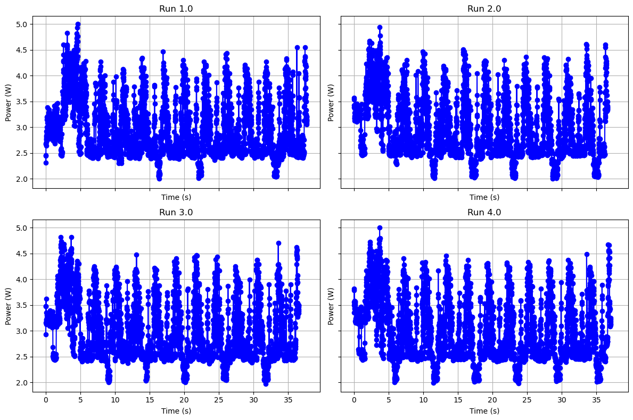
Power Consumption: Reload website 11 times in <40 seconds

Slide 37
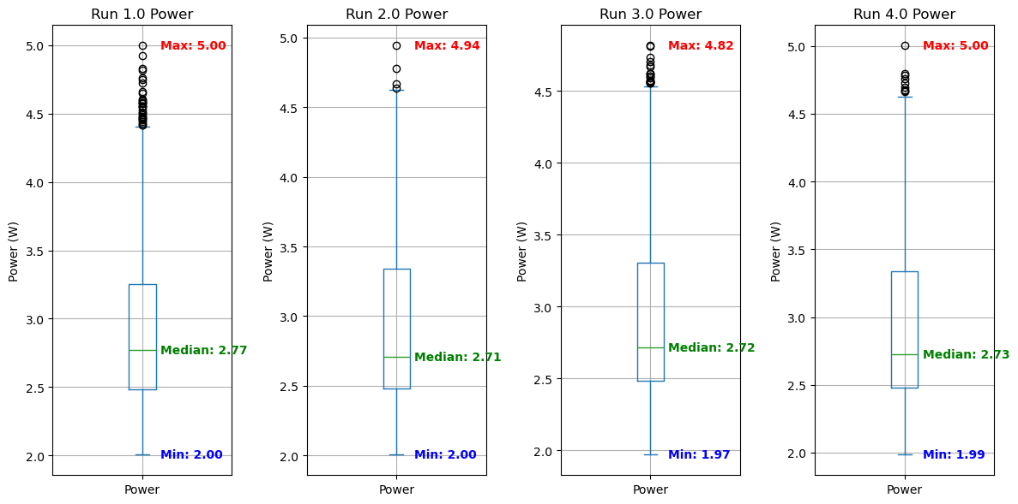
Power Consumption: Min 1.97 W, Max 5.00 W

Slide 38
Summary: Power Consumption Testing Frontend
Baseline
Optimised
Power Consumption:
Min: 1.96 W
Max: 4.97 W
Power Consumption:
Min: 1.97 W
Max: 5.00 W
Conclusion: Insignificant difference in power consumption before and after optimization

Slide 39
Backend Measurement and Optimization
Google Cloud Platform

Slide 40
Send Contract from local device to server
Baseline Measurement
Optimized Measurement
1 by 1
batch
One Contract: 1370ms
Four Contracts: 1325ms
One Contract ≈ 331.25ms

Slide 41
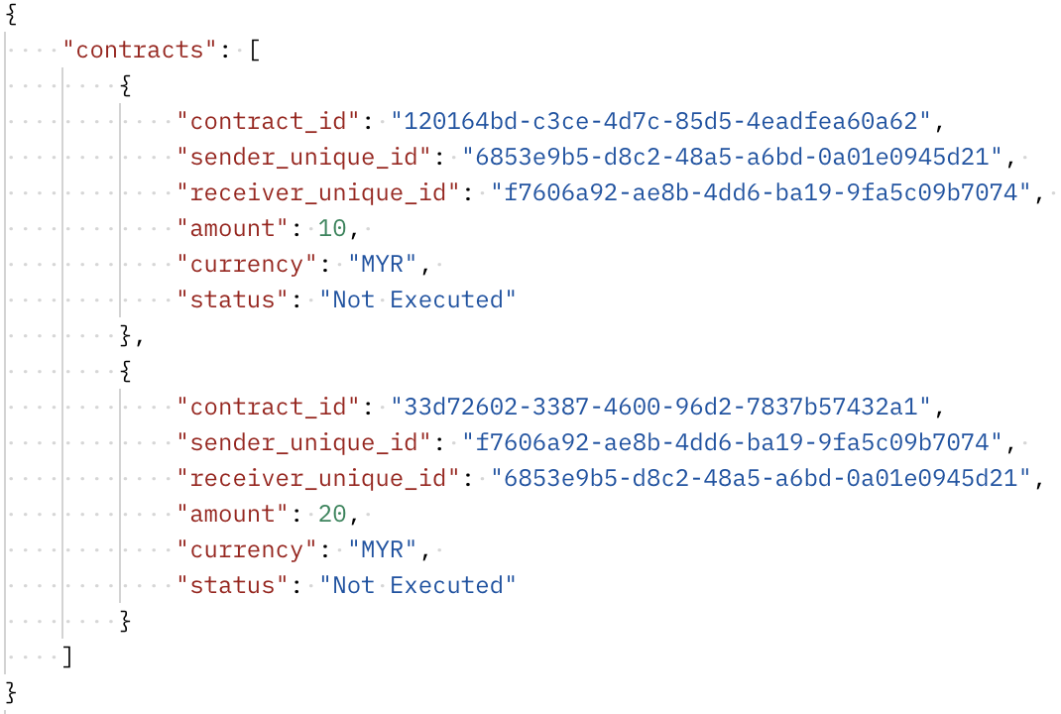
Optimize Contract send
x10 Request to server
x1 Request to server

Slide 42
Fetching Wallet Balance
Baseline Measurement
Optimized Measurement
Full Data
Necessary Data
10 Contracts
Time : 659ms
Size : 7.36KB
1 Contract ≈ 736 B
42 Contracts
Time : 1223ms
Size : 7.95KB
1 Contract ≈ 189.29 B

Slide 43
CPU Utilization
Before
After
1
Before Optimize: O(n)
1 contract = 0.648%
1 contract = 0.871%
After Optimize: O(log n)
1 contract = 1.456%
4 contract = 0.542%
1
1
4

Slide 44
Execute Contract
Before Optimize
After Optimize
Future Optimize

Slide 45
Mobile App Frontend Baseline
Flutter Dev Tools

Slide 46
UI Performance
E.g. Opening Receive Page (for the first time)

Slide 47
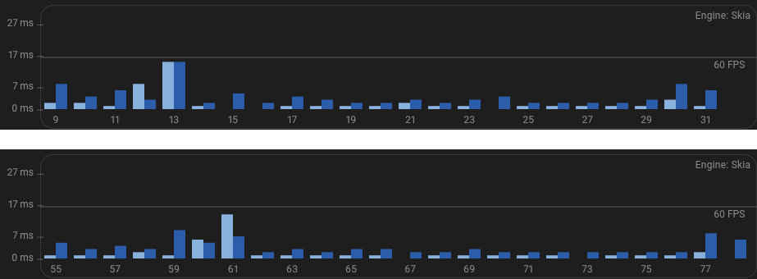
Opening the same page for the second time & onwards
Frame drops are less prevalent as the UI shaders have been compiled

Slide 48
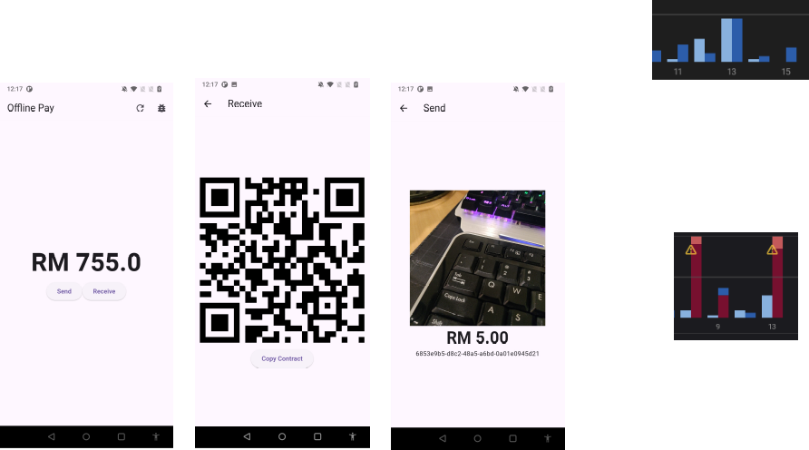
Keeping the application UI simple helps
Spikes in frame rendering times are caused by certain elements such as QR code generation
Ideally pre-compiled shaders should be bundled with every new app. However, it is
not currently possible
on android

Slide 49
CPU Profiling

Slide 50
Networking

Slide 51
Mobile App Frontend Improvements
Flutter Dev Tools

Slide 52
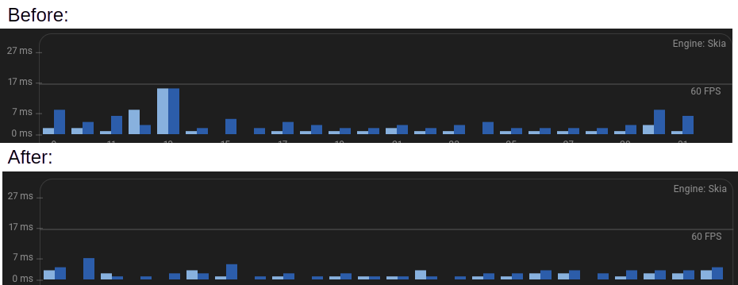
Reduce redundant re-rendering of QR
Cache the Receive QR, as it remains the for each user.
Update the cache when account changes.

Slide 53
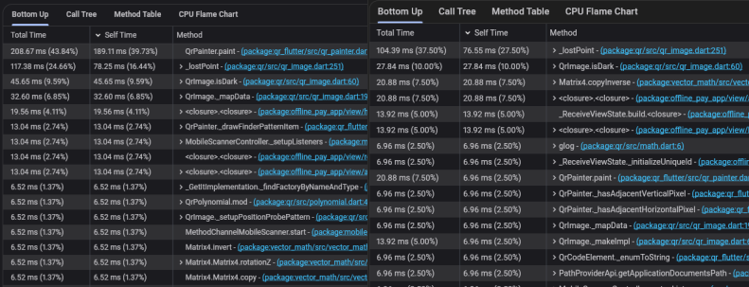
Results in lower energy usage
Before:
After:

Slide 54
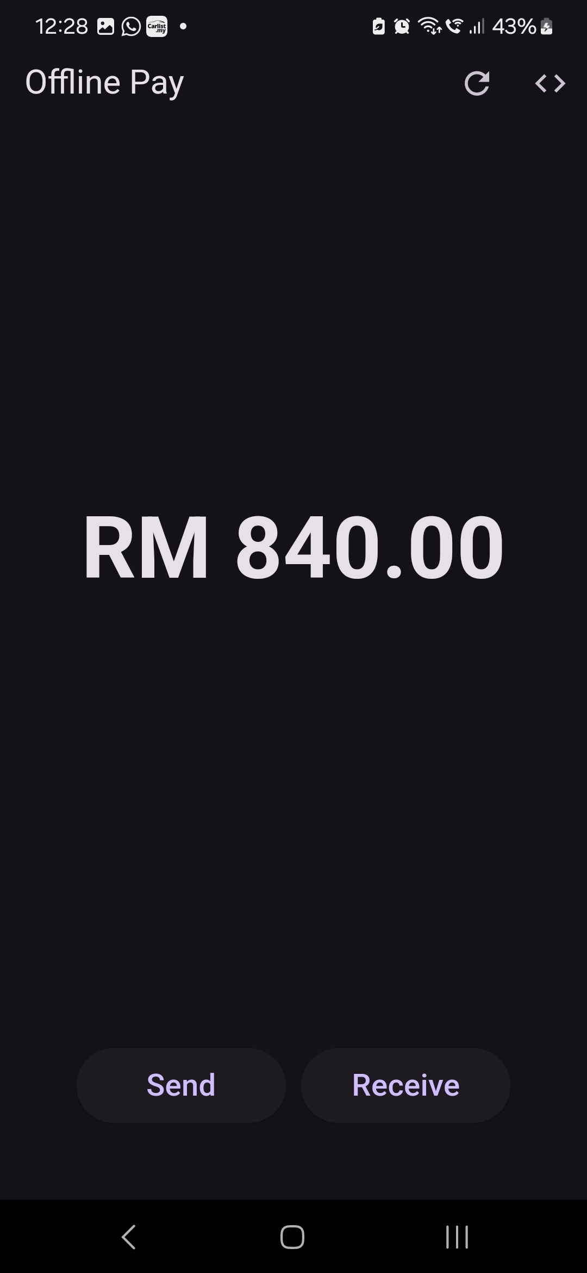
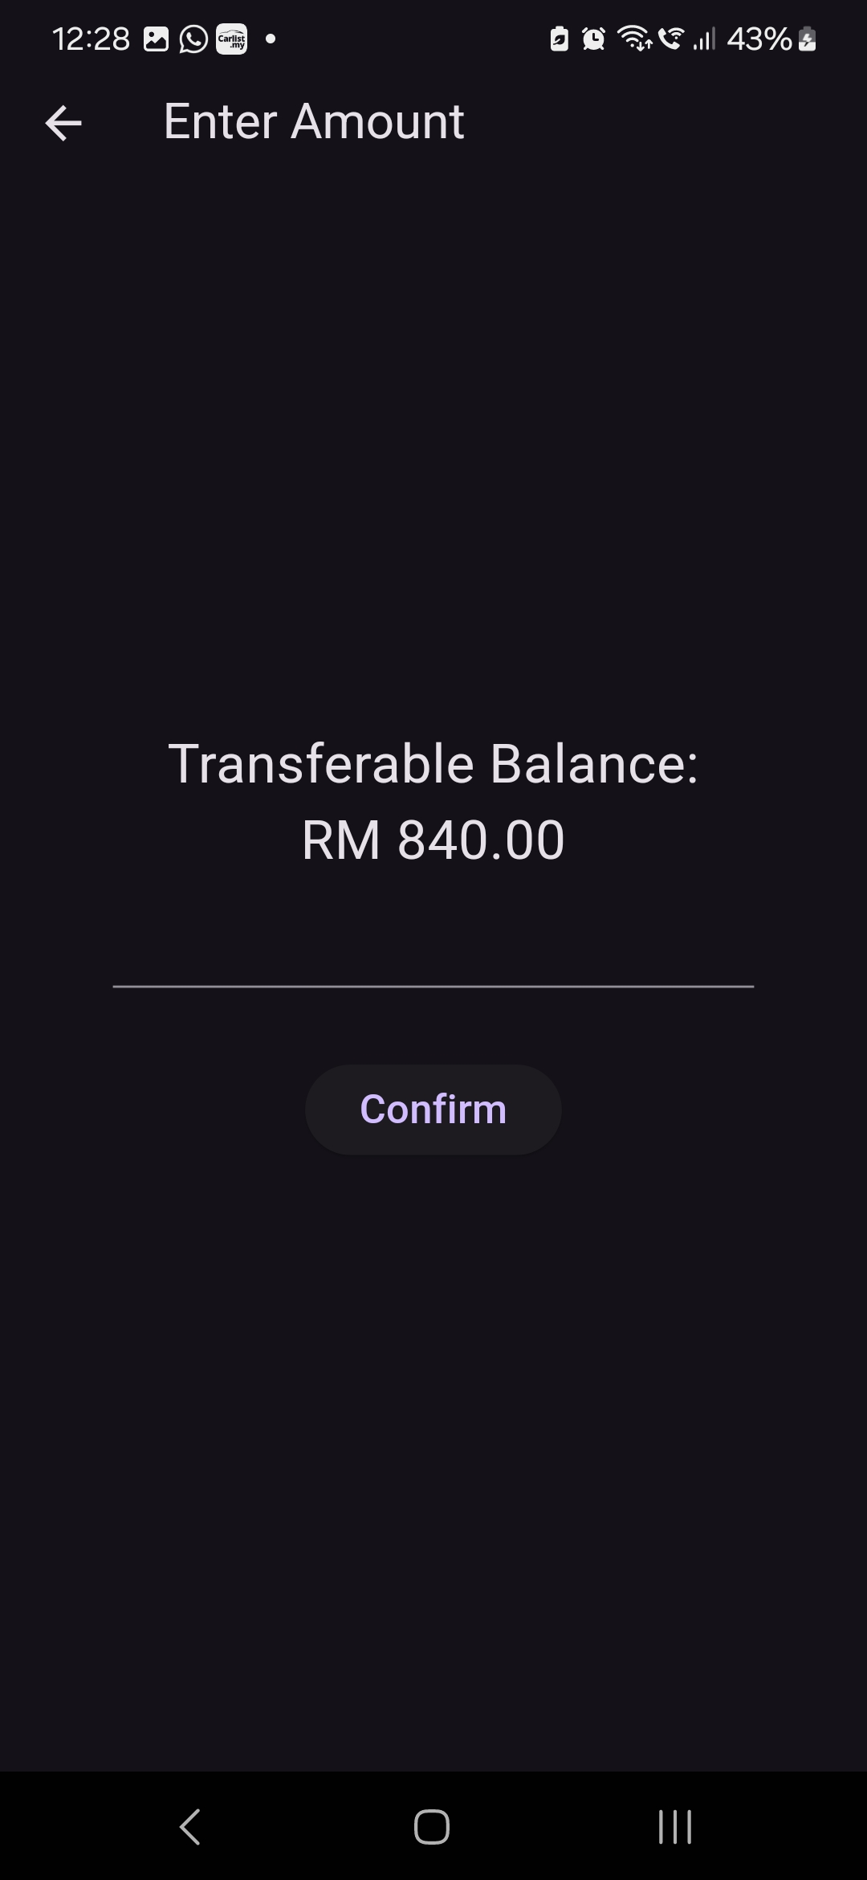
UI Retouching
Dark mode
Added benefit of improving battery life on certain phones
Bigger Buttons
Improved user experience
Slightly Cleaner UI

Slide 55
Reflections: What We Learned from the Hackathon
Kavi
Stephen
Irfan
Explored new tools & areas in software engineering
Learned and applied sustainable software practices on real world software products and observed its benefits
Emphasized the importance of brainstorming and collaboration.
Developed solutions that not only solved immediate problems but also had long-term viability
Learned the importance of building software solutions that prioritize efficiency, energy consumption, and long-term scalability
Applying the SusAF allows for a broader analysis of the impacts of the software in different dimensions
Always have a proper testing plan for performance improvements

