Slide 1
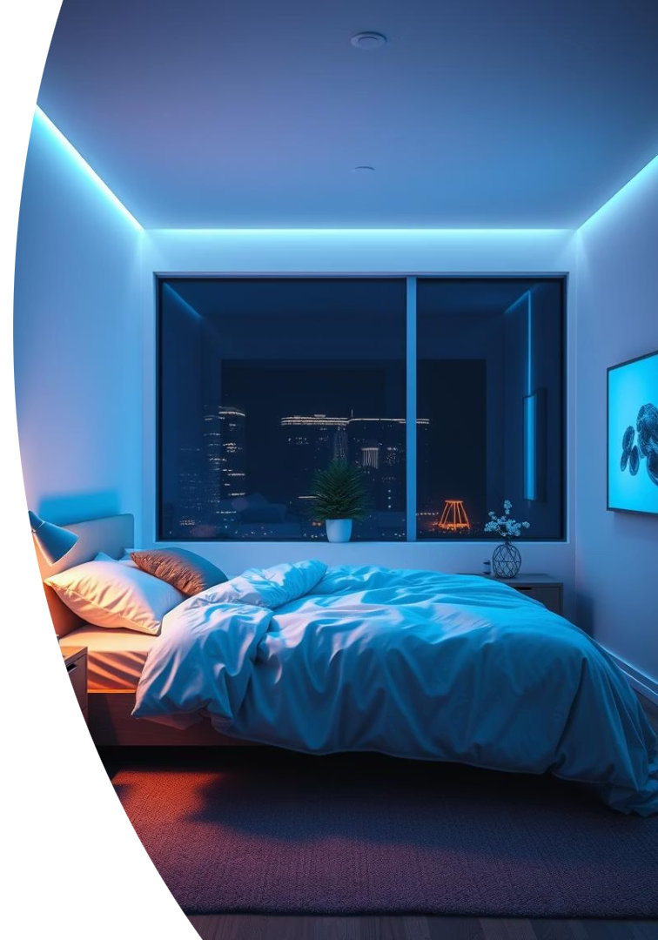
Smart Sleep Assistant: Enhancing Sleep and Efficiency
Group: DEVS – Dũng, Eric, Victor, Samad Sustainablity IoT Hackathon – Problem and Solution proposal

Slide 2
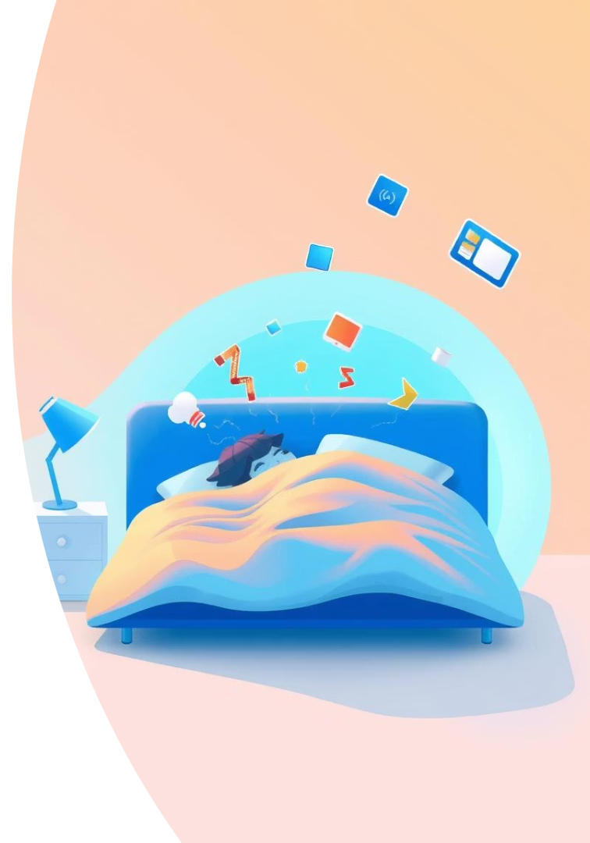
Problem & Motivation
Poor Sleep Habits
Screen time, caffeine, disrupted routines
Energy Waste
Unnecessary appliance use in homes
Motivation
Enhance sleep, better wellbeing, better mental health
Behavioral Nudges
Actuators guide gentle habit changes

Slide 3
Final Concept Overview
Smart Sleep Assistant
Behavior Focus
Sensor-driven system to improve sleep and save energy
Tracks sleep, phone use, caffeine intake
RFID, PIR, humidity/temp sensors, coffee machine integrated
Context-aware interventions
Long-term sleep habit monitoring
Automatic sleep environment monitoring/enhancing
Smart device usage monitoring + restriction

Slide 4
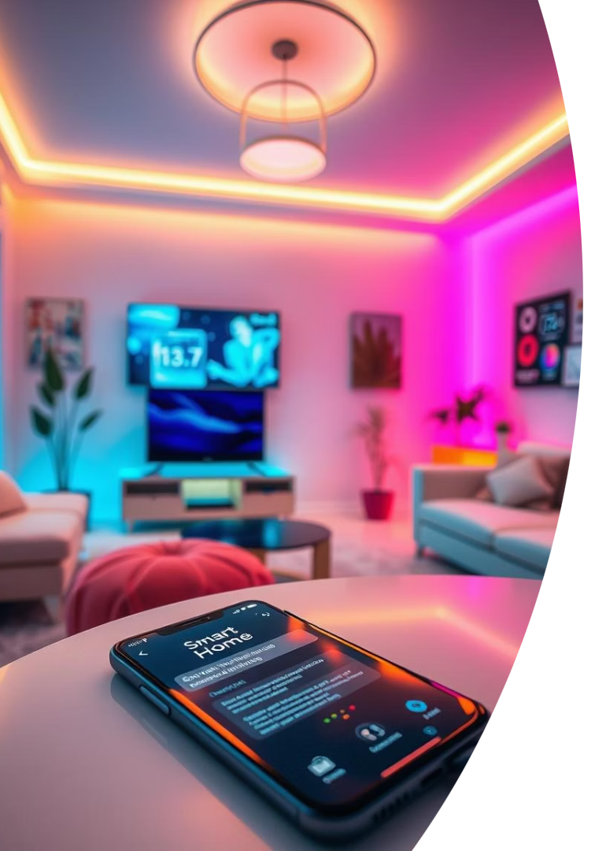
Key Features Part 1
Prevent Phone Usage
Detect phone, remind user at bedtime
Sleep Time Reminder
Dim lights, LCD alert 1 hour before sleep
Appliance Shutoff & Night Mode
Turn off devices and lock doors/windows post-bedtime
Coffee Habit Alert
Disable evening coffee use after 6 PM and warn after 5 PM

Slide 5
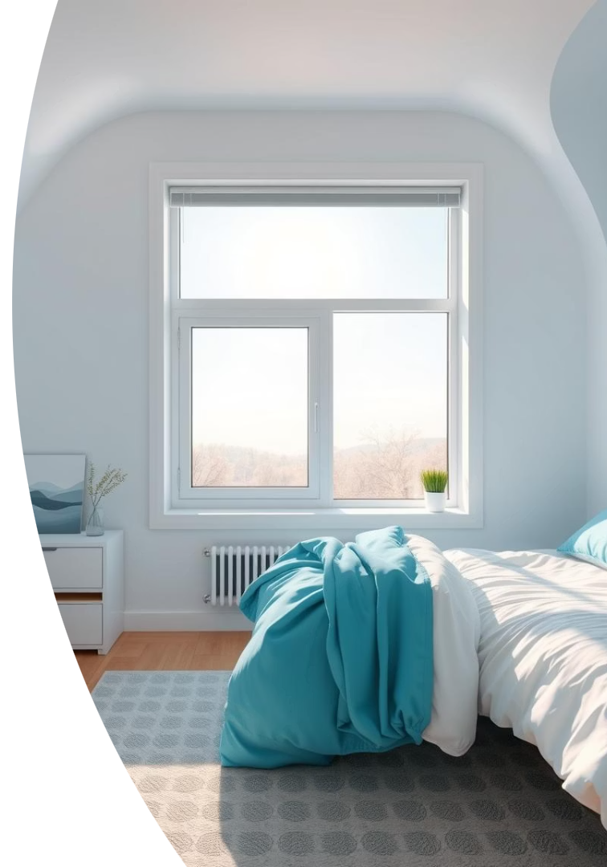
Key Features Part 2
Natural Light Exposure
Sleep Environment Optimization
Open windows and brighten lights before wake-up
Control temperature, humidity, light

Slide 6
Technical Architecture
Sensors
Actuators & Control
RFID for phone detection
LCD displays
PIR for motion
Fan, light, window motor
Temperature & humidity sensor
Smart coffee maker control
Gas & steam sensor
Coffee button

Slide 7
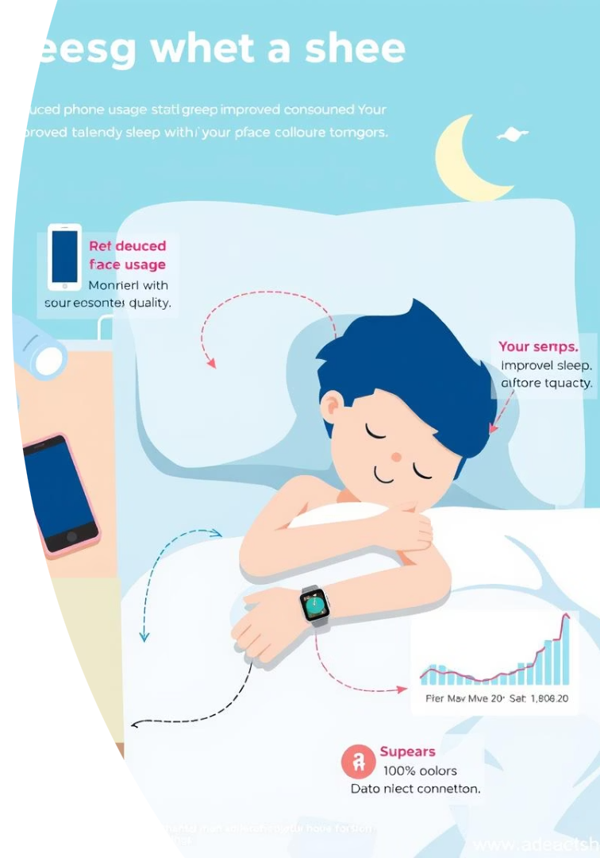
Behavioral Change Mapping
Feature
Goal
Sensor/Input
Metric
Phone Usage
Reduce screen time
RFID
Phone absent after bedtime
Coffee Alert
Less evening caffeine
Button + Clock
Presses post 5 PM
Sleep Reminder
Consistent bedtime
Clock + PIR
Motion + sleep logs
Environment Control
Better sleep
Temp/Humidity
Time in optimal range

Slide 8
Impact Analysis Using SusAF Framework
Social
Environmental
Reduced screen usage at night, safer home
Lower energy use, natural light syncing
Individual
Economic
Improved sleep, healthier habits
Reduced bills, longer device lifespan
Technical Risks
Sensor failure, override issues
Mitigations include customization, fallback logic, user override.

Slide 9
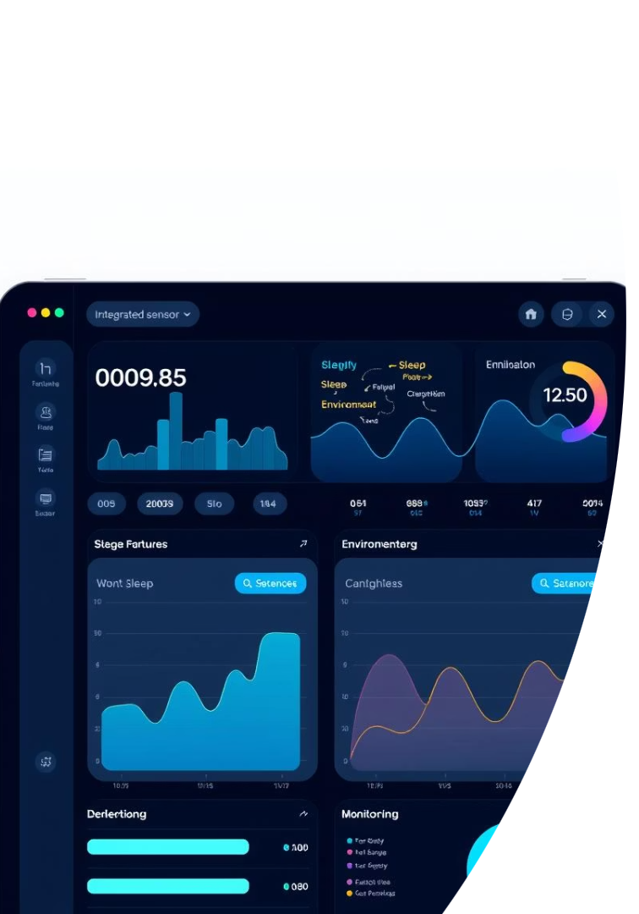
Data Logging & Future Enhancements
Current Data Tracking
PIR, temperature, humidity sensor logs
Coffee button presses and RFID phone use
Self-reported sleep scores
Future Improvements
Adaptive wake/sleep scheduling
Dynamic sunlight syncing
Enhanced wearable device integration
App-based user customization

Slide 10
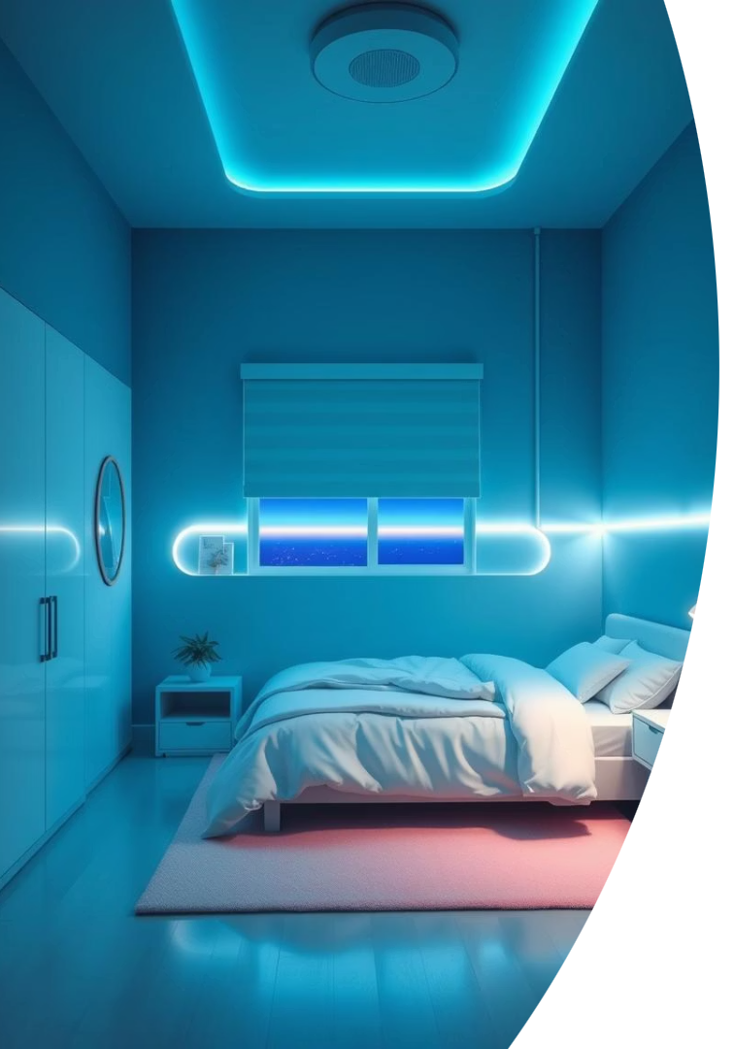
Conclusion & Q&A
Summary
Smart tech plus behavioral psychology enhances sleep
Automation encourages healthier routines
Focus on comfort, sustainability, user empowerment
Next Steps
Gather feedback and ideas
Collaborate on prototyping and testing

