Slide 1
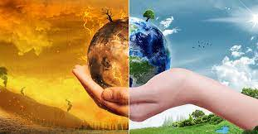
Sustainability Awareness Framework
(SusAF)
Shola Oyedeji

Slide 2
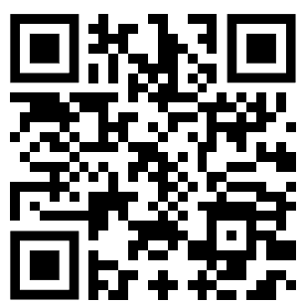
Sustainability Impacts Survey
https://forms.gle/V9vVS1vwaDBtdByUA
12 minutes to fill

Slide 3
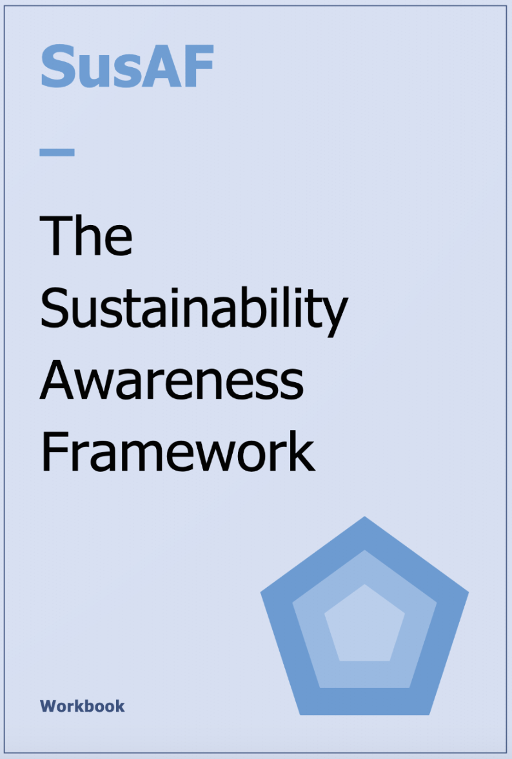
Sustainability Awareness Framework
A question-based “sustainability Awareness Framework” (SusAF) for raising awareness of the impacts that a software system could have on sustainability
SusAF aims to:
Help identify the sustainability impacts and effects of IT products and services on the five dimensions of sustainability (social, individual, environmental, economic, and technical) across three orders of effect (direct, indirect, and systemic)
Support discussion about the anticipated effects of IT products and services
Link: https://www.suso.academy/en/sustainability-awareness-framework-susaf/

Slide 4
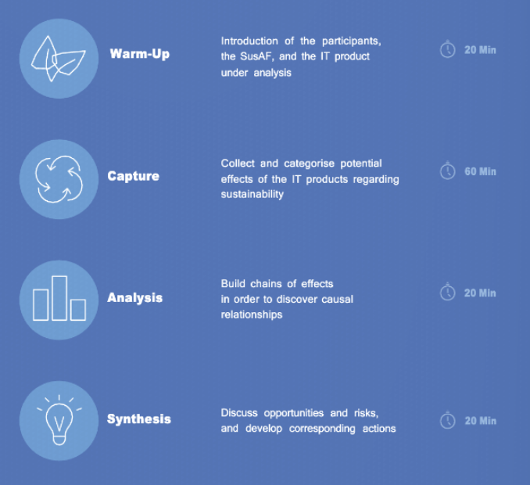
SusAF Process

Slide 5
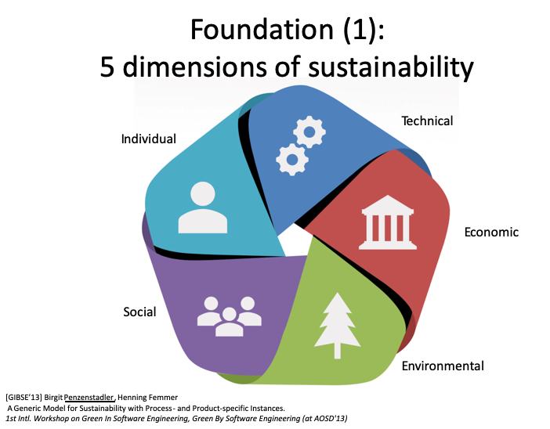
Key Elements in SusAF
The 5 dimensions of Sustainability :
The environmental dimension is about conserving natural resources and protect global ecosystems to support health and wellbeing, now and in the future
The economic dimension is concerned with finance, profit, investment
The social dimension covers relationships between individuals and groups.
The individual dimension focus on o the maintenance of individual human capital
The technical dimension refers to maintenance and evolution, resilience of IT products, services or software systems

Slide 6
Key Elements in SusAF
Economic Dimension: maintaining financial capital
Assets
Capital
Added Value
The focus is on how to design and develop IT products, services or software systems in a cost-effective manner.

Slide 7
Key Elements in SusAF
Technical Dimension: the ease of system transitions and evolution with changing requirements and condition.
‘How can IT products, services or software systems be designed and developed for easy evolution, maintainability, adaptability to changes in the future’?
Some factors:
Technical debt
Scalability
Data integrity
Software Testing

Slide 8
Key Elements in SusAF
Individual dimension: Well-being of individuals and equal access to services. It includes the ability of individuals (end users) to thrive and exercise their rights.
How does IT products, services or software systems support the individual endeavor towards the goals of that person (end user)?”
Support adaptation
Personalization (end user).
Mental and physical well-being
Self-respect
For software developers this individual sustainability may also mean their own satisfaction of their product.

Slide 9
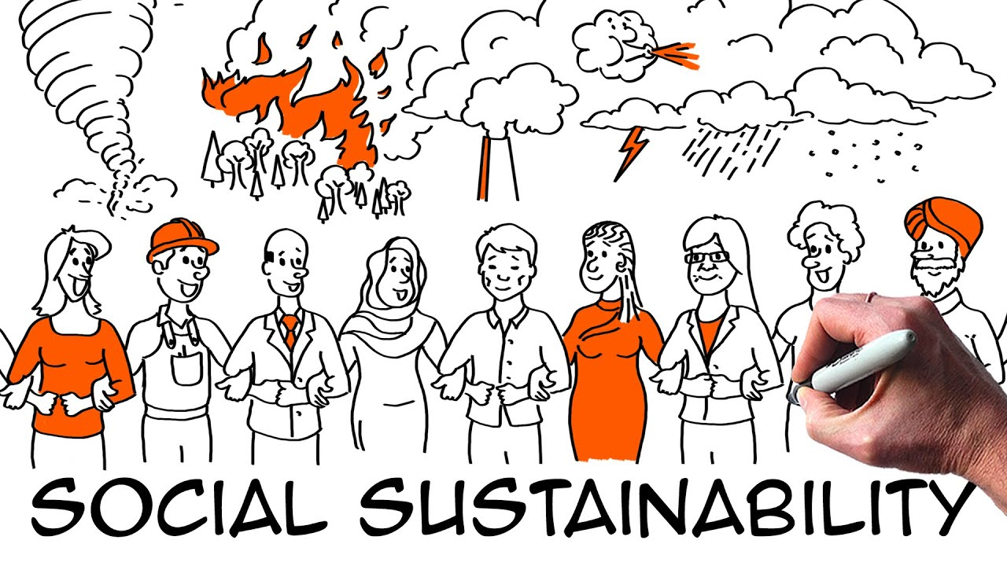
Key Elements in SusAF
Social dimension: The factors that affect interaction between group of people or communities such as trust, equality.
‘What are the impacts of IT products, services or software systems on the society?’ Example:
Communication
sense of belonging,
interaction and social equity

Slide 10
Key Elements in SusAF
Environmental dimension refers to the use and maintenance of natural resources. For software engineering (SE), ‘How does IT products, services or software systems impact and affect the environment and energy consumption’. Example:
Material and resource usage
Energy usage
CO2 Emissions

Slide 11
Key Elements in SusAF
Social | (1) Sense of Community; (2) Trust; (3) Inclusiveness and Diversity; (4) Equality; (5) Participation and Communication;
Individual | (1) Health; (2) Lifelong learning; (3) Privacy; (4) Safety; (5) Self Awareness and Free will;
Environment | (1) Material and Resources; (2) Soil, Atmospheric and Water Pollution; (3) Energy; (4) Biodiversity and Land Use; (5) Logistics and Transportation;
Economic | (1) Value; (2) Customer Relationship Management (CRM); (3) Supply chain; (4) Ecosystem; (5)Governance and Processes; (6) Innovation and R&D;
Technical | (1) Maintainability; (2) Usability; (3) Extensibility and Adaptability; (4) Security; (5) Scalability;

Slide 12
Key Elements in SusAF
The assessment of sustainability effects on different time scale are classified into three order of impacts:
First order (Immediate effects) are the direct effects of the production, operation, use and disposal of socio-technical systems. This includes the properties and the full lifecycle impacts, such as in the Life-Cycle Assessment (LCA) approach. Although the timeline for the changes might be rather long (as we look at the lifecycle of the product), these effects are still direct consequences of the product.
Second order (Enabling effects) of operation and use of a system include any change enabled or induced by the system usage. These effects are not tied to the actual product but are side effects when the product is taken into use.
Third order (Structural or systemic) effects represent structural changes caused by the ongoing operation and use of the socio-technical system. These are usually consequences of changed habits due to the use of product and typically take a longer time to evolve. However, these effects are the game changers in sustainable development, effects that can truly make a difference.

Slide 13
SusAF Scoping

Slide 14
Key Elements in SusAF

Slide 15
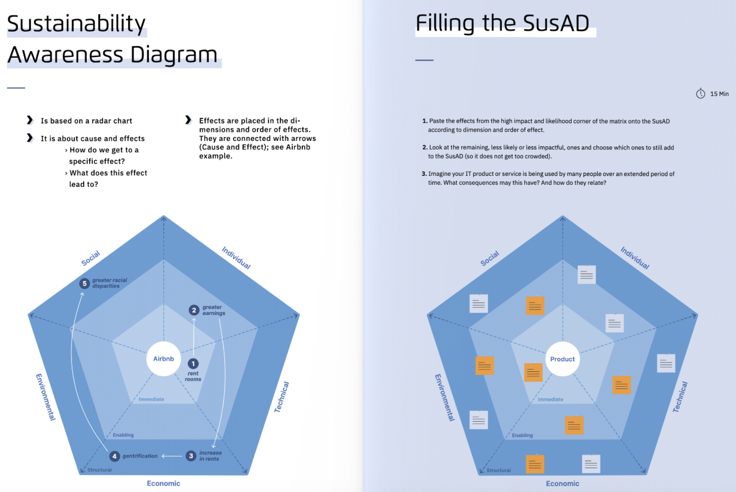
Key Elements in SusAF
SusAD: a graphical illustration to visualize these impacts
Write down effects/impacts of the IT product or service or software system features according to dimension and order of effect.

Slide 16
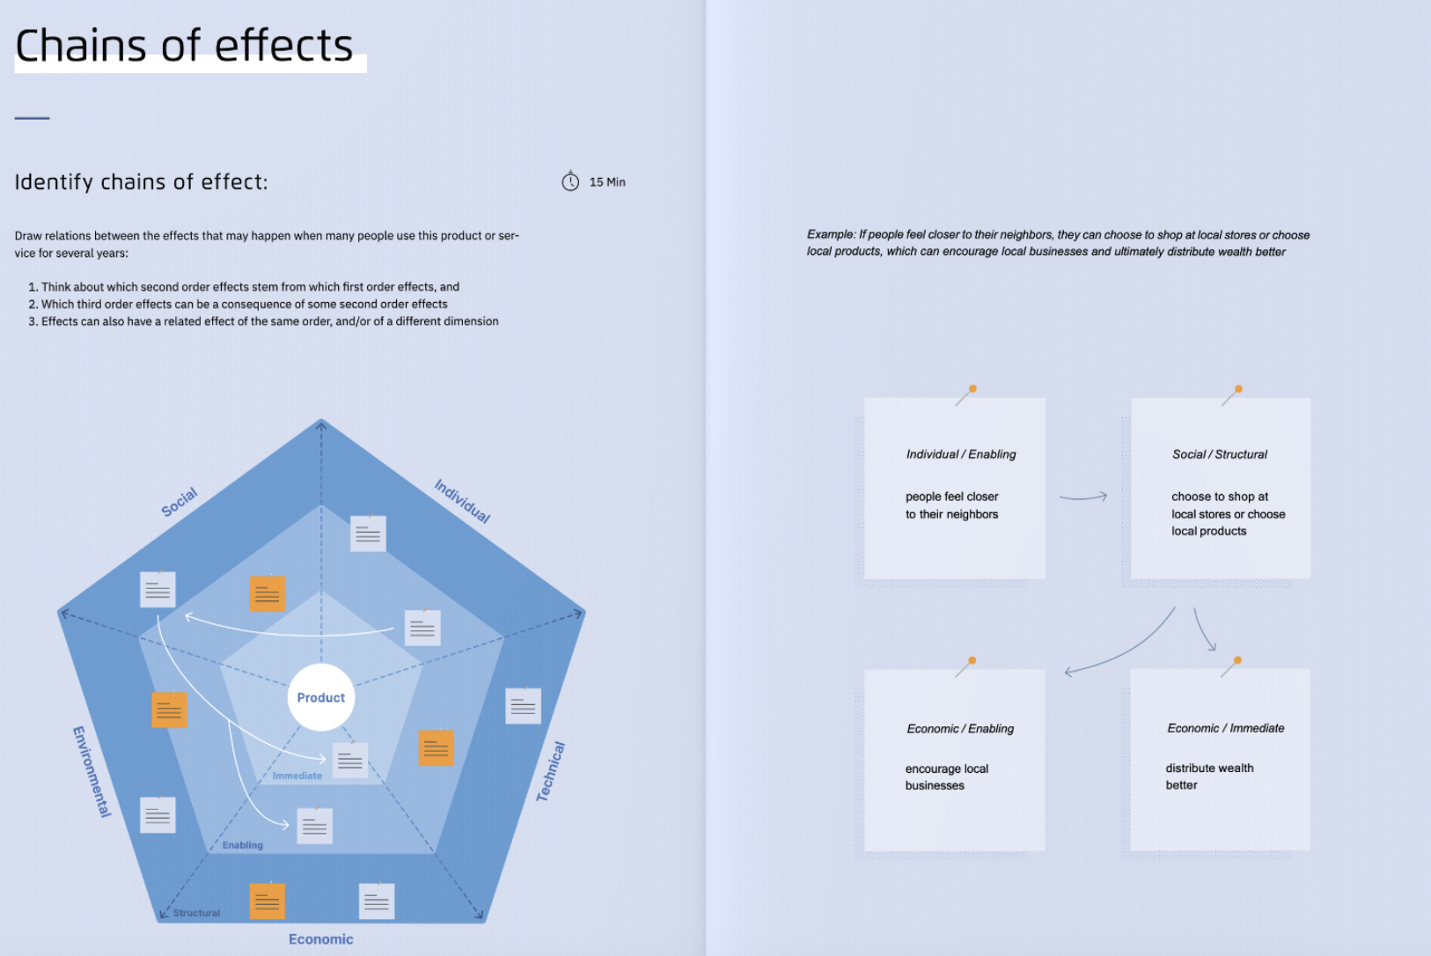
Key Elements in SusAF

Slide 17
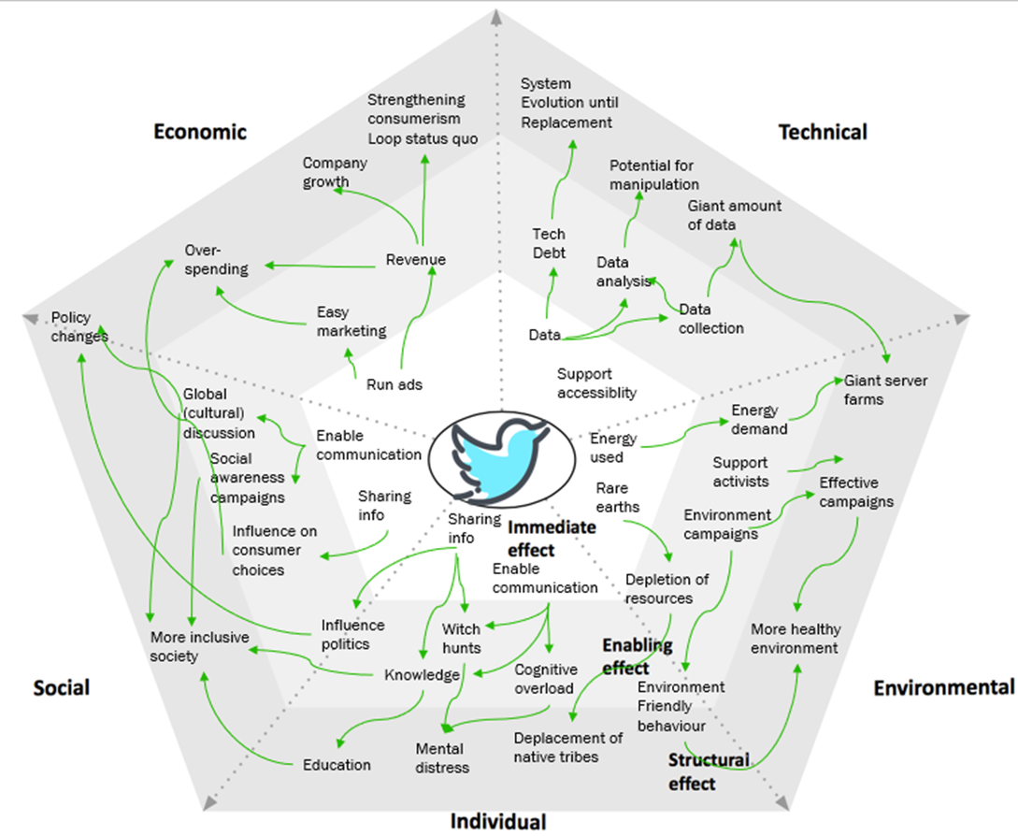
Key Elements in SusAF - Example
Analysis: SusAD
Draw a relationship between effects that may happen when people use the IT product or services or software system

Slide 18
Key Elements in SusAF
Synthesis: Threats, opportunities, actions
A structure to communicate sustainability impacts to diverse stakeholders.

Slide 19
Questions ?

