Slide 1
Sustainablity IoT Hackathon
Team Members: Petri, Saara, Ilmari, Felix, Patrik, Olli, Leevi Roles: The Code Whisperers

Slide 2
GreenGuard Smart Home System
The GreenGuard Smart Home System is an innovative, sustainable IoT solution designed to enhance energy efficiency, safety, and comfort in residential environments. It leverages various sensors, including temperature, humidity, gas, and motion detectors, to optimize energy consumption and reduce environmental impact.

Slide 3
Problem Statement
Energy Cost and Carbon Footprint:​
High electricity costs and fluctuating energy prices make it challenging for homeowners to optimize energy use.​
High demand periods can increase the carbon footprint if fossil fuels are used for power generation.​
Thermal Comfort and Air Quality:​
Homes can become too hot or too cold without proper ventilation.​
Poor air quality can affect health and comfort, but is often overlooked.​
Water Damage and Resource Wastage:​
Undetected water leaks can cause significant damage and waste resources.​

Slide 4
Solution Overview
1. Energy Efficiency:
- Automated window control based on temperature and humidity.
- Smart fan management for optimal air circulation.
- Adaptive lighting based on motion and ambient temperature.
- Automated energy usage control based on real-time electricity pricing.
2. Safety and Security:
- Gas and steam sensors for air quality monitoring.
- Motion-activated door control for enhanced security.
- RFID-enabled silent mode to avoid unnecessary alerts.
3. User Comfort and Convenience:
- Live environmental data display on an LCD screen.
- Intuitive control using physical buttons for easy operation.
- Modular design for easy integration with future smart city technologies.
4. Sustainability:
- Reduces carbon footprint by optimizing energy consumption.
- Promotes responsible resource management for a greener future.

Slide 5
Impact of Solution
1. Contribution to Smart Cities:
Energy Efficiency: Optimizes energy consumption based on real-time electricity prices.
Resource Management: Uses sensors to control ventilation, heating, and lighting based on occupancy and environmental conditions.
Data-Driven Decisions: Integrates real-time data (temperature, gas levels, electricity prices) for smarter home management.
Improved Safety: Detects gas leaks, high humidity, and motion for enhanced home security.
2. Sustainability Impact:
Reduced Carbon Footprint: Minimizes unnecessary energy use by automating appliances and lights based on occupancy and conditions.
Lower Energy Bills: Reduces costs by using appliances during low-price periods.
Waste Reduction: Uses RFID to minimize false alarms, reducing unnecessary power use.
Scalable and Modular: Easily adaptable to future smart city infrastructure with added IoT components.

Slide 6
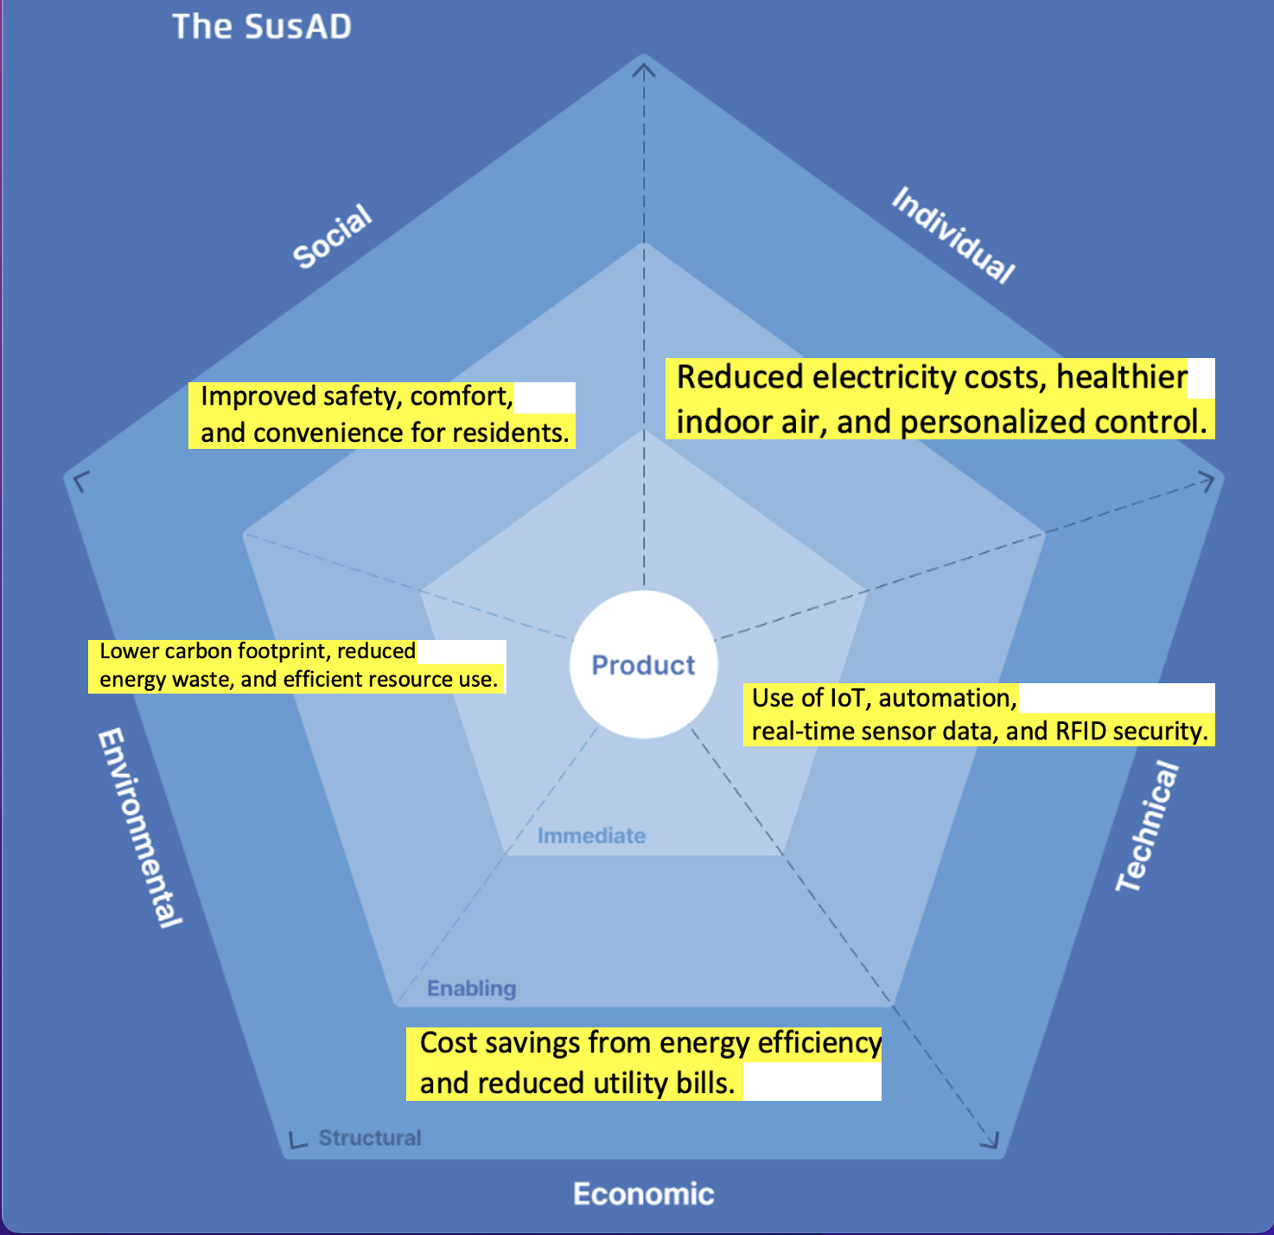
SUSAF Analysis
Key Insights from Analysis
The smart home system shows strong positive impacts in environmental and economic dimensions through energy efficiency.
Technology plays a key role in driving individual benefits.

Slide 7
Power Measurements Analysis

Slide 8
Possible Improvements
Only use WIFI when needed
Less API calls
Lower the LEDs brightness
Make a low power mode to the code

Slide 9
Reflection
Key achievements
Developed a functional smart home system prototype.
Successfully integrated various sensors and electricity price API.
Addressed the problem of high energy costs and inefficient usage.
Challenges
Time management
Getting the code to work properly

Slide 10
Takeaways
Scalability: The system can be expanded to include more sensors or smart devices.​
Integration: Possible future integration with solar power systems and battery storage.​
Data-Driven Decisions:
Real-time data allows for smarter, more efficient home automation.​
User-Centric Design: Customizable profiles for different energy usage needs

Slide 11
Future Ideas
Ad-Hoc Sensor Networks for Neighborhood Safety:
Emergency Alerts: Nearby homes can communicate to share data about fire, smoke, gas leaks, or intrusions.
Collective Security: Use mesh networks to create a neighborhood-wide alarm system for better safety.
Predictive Maintenance and Analytics:
AI-Based Predictions: Use machine learning to predict appliance failures and optimize maintenance schedules.
Usage Analytics: Provide insights on energy usage to promote more sustainable habits.
Renewable Energy Integration:
Solar and Battery Integration: Smart control for charging and discharging based on real-time energy prices.
Electric Vehicle (EV) Charging Management: Coordinate EV charging when electricity is cheapest.
Waste and Water Management:
Smart Water Meters: Detect leaks and optimize water usage.
Compost and Recycling Guidance: Use sensors to assist in proper waste segregation.

Slide 12
Future Ideas
Advanced Air Quality Monitoring:
External Pollution Alerts: Automatically close windows if outdoor air quality is poor.
Indoor Air Purification: Smart control of air purifiers based on real-time data.
User-Centric Personalization:
Learning-Based Automation: Use AI to adjust settings based on user habits.
Voice and Gesture Control: Integrate with smart assistants like Alexa or Google Home.
Extended Device Compatibility:
Matter Protocol Support: Ensure future compatibility with a wide range of IoT devices.
Integration with Smart City Infrastructure: Seamlessly connect to city services like smart grids and public safety networks.

