Slide 1
Agile Software Development
Lappeenranta University of Technology
Department of Communication Software
Code Camp on Communications Engineering CT30A9300
Saeed Mirzaeifar
Yasir Ali
Zahid Butt

Slide 2
Problem → Idea!!!

Slide 3
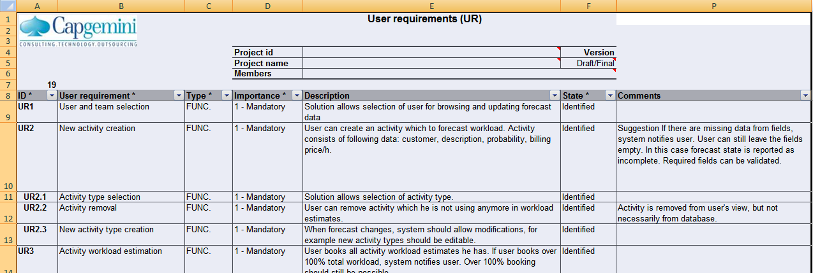
Basic Requirement

Slide 4
Agile Development → Scrum

Slide 5
User Story
As a <Consultant> I want to Maintain my workload forecast easily.
System Interfaces should be so simple so the user can make the Workload easily.
As a manager I want/can improve the usability of resources.
As a system owner I want to manage my resources by spending less money.
As a System owner I expect the interfaces should be simple and self-explanatory.
As an Owner the system should be provided easy way to forecast process.
As a manager I want to manage the changes in system easily.
As a user I will be able to view/update forecast by browsing.
As a user I will be able to create an activity to forecast workload.
As a user I will be able to select activity type.
As a user I will be able to remove particular activity. (Particular activity means not using anymore).
As a user I will be able to book activity easily.
As a user I expect from system to notify me if I exceed his total workload.
As a user I will be able to book activity weekly, Monthly, time.
As a user I will not be able to enter workload of holiday.
As an owner I expect that the system should work with concurrent user.
System can calculate and estimate the updated data from user interface automatically.
As an administration the system should be able to view activities.
As an administration the system should be able to view activities monthly, weekly, by day.
As a user I will be able to view the workload forecast for each user.
As a user I will be able to update the workload forecast for each user.
The system will be able to create groups and teams.
The system will be able to add the groups and teams it can be able to add to participated team or group.
The system will be able to log data
As a user I will be able to view history log.

Slide 6
Sprints
Sprint 1 | Status | Estimation Time | Priority
As a Consultant I would be able to log my waorkload forecast. | Done | 3 h | 1
As owner I want my system should notify user if he_she log over 100% workload forecast. | Done | 10 h | 1
As a user I want to view the activity forecast weekly_ monthly. | Done | 18 h | 2
Sprint 2
As a user I would be able to create/deactivate account | Done | 20 h | 1
As a Manager/Administrator I would be able to create teams and groups. | in Progress | 20 h | 3
Sprint 3
As a Manager/Director I would be able to brows users to view workload forecast weekly/monthly. | Done | 32 h | 2
Sprint 4
As a user I would be able to assign /crud the activity for the consultant/teams /groups. | In Progress | 7h | 2
As a manager/administrator I want to select the type of activity that I will assign to consultant/teams /groups. | In Progress | 5h | 2

Slide 7
Implementation → Demo

Slide 8
Thank you !
Questions???!!!!

