Slide 1
Code Camp on Agile Java Development(using scrum) by Capgemini - Fall 2012 Project Name: Work Load Management
Group: 4
Group Name : Jeewa
Group members:
Esa Hiiva
Alexander Fürthmaier
Mehar Ullah

Slide 2
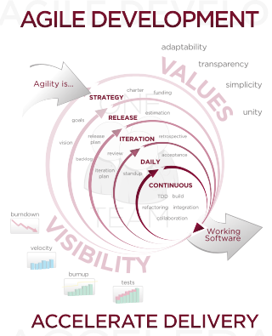
Introduction of agile development
A development method in which a group of people are working on a project by dividing the project into small pieces and then find the soultion of those pieces and at the end combine the solution of all the small pieces.
Characteristics of Agile development:
Modularity
Iterative
Time-Bound
Parsimony
Adaptive
Incremental
People-Oriented
Collaborative

Slide 3
Scrum Activities

Slide 4
Priority 1
As a user I will be, see and edit forecast on browser.
As a user I will be able to create, (edit and remove) an activity types.
As a user I will be able to create, edit and remove an activity for distinct consultant.
As a user I will be able to create weekly or monthly workload recordings for different timeframes.
As a user I will be able to update the data at same time as other user is updating data.
As a user I want my current forecast be loaded when I open forecast view.
As a user I want be able to create a report
Priority 2
As a user I want to be able to manage users and teams.
As a user I want to be able to link users to a teams
Priority 3
As a user I will be able to go over 100% workload but I will be notified if I do so.
As a user I will be able to inspect forecasts which takes holydays into account
As a user I want be able to track all changes

Slide 5
Sprints

Slide 6
Progress

Slide 7
The login screen of the application
Front view of the project user interface

Slide 8
References:
http://en.wikipedia.org/w/index.php?title=File:Agile_Software_Development_methodology.svg&page=1.
The Characteristics of Agile Software Processes Granville G. Miller rmiller@togethersoft.com TogetherSoft,
faculty.salisbury.edu/~xswang/Research/.../Agile/12510385.pd

