Slide 1
Living Labs & Product Development
Ashok

Slide 2
Living Labs
What is a living lab
Living Lab” is a term that was first used at the Massachusetts Institute of Technology (MIT), first one ran from 2004-2007 called PlaceLab (look it up!)
A research methodology that is not only user-centered but “carried by the users”
Allows the formulation, prototyping and validation of complex solutions in a multifaceted real-life environment
Defining the term
To date there exists no agreed upon definition of the concept.
It has been defined as a methodology, an organization, a system, an arena, an environment, and/or a systemic innovation approach.
It can be considered as both an environment (milieu, arena) and an approach (methodology, innovation approach).

Slide 4
Types of Living Labs
Many different types exist such as (but not limited to)
Research Living Labs focusing on performing research on different aspects of the innovation process.
Corporate Living Labs that focus on having a physical place where they invite stakeholders (e.g. citizens) to co-create innovations.
Organizational Living Lab where the members of an organization co-creatively develop innovations.
Intermediary Living Labs in which different partners are invited to collaboratively innovate in a neutral arena.
A Time Limited Living Lab as a support for the innovation process in a project. The Living Lab closes when the project ends.

Slide 5
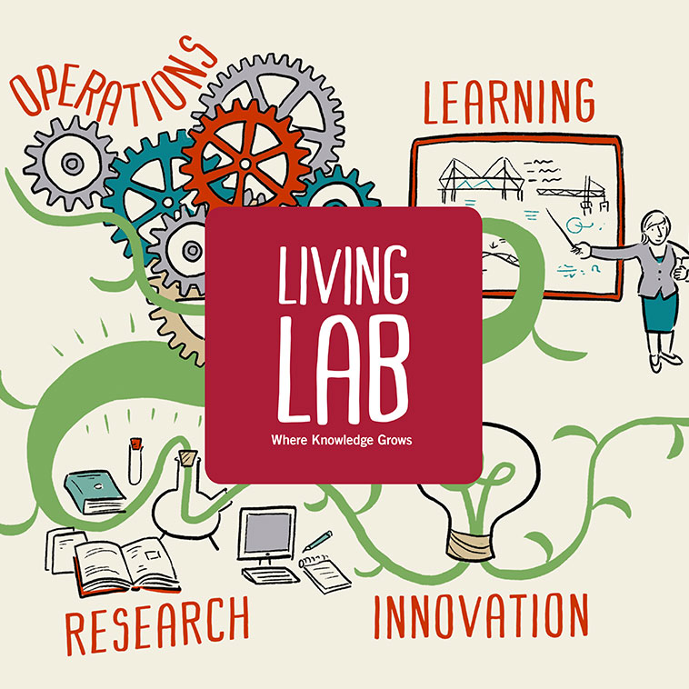

Slide 6
Living Lab Key Principles
In Living Lab activities there are five Key Principles that should, if possible, permeate all operations:
Value
Influence
Sustainability
Openness
Realism
These Key Principles are valuable since they provide
the foundation for design of Living Lab operations.
they also define what counts as a Living Lab
and how the value of Living Lab operations can be assessed.

Slide 8
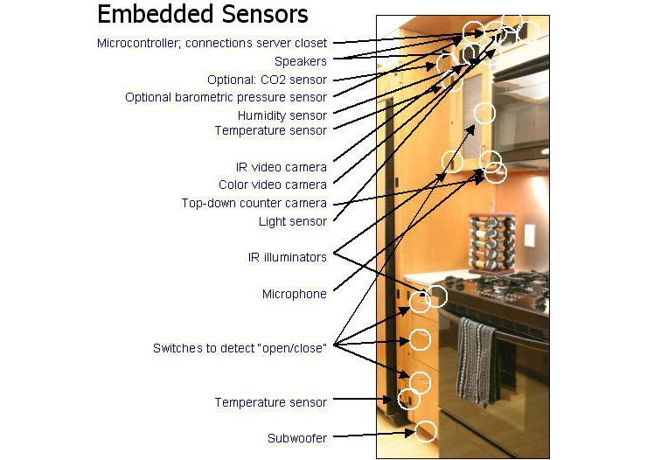
PlaceLab @ MIT

Slide 10
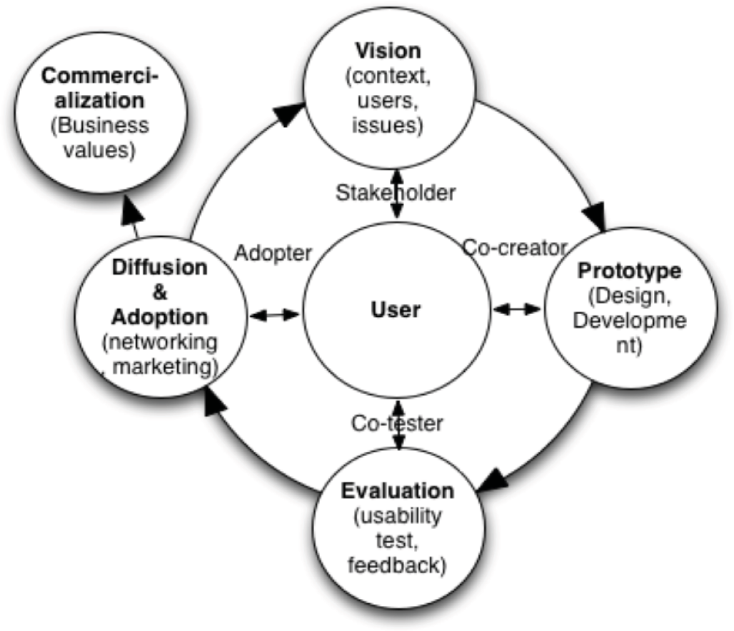

Slide 11
Universal Hearing Aid (UNI-HAID)
In 2016 a group of students of LUT had an idea:
To turn a smartphone into a hearing aid with an application
The group worked hardon the idea during the summer, won and succeeded in business idea competitions in Finland
Turned into a funded research project in LUT until 2018 (Q4) and a potential incubator (funder: Business Finland, Finnish Funding Agency for Innovation).
Achievements: Willi Idea 2016 winner and University Startup World Cup 2017 award winner.

Slide 12
Evolution

Slide 13
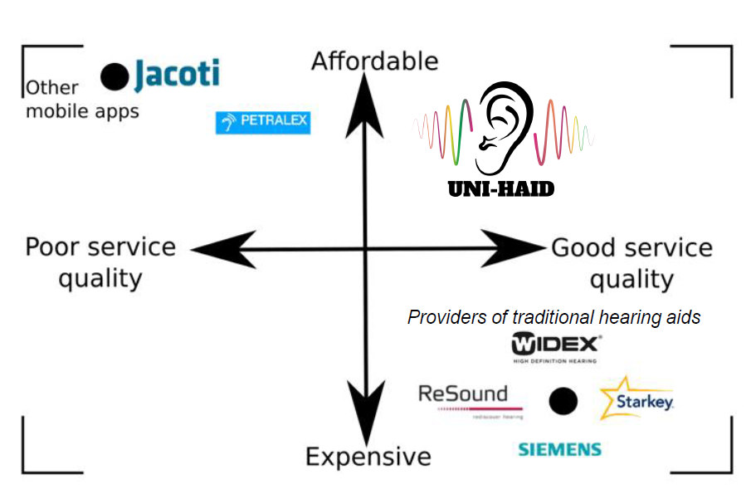
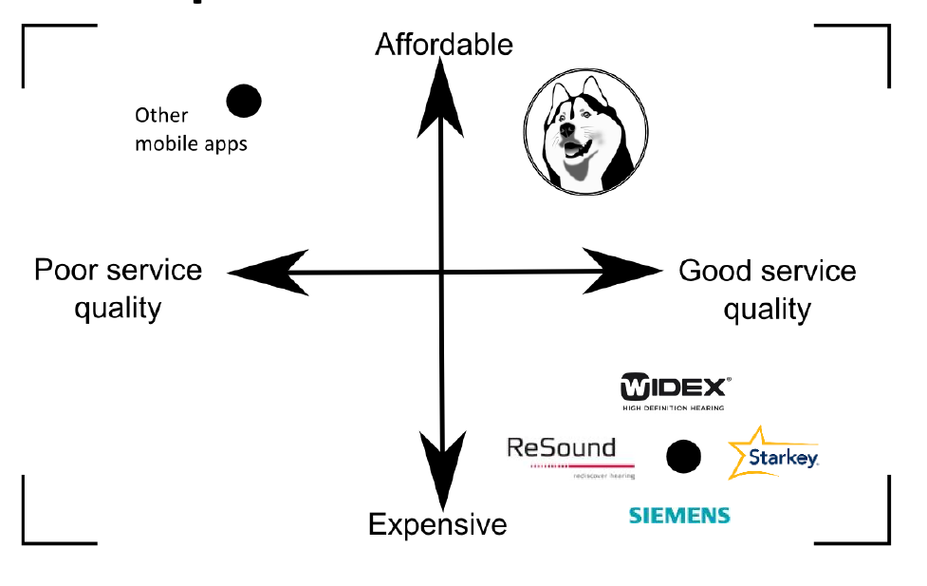

Slide 14
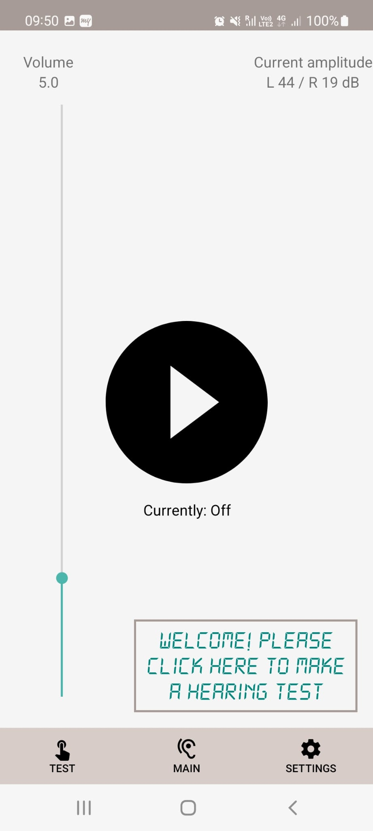
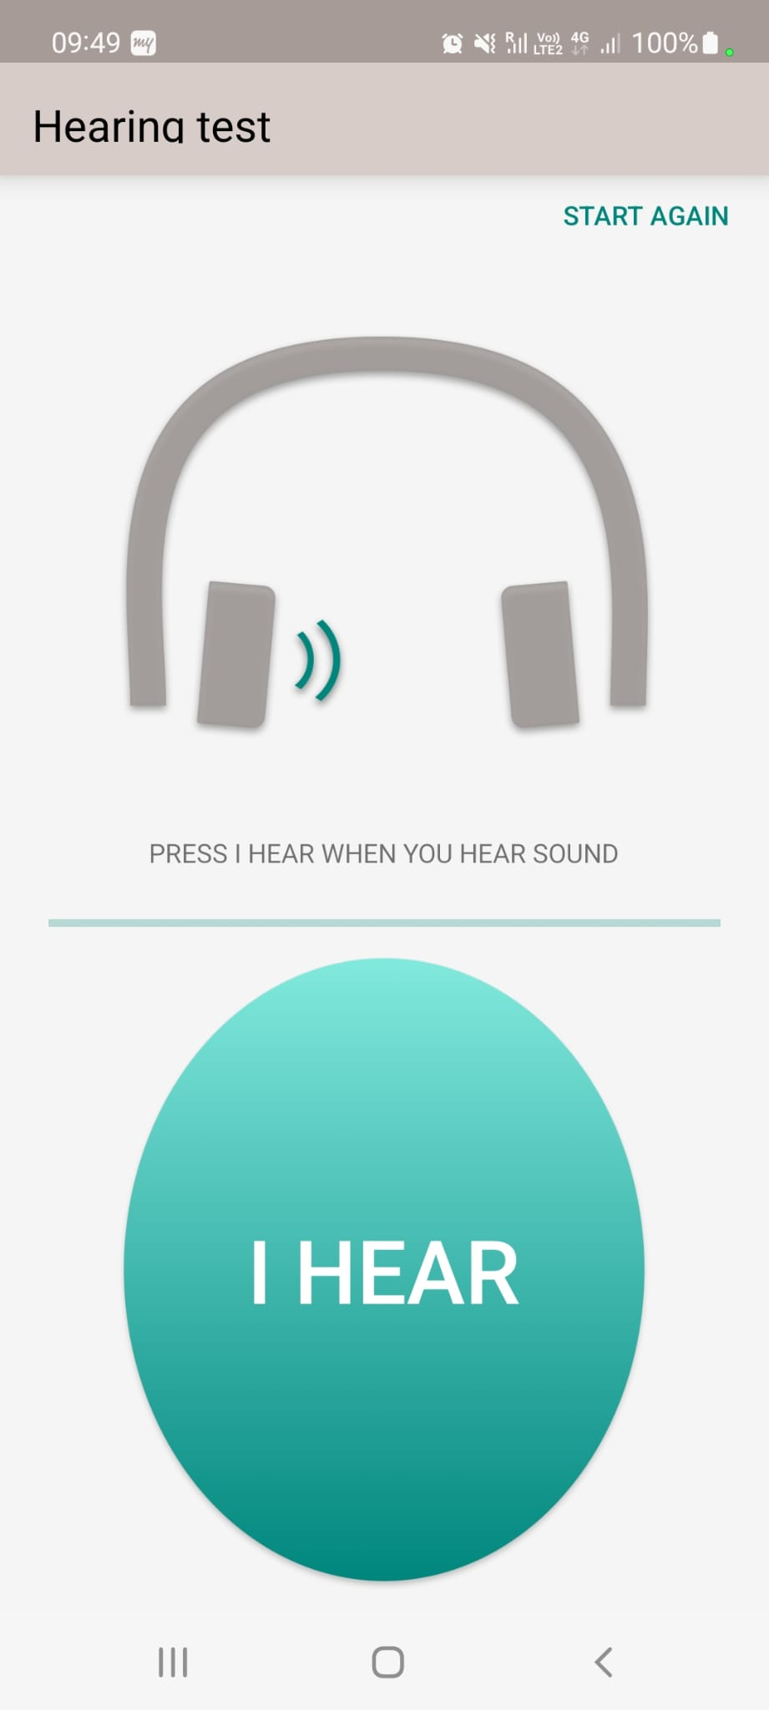
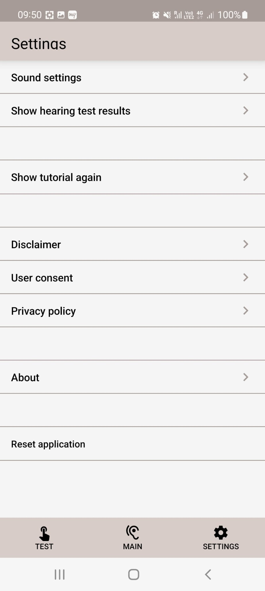

Slide 15
UNI-HAID Team
@ start
@ conclusion
Esa-Petri Tirkkonen (Lead, dev)
Igor Soroka (dev)
Michal Micor (dev)
Ashok (AI)
Esa-Petri Tirkkonen (Lead, dev)
Michal Micor (dev)
Svante Kärkkäinen (business, accounts)
Marina Kovshova (UX)
Filipp Semin (dev – threads)
Mikhail Kondra (dev)
Ashok (dev, quality)
Simo Keskinen (business consulting)
In addition, team had the backing of a support staff and steering group of professionals at LUT, including Jari Porras, Antti Knutas, Victoria Palacin Silva and Tarja Nikkinen.

