Slide 1
Using technology as a tool: How to engage relevant stakeholders?
Dr Sanaul Haque
LUT Software Sustainability Research Group

Slide 2
LUT Software Sustainability Research Group team engagement activities
Prof. Jari Porras
Post Doc Sanaul Haque
Engagement
Doctoral student Abdul-Rauf Abdullai
Ecosystem modelling
Doctoral student Ashok Tripathi
Living labs and ecosystems
Doctoral student Inna Sosunova
Smart cities
Doctoral student Mikhail Ola’Adisa
Participation

Slide 4
Engagement?
Engaging users/stakeholders is a priority to design services (Doherty and Doherty, 2018).
It is therefore important to understand users’ and other stakeholders’ experiences which has motivated a focus on stakeholders’ engagement

Slide 5
Stakeholder engagement in building a service/app
Sustainable behavioural change solutions (e.g., low-cost, climate friednly etc)
Stakeholders needs and feedbacks
Iterative approach e.g. design thinking
Social interaction (community)
Peer-review based on feedbacks

Slide 7
What affects engagement and empowerment?
What affects citizen/stakeholder engagement?
Aham-Ayanwu et al (2017) highlighted factors that affects citizen engagement (attributes of the contents, the perception of the writer, information need, trust in government, and citizens' affinity for governments’ online platforms)
Farina et al (2013) stated that citizen participation is grounded on three pillars of open government (transparency, participation, and collaboration).
Tran et al (2014) proposed a framework that incorporates the Information System (IS) Success Model with fundamental concepts of information transparency and Trust Theory, to explain citizens’ e-Participation
What affects Empowerment
Alathur et al (2011) examined whether citizens’ empowered status influences their online democratic participation. They suggested two stages of citizen empowerment in the online environment: citizens are empowered for e-democracy participation and citizens are part of the decision-making process.

Slide 8
Service/app based on theoretical constructs and models!
For a long-term sustainable solutions

Slide 9
Social-ecological system (Andeies et al. 2004)
A social-ecological system can be defined as a coherent system of biophysical and social factors that regularly interact in a resilient and sustained manner (Redman et al. 2004)
Biophysical: The study of living things (e.g., human) using the techniques of physics (e.g., an app)

Slide 10
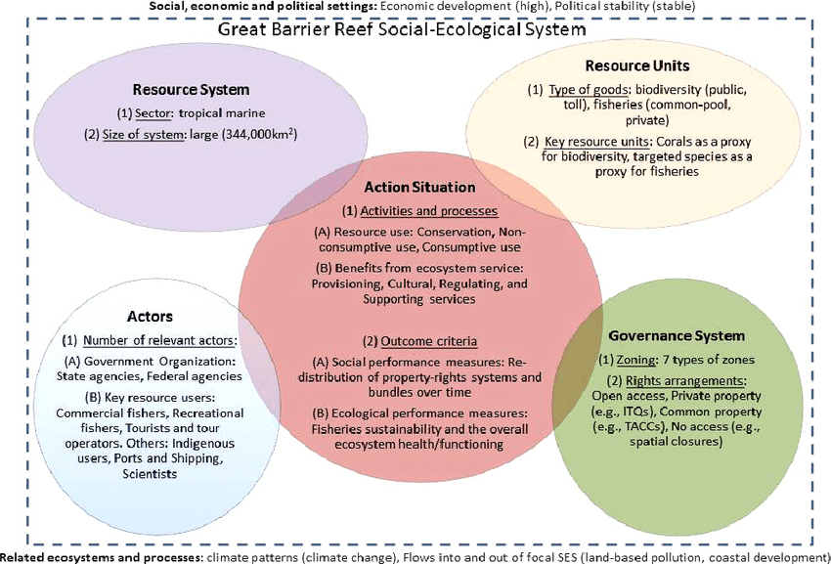
SESF
Adopted from Ban, 2015

Slide 11
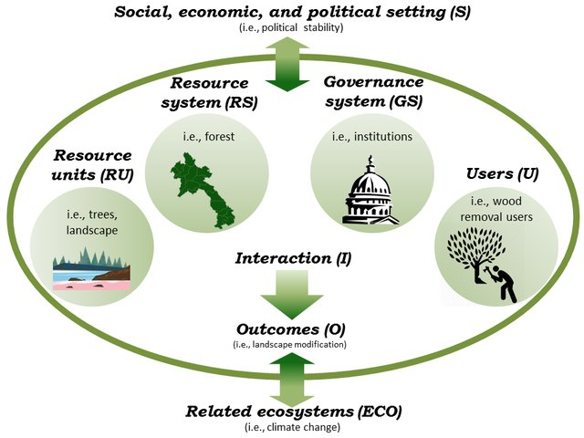
SESF: Ostrom (2004), and McGinnis and Ostrom (2014)

Slide 12
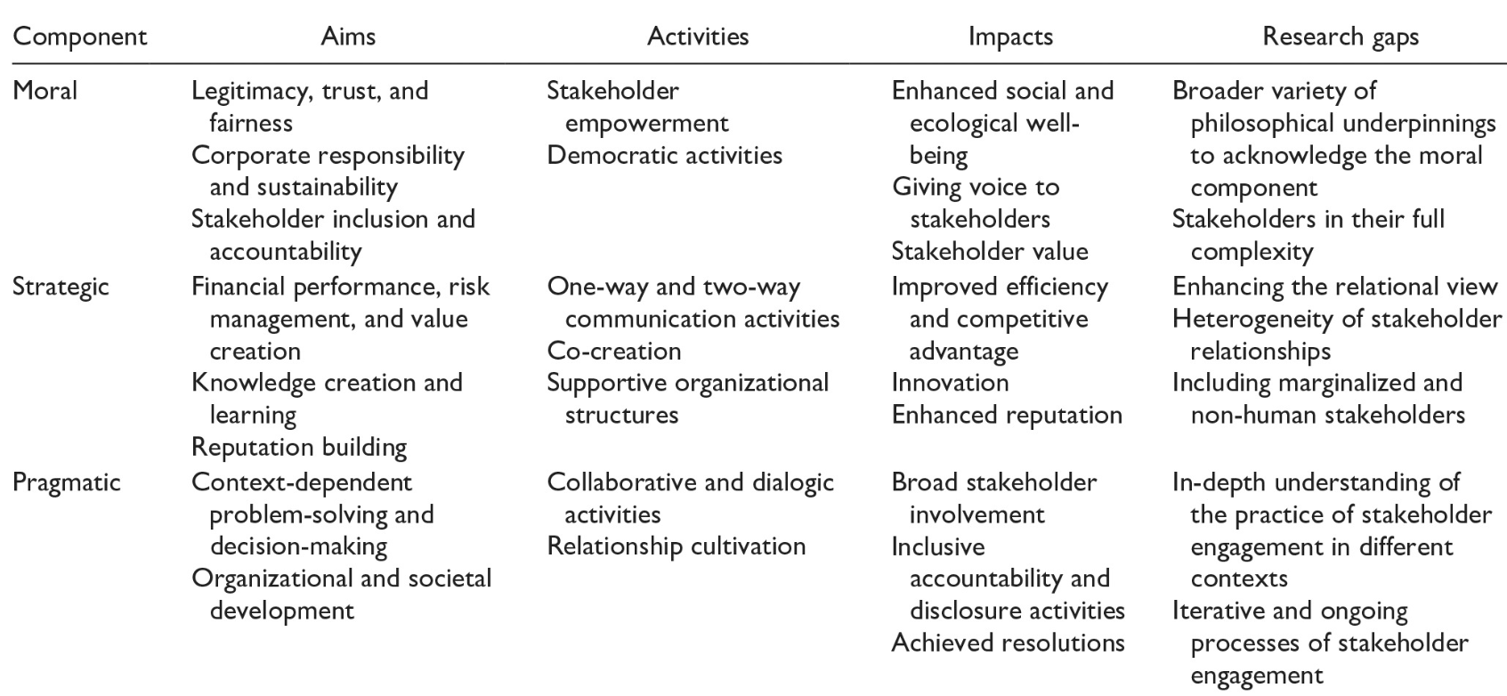
Guide for stakeholder engagement
Adopted from Kujala et al. 2022

Slide 13
Some questions on stakeholders engagement
What is the level of engagement in a service like your app? such as online, offline engagement, one-to-one interviews, questionnaires, workshop surveys, social media interaction etc,
How to evaluate these Levels of stakeholders’ engagement?
What are the core elements (Elements = context, personal interest, fun…?) that affect participation and engagement in an app like yours? What would persuade you and how/why?
Does your app create impacts to motivate you to participate in this service design?
What trust-related concerns would you have regarding your app? How do you think trust will influence people’s engagement with your app?

Slide 14
Organized live study event on March 29, at DNDP Workshop, Doha, Qatar

Slide 16
Engagement level

Slide 17
Towards proposing a stakeholder engagement model

Slide 20
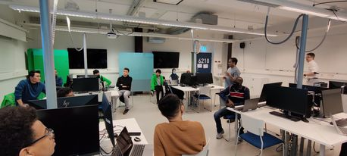
Now it is your turn to proceed!

