Slide 1
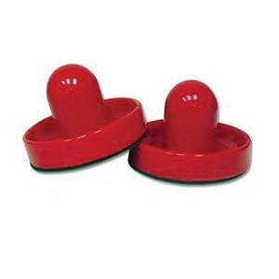
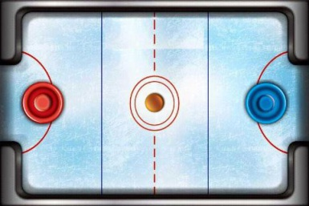
Air Hockey
Group 3
Rasmus Halsas
Tatu Huttunen
Poorang Vosough

Slide 2
Idea + Motivation
AirHockey
Bubble Explosion
Rally
To develop a game which can be published in the market.
To learn
XNA/Monogame
Game development

Slide 3
Technologies
C#
XNA/Monogame
Visual Studio 2012
Windows 8

Slide 4
Game features
Main Menu
Settings
Time (5,10,15 mins)
Goals (4,8,10 goals)
Game environmnt (Hockey, Soccer)
Game
Game over

Slide 5
Game engine and physics
The engine developed based on Pong Clone
example.
No additional libraries were used in the game
engine.
We implemented all physics for the game engine.

Slide 6
In the future
Prepare the game for publishing.
More testing for bugs.
Add more features and effects.
More environments
Environment affects the game engine.
Providing 4-player mode.

