Slide 1
Open Data Code Camp
Group 5: GreenPackTage
Members: Shola, Ornela, Dagnachew, Jonathan

Slide 2
Problems:
Local farmers are not well referenced
Difficult to find them on Internet
Time consuming process
Motivations:
65,300 farms in Finland (almost private)
Awareness of food’s contents
Saving some money and a lot of time
Buying local and fresh products
Supporting local economy
Farmers: benefits + recognized
Reducing CO2 footprint

Slide 3
BioFood’s goals:
Gathering all local farmers into one place
Giving to users facilities to buy local food
Farmers can add their products and information
Showing the nearest products matching the user’s request
Giving to users information about CO2 footprint
Giving to users the ability to rate and leave a feedback for a product and/or a farmer

Slide 4
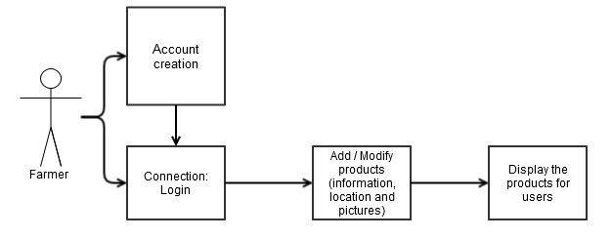

Slide 5
“Node Cellar” is a CRUD application with:
Backbone.js
Twitter Bootstrap
Node.js
Express
MongoDB
The application allows you to:
Browse through a list of bio products
Add products / Update products / Delete products
Constraint:
Due to time constraint it was difficult to find open data for farmers in Finland > data were gathered from several sources online to form bases for data used.

