Slide 1
GRP4
Jarkko Pulli
Lauri Kyttälä
Petteri Pesonen

Slide 2
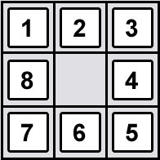
Idea 8-puzzle game
Time / Move
NewGame
Exit
Instructions
HighScores
Device Movements
Picture replacing the numbers

Slide 3
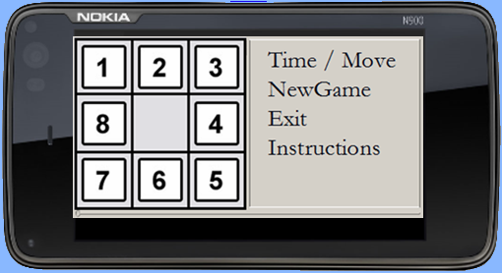
Idea 8-puzzle game

