Slide 1
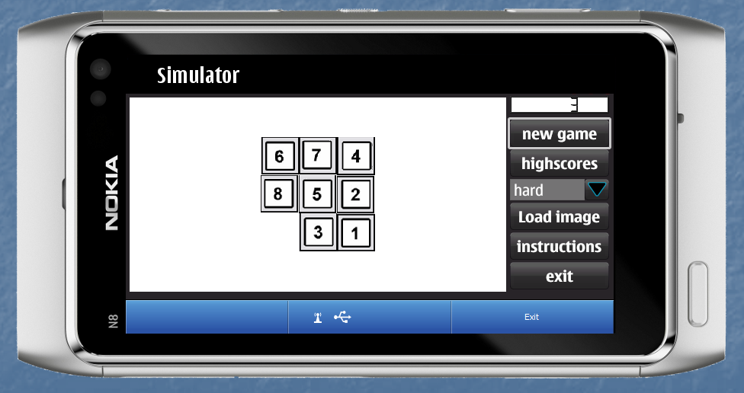
8-puzzle game
Jarkko Pulli Lauri Kyttälä Petteri Pekonen

Slide 2
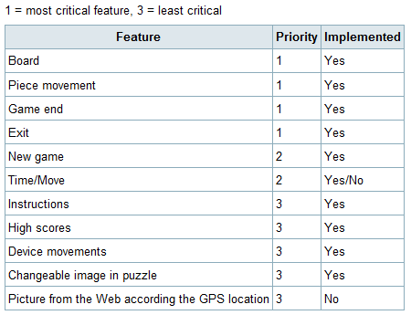
8-puzzle game

Slide 3
Qt Coding Experiences
Pros: Diverse library functions
Cons: The difficulty to ”find the most suitable” way to accomplish different tasks
Time was a showstopper

Slide 4
Jump to Demo

