Slide 1
LOVE CALCULATOR
GROUP 6
PARAM JYOTHI MARILLA
SIDHARTHA YALAVARTHI
JALAMADUGU RAVITHEJA

Slide 2
Idea
Everyone knows that a name can tell about the person and their behavior. Names are not randomly chosen they all have a meaning.With love calculator you can calculate the probalility of a successful relationship between two people , it is effective way to get an impresssion of what the chances are on a relationship.
Solution
To get an impression of what the chances are on a relationship.

Slide 3
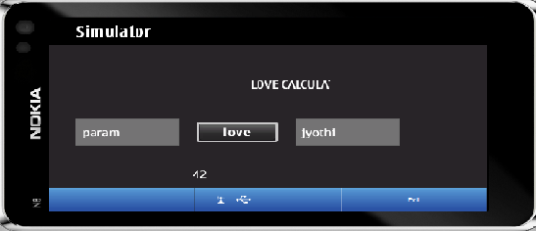
Features
Take two persons name
Calculate the percentage of love
Display the result

Slide 4
Coding Experiences
API’s made learning easy.
QtSimulator was impressive
Showstopper was Time
Jump to Demo

