Slide 1
EveryWalk
By: Kookospähkinät

Slide 2
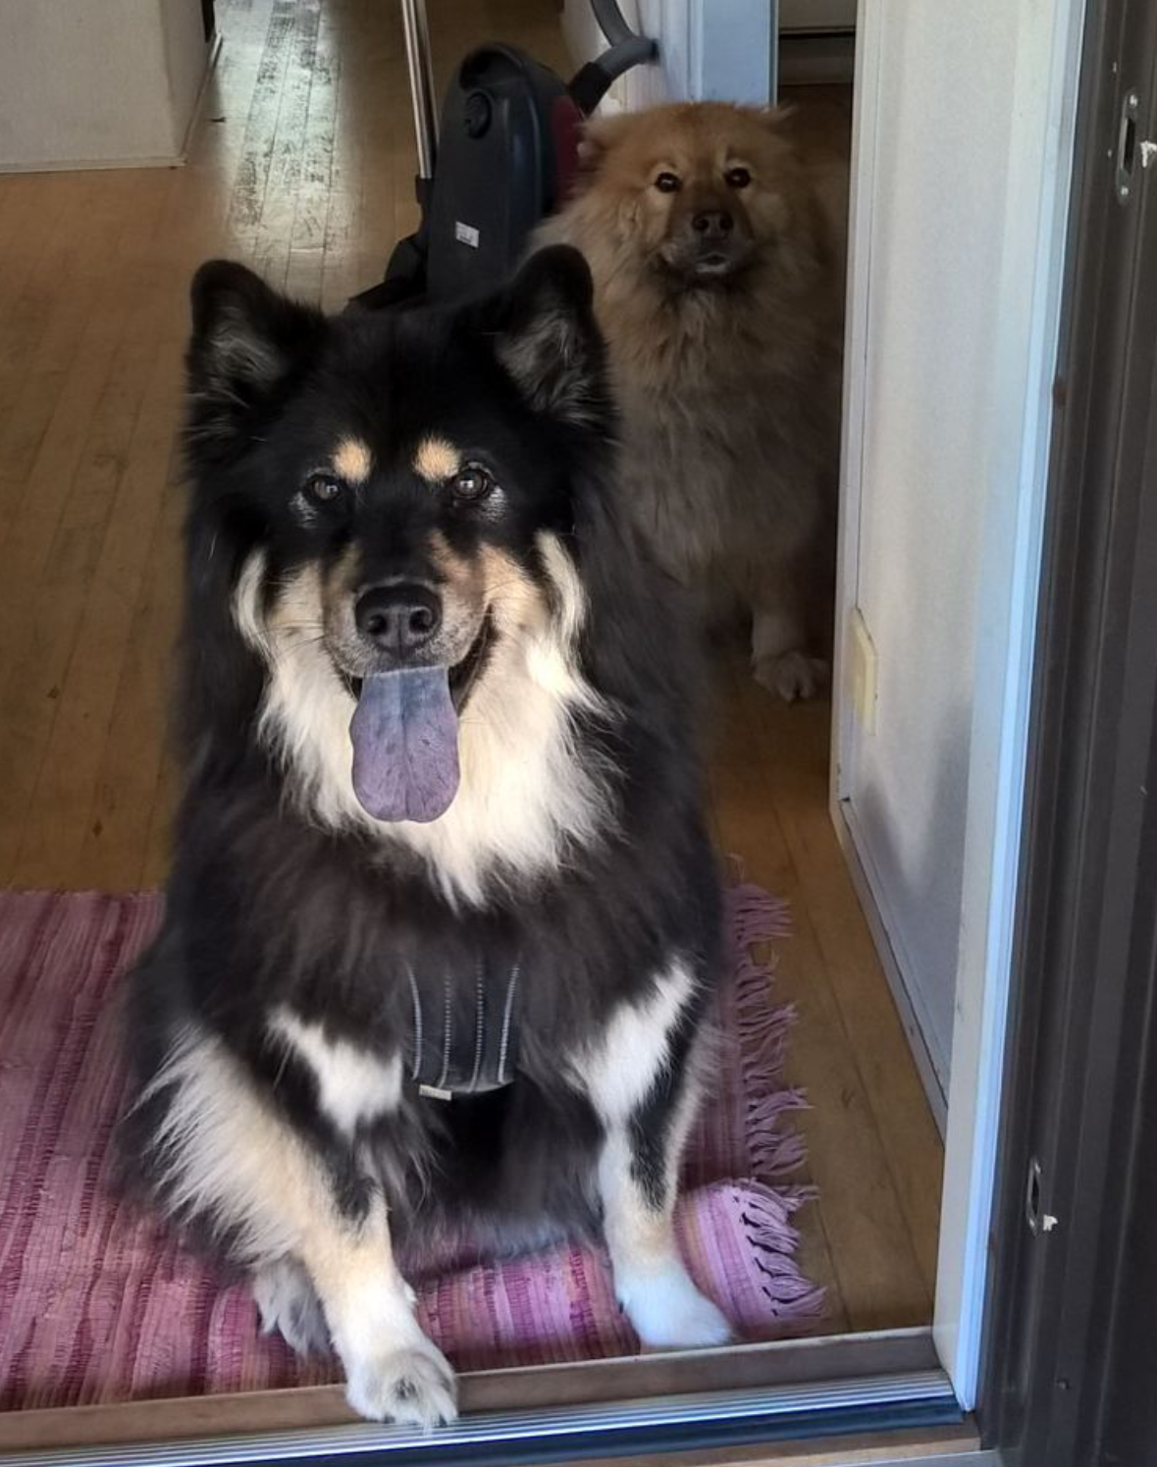
Overview

Slide 3
Overview
List of Dogs
Create new dog profile
Browse dog walkers

Slide 4
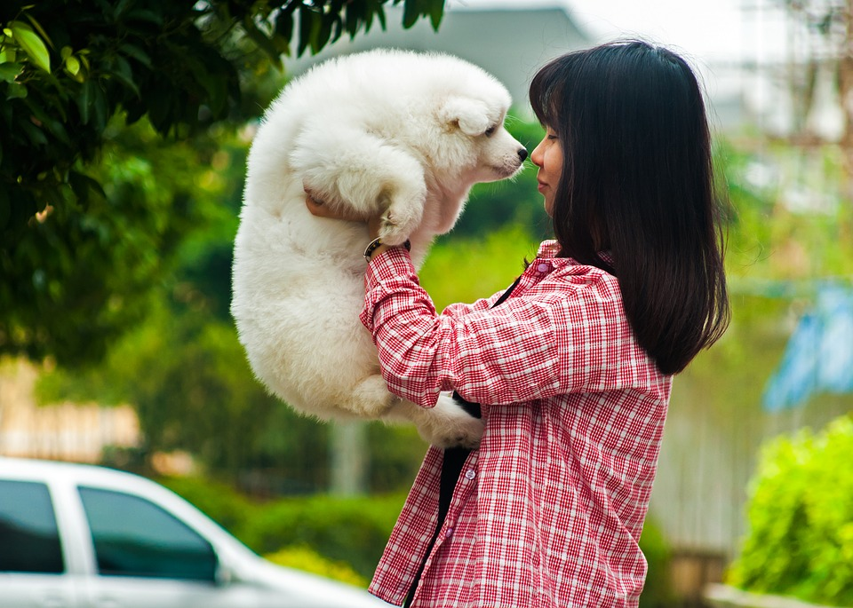
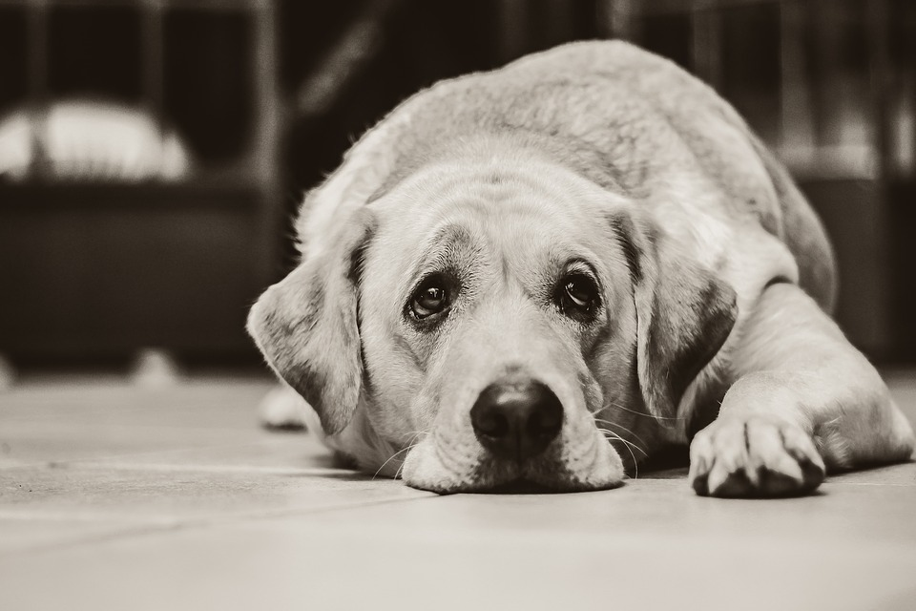
Customers and business

Slide 5
Camilla – Designer
INTRODUCING THE TEAM
Search filter settings
Visual design

Slide 6
Joel – Back End Development
INTRODUCING THE TEAM
Database
Login/Logout

Slide 7
Matia – Front End Development
INTRODUCING THE TEAM
React Master

Slide 8
Harri – Quality Assurance
INTRODUCING THE TEAM
Search filter settings
Visual design

