Slide 1
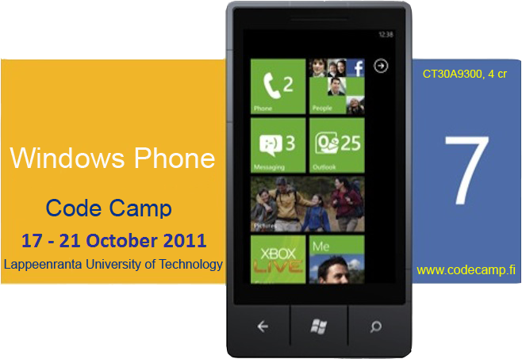
Librarian
Mihai Iusan
Camilo Cifuentes
Valtteri Kekki

Slide 2
Idea
Help people to find books that they need
Centralized searching in multiple libraries
Show the book position on the map

Slide 3
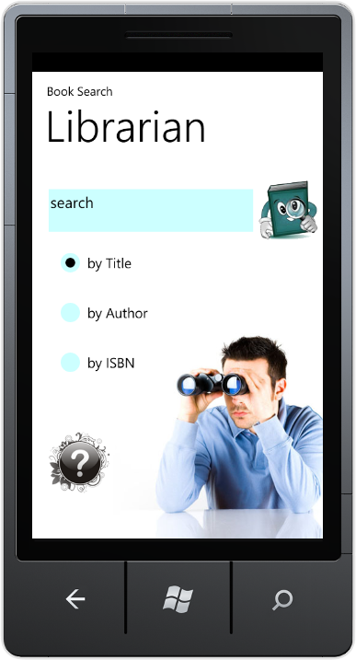
Motivation
Finding a book can be a headache
The book might be closer than you think
Time consuming search over internet
for the book

Slide 4
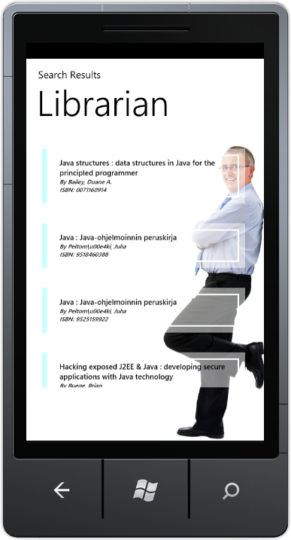
Solution
Search multiple libraries simultaneously
Use Open Data
Book position on the map
Show book status

Slide 5
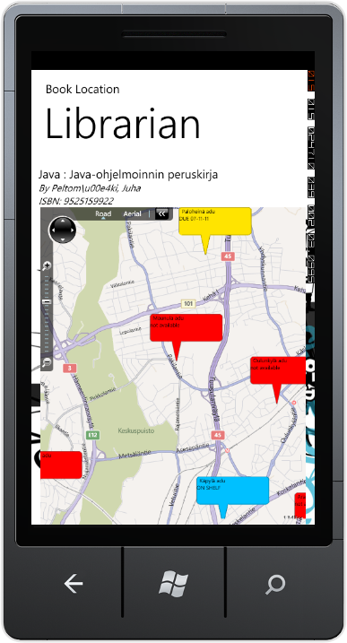
Demo

Slide 6
Technologies

