Slide 1
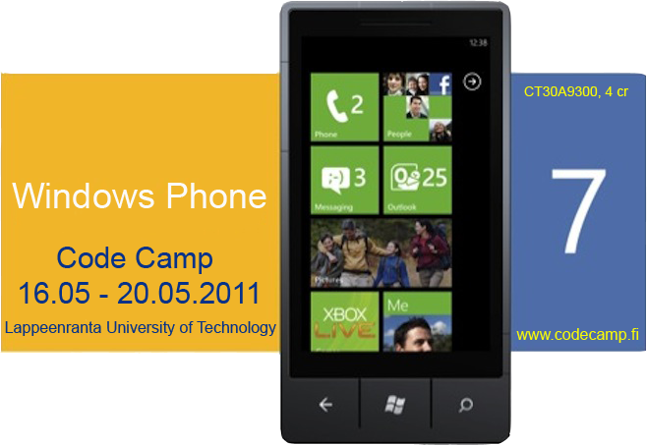
Dev4Fun
Mihai Iusan
Camilo Cifuentes
Alex Ovcharenko

Slide 2
Idea
Motivation
people just get bored
what can they to do?
Answer: Create a game!!!
Killing time
Improving reactions
Observation
Competitive attitude

Slide 3
FindIT is a game that satisfies all our needs
Rules:
You need to find specific objects on a grid
The object is specified on the top of the grid
Pressing a wrong object will decrease your time
The game ends when the time runs out

Slide 4
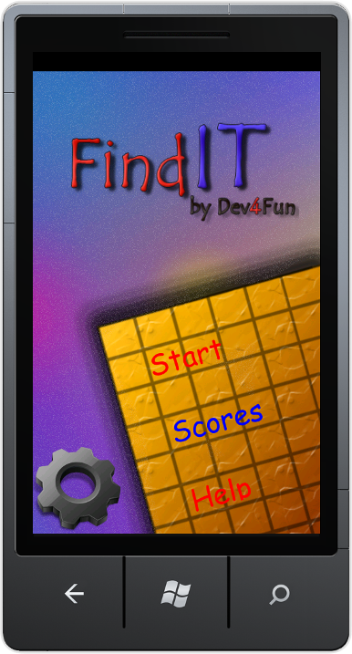
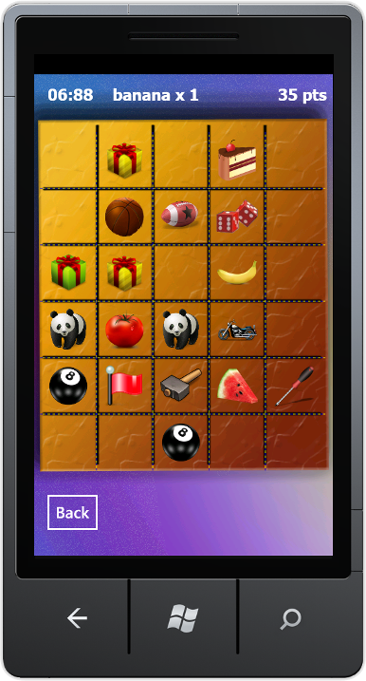
Demo

Slide 5
Further improvements
High scores into the cloud
New levels
New themes
Shake for changing figures
More animations

Slide 6
Technologies

