Slide 2
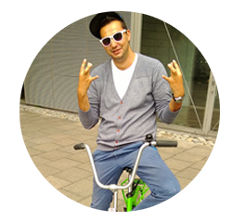
HELLO!
I’M DRAZEN
Microsoftie
Technical Evangelist
email
drazend@microsoft.com
phone
+358 40 1970 505
blog
diggthedrazen.com
twitter
@DiggTheDrazen

Slide 3
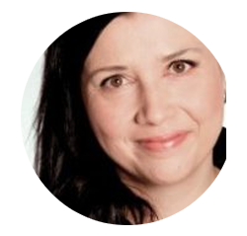
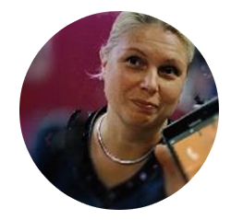
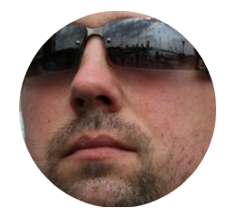
AND THIS IS
DPE
MIKA
(FEARLESS LEAD)
TARJA
MERETA
TERO
(APPS & STARTUPS)
(MARKETING)
(TOOLS)
JUKKA
JUHANI
DRAZEN
(WINDOWS)
(AZURE)
(PHONE & ACADEMIC)

Slide 4
THE
AGENDA
Time | Topic
9:00 | Welcome & introduction
9:10 | What makes an kickass app - recap
9:40 | HTML5 templates and examples
10:00 | Time to get jiggy
12:00 | Lunch

Slide 5
WE
APPS

Slide 6
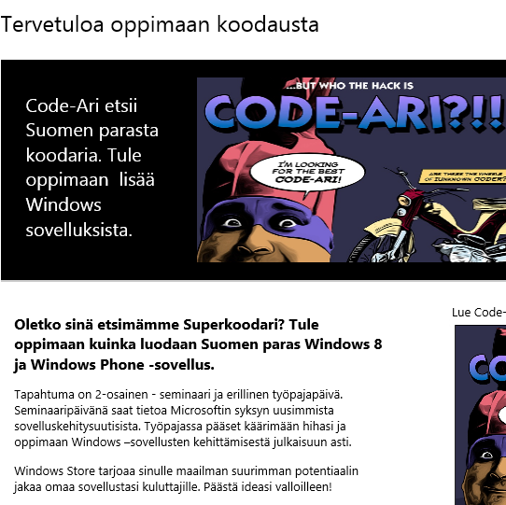
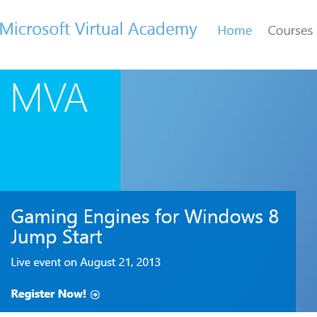
EXPRESSING OUR
LOVE
microsoft.fi/app
MSDN Flash -newsletter
Microsoft Virtual Academy
Local app news, events and campaigns
Newsletter for Finnish developers
News and local activity
Free quality training for developers

Slide 7
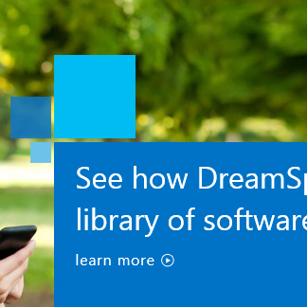
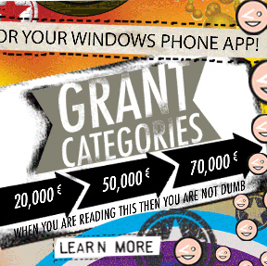
HELPING YOU BE AMAZING
DreamSpark
BizSpark
AppCampus
Offering for students
Tools, developer licences
For startups
Tools, developer licences
Azure time
Funding for innovative Windows Phone apps

Slide 8
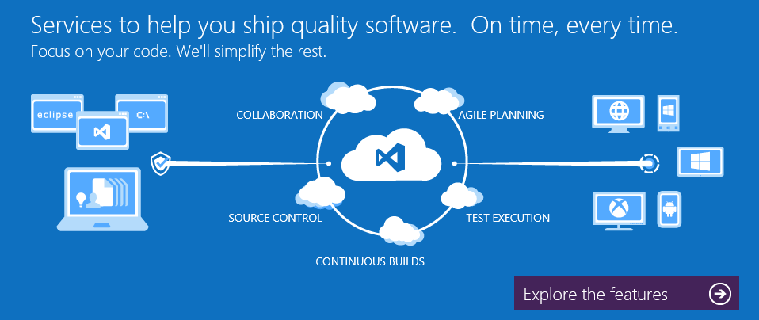
TFS SERVICE

Slide 9
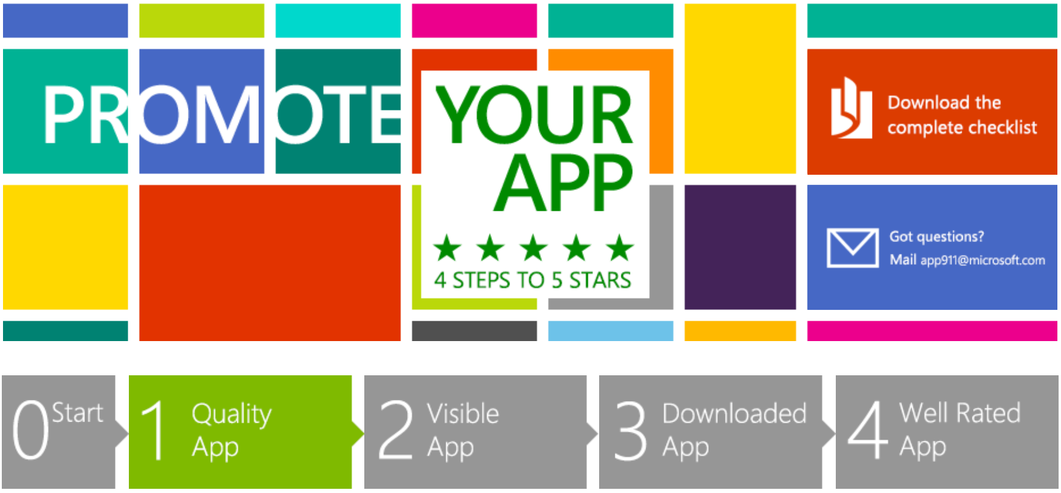

Slide 10
Plan your App
Think
Why would a user want to use your app? What is your app good at? You want to make something people want to use.
Create purpose
Some of the reasons why someone would use your app:
Makes something easier – buying shoes, watching a movie, finding a house you want to buy, etc.
Valuable information – sports scores, stock prices, subway schedules, lake conditions for fishing, etc.
Pushed information tailored to your interests – notice of a deposit to your account, the expiration of an auction where you are the high bidder, etc.
Fun and entertaining – games, Location Based services, Augmented Reality, etc.
Saves money or saves time – like Couponing Apps.
Solving a problem – you need to earn the place on the users’ device.
Make people happy
Usefulness alone will not make a great app: is the app a pleasure to use? Is it at least easy to use and understand? Do users love it? Really?
Be original
How many clones do we see in the stores? Be bold and DO try something new! Up to you to assess what is missing on the app market and make your idea a reality. What you need is a twist that makes your app special, different, original.
Notes:
Part 1 Quality app
It all starts with a quality app. But how can you make sure your app is good quality? Use this checklist!

Slide 11
Plan your App
Plan
Planning ahead for different form factors, accessibility, monetization, and selling in the global market can reduce your development time and make it easier to create a high quality app and get it certified.
Design
Use the Windows Store user experience guidelines and design patterns. It makes it easier for you to design an app that’s attractive and easy to use. Use the UX checklist.
First impression counts
Apps need to strike a positive cord, immediately. If a user’s initial experience is positive, then they’ll want to use the app again.
More about planning your app.

Slide 12
Design for a global market
Think outside of your country
Don’t only think of your own language and culture. Go global. Check out the Guidelines and checklist for globalizing your app.
Make your app inclusive.
Make sure your app can be used by everyone:
Do not use technical jargon, abbreviations, or acronyms.
Avoid culture-specific text or images.
Display numeric values, names, and addresses appropriately for global markets.
More on Designing for a global market.

Slide 13
Plan for quality and certification
Do some reading
Check the Windows Store Certification Guidelines.
Validate and test
To give your app the best chance of being certified, validate and test it on your computer before you submit it for certification and listing in the Windows Store. Use the Windows App Certification Kit (Windows ACK).
More on quality & certification.

Slide 14
Visible App
Description is not optional
Discoverability is key to organic growth. That means great screenshots & feature bullet points. And why not show people using your app? It’s all about the feeling of using the app/product. Give your users a clear picture – are they going to use the app outdoors, at the office, in the kitchen? During the day or at evening time? In a crowded place or by themselves?
Check how your app will appear
Each app has its own listing page in the Windows Store using info that you provide when you submit an app. Search engines such as Bing and Google will point users to this page. So make sure it looks good, check out these App appearance tips.
Choose the right Store category
Choose the category that best describes your app. Then choose a subcategory, if there are any for your category. An app can only be listed in one category (and one subcategory, if available.) Overview of categories.
Choose your markets & language
If your app is globally relevant: go global and go English! Choose wisely, tips here.
Notes:
Your app is written…now what? Now it’s time to make sure your app is 100% visible in the Windows Store. Check out our handy tips & tricks to make sure your app stands out!

Slide 15
Downloaded App
Share! Share!
One tweet is not enough. Repeat the message on all your social channels. For Twitter, make sure you use #WP8 for phone apps and #win8 for Windows 8 apps.
Link to your app
Point customers to your app by linking to your app’s listing page in the Windows Store and on the web. Use it as an email signature, tweet it and…why not create a Facebook Page? Read about getting links for your app.
Use our logos
Use our logos to promote your app. Check out the logo page.
Use tools
Use tools like AdDuplex, a cross-promotion network specifically targeted at Windows 8 and Windows Phone apps and games. It empowers developers to promote apps for free by helping each other.
Notes:
Part 3 Downloaded app
Your app is in the Windows Store. Now it’s time to get your app downloaded. One tweet is not enough. Aside from making your app the best it can be, there are things you can do that make it easy for others to showcase your app and help it get more attention.

Slide 16
Downloaded App
Build on previous work
If you already have a website, blog, or an app, cross promote to help your new app build on your past successes. The products don’t have to be related, but to the extent you already have a platform, use it!
Leverage the social network
Whoever your contacts are, share your app with them and make it easy for them to spread the word. Better yet, design your app so that people can interact socially within it. When friends need to use an app with their contacts to get the most out of it, you can get a ton of natural, built-in referrals.
Encourage users to promote your app
For example, after 2nd start of app, you could ask your users “Do you like this app? Why not share it with friends?”. Social app marketing – engagement based on social elements, like users inviting friends to use a mobile app via a social network - is the number one tactic in getting more downloads.
Check out more app promotion tips

Slide 17
Well Rated App
Encourage users to review your app
For example, after 5th startup of the app, ask the user for a review. You can find ready made code to use in your Windows 8 app right here and Windows Phone over here. Some tips:
Don’t be annoying!
Disrupt the user as little as possible
Make rating the app as easy as possible.
Prompt at every update.
After the user has reviewed, thank him and ask to share the enthusiasm on social networks, like for example Facebook, Twitter, or LinkedIn. Have your users spread the word is the most powerful tool you have at hand.
Incentivise reviews
A simple way to generate ratings and reviews is to incentivize users. In other words, reward users for rating your app. You can think about coins, points, new levels or new pieces of content that are ‘unlocked’ when the user rates your app.
Praise publicly, criticize privately
Keeping negative feedback out of the Store while helping disgruntled customers. You can think about integrating two options in your app, “Send Feedback”, and “Send Love”. Send Feedback opens up a screen which looks and feels like a review, but sends an email directly to the developer. Send Love takes you to the app store for a review.
Take feedback seriously
Ensure that you take the user feedback very seriously and act on it to improve your chances of sustaining top ranks on the Store!
Notes:
Word-of-mouth and user reviews are critical for floating up an app in searches while positive reviews increase the likelihood of downloads – both organic and inorganic. Apps designed to encourage or simplify user review submissions are likely to see more success when it comes to leveraging user reviews for driving downloads. Highly rated apps will also pop up first when a user sorts search results on ‘Sort by highest rating’.

Slide 18
ONE STEP FURTHER
Do you have the best app in the field? Innovative, fresh idea that you will launch to international markets via Windows Store? Then do not hesitate to submit it for the Finnish App Awards 2014.
Nominees will be tested for their app idea by jury of experts. The winners will be announced on April 2014 at The App Awards Gala in Helsinki.
Selected nominees will get during 2013 and 2014 high media coverage and opportunity to win ultimate App of the Year 2014 –award! Prize is an amazing marketing, pr and advertising sponsor deal with Microsoft, Nokia, AppCampus and Miltton.
www.microsoft.fi/appawards

Slide 20
http://www.youtube.com/watch?v=V2mPGB9k018

Slide 21
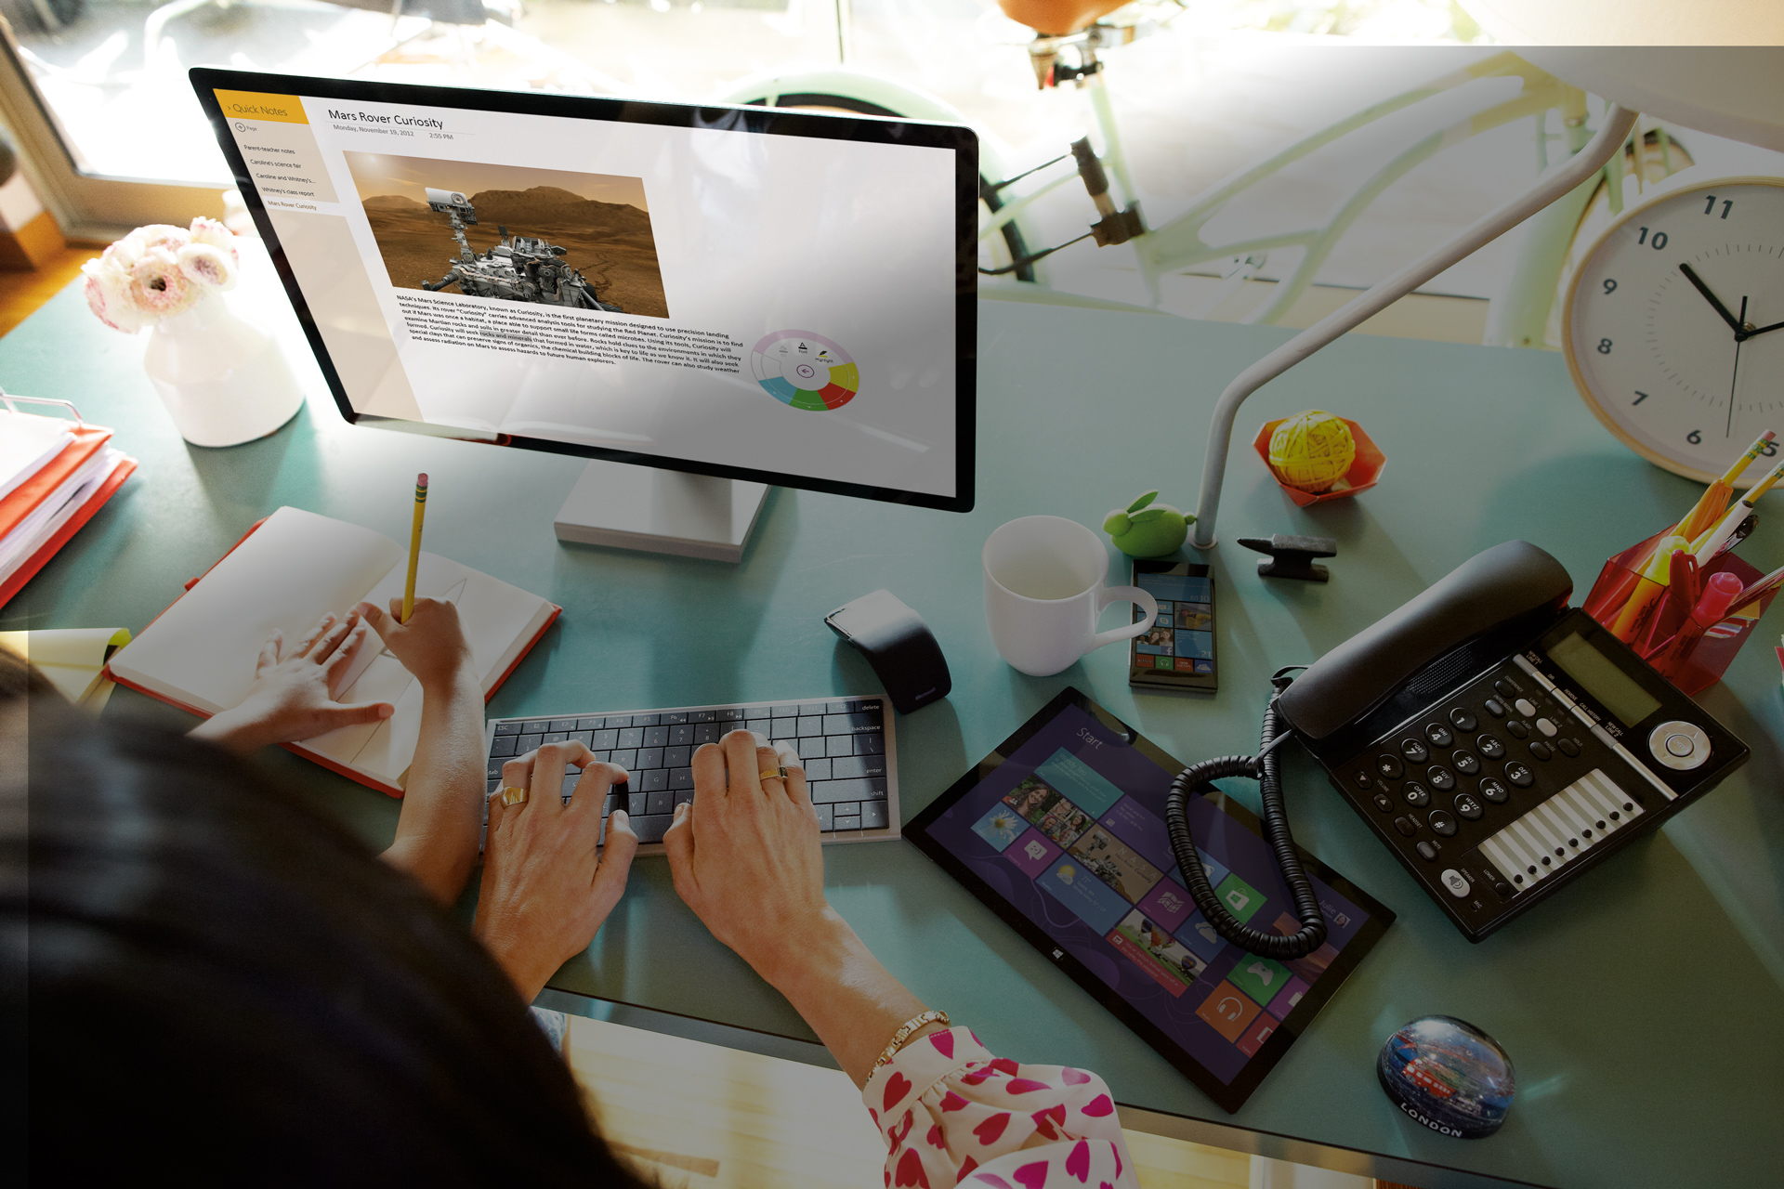
Windows 8
> 100 million licenses
>100,000 apps in Store
>250 million app downloads
~90% of app catalog downloaded
Windows 8.1
FREE upgrade for Windows 8 and RT
RTM in late August
More devices…
Notes:
Windows 8.1 Momentum, Windows 8.1 continuous investment

Slide 22
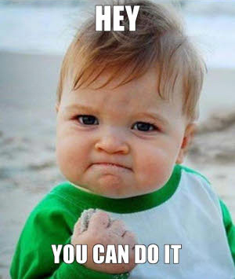
MORE THAN AN APP
Own the tile. Effective and original Live Tiles are crucial to your apps success in the Windows Store. Make sure you think about great apps
Connect with other apps. Leverage the platform specific features to empower the user and gain more visibility. Think about things likeShare and Settings-charms or work with the FilePicker dialog.
Follow the design. Check out the design guidelines at design.windows.com and leverage the resources available there.
Leverage the Microsoft-account to save user preferences, highscore and settings.

Slide 23
RESOURCES
Windows 8 CookBook (8.0)
HTML5 Game Starter Kit (8.0)
Platformer Game StarterKit + Graphics (8.0 & 8.1)
News reader end-to-end sample (8.0 & 8.1)
App settings sample (8.0 & 8.1)
App tiles and badges (8.0 & 8.1)
App data sample (8.0 & 8.1)
Snap sample (8.0 & 8.1)
HttpClient sample (8.0 & 8.1)
Sharing content (8.0 & 8.1)
File picker sample (8.0 & 8.1)
Proximity sample (8.0 & 8.1)
Geolocation sample (8.0 & 8.1)
File access sample (8.0 & 8.1)
Search sample (8.0 & 8.1 searchbox / Search charm)
And many more at http://dev.windows.com and www.codeplex.com

Slide 24
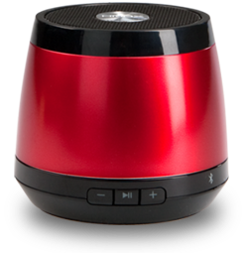
WIN SOME SPEAKERS
Submit your app to the Windows 8 Store. As a student you can register as a Store developer for free through DreamSpark.com
Get downloads. Once your app passes certification start promoting it to get downloads. You can submit it to AppAwards to get more downloads.
Win a Bluetooth device. The team that has the most downloads by 31.10.2013 will win 3 Bluetooth JamBox speakers
Win AppAwards People’s Choice. You can continue gathering downloads for your app/game and win the AppAwards People’s Choice Award in April.

