Slide 1
COGNITIVE LIVING
Carl Kugblenu
Geraldine Villers
Madhubala Ganesan
Syed Asif Iqbal

Slide 2
Agenda
Home Automation Protocols
Motivation
Goals
Our Idea
FHEM
Components Used
System Architecture
Proof of Concept
Energy Analysis
Conclusion

Slide 3
Home Automation Protocols
LonWorks

Slide 4
Introduction
This technology was developed by Echelon Corporation for implementing control system networks.
The root term LON, is an acronym for: Local Operating Network.
Is a complete solution for implementing distributed control networks.
The goal of the platform is to make it easy and cost effective to build open control systems.
Users can access all the elements required to design, install, and support control networks.
The major elements include Neuron Chips, LonWorks transceivers, LonTalk protocol and LNS (LonWorks Network Service).
These networks consist of nodes that communicate with one another over a variety of communications media using a common message-based communications protocol.

Slide 5
LONTalk Protocol
LONTalk is a Control Network Protocol
Is a complete seven-layer communications protocol, with each layer optimized to the needs of control applications.
The seven layers follow the reference model for open systems interconnection (OSI) developed by the International Standard Organization (ISO).

Slide 6
Features.
Efficient delivery of small messages.
Reliable delivery of messages.
Duplicate message detection.
Multiple communications media.
Low installation and maintenance cost
Efficient use of channel bandwidth.
Prevent tampering.

Slide 7
Layer | Purpose | Services provided
Physical | Electrical Interconnect | Media-Specific Interfaces and Modulation Schemes (twisted pair, power line, radio frequency, coaxial cable, infrared, fiber optic)
Link | Media Access and Framing | Framing; Data Encoding; CRC Error Checking; Predictive CSMA; Collision Avoidance; Priority & Collision Detection
Network | Message Delivery | Unicast & Multicast Addressing; Routers
Transport | End-to-End Reliability | Acknowledged & Unacknowledged Message Delivery; Common Ordering; Duplicate Detection
Session | Control | Request-Response; Authentication
Presentation | Data Interpretation | Network Variables; Application Messages; Foreign Frame Transmission
Application | Application Compatibility | Network Configuration; Network Diagnostics; File Transfer; Application Configuration; Application Specification; Alarming; Data Logging; Scheduling

Slide 8
Implementations
Municipal and highway/tunnel/street lighting.
Heating and air conditioning systems.
Subway train control.
Stadium lighting and speaker control.
Security systems, fire detection and suppression, and newborn location monitoring and alarming.
Smart electricity metering

Slide 9
DASH7 Alliance Protocol

Slide 10
Features.
Is an open source Wireless Sensor and Actuator Network protocol.
Built on top of an asynchronous Wireless Sensor Network Media Access Control.
This standard was mainly used for military logistics.
It uses Generally Radio Frequency Identification technology, which is used for locating and tracking objects in a variety of applications.
This technology consists of a tag and a reader. There are two types of tags, active and passive. Passive tags receive their energy from the readers, when readers emit electromagnetic radiations to detect the tag.

Slide 11
Advantages.
DASH7 provides multi-year battery life.
Long range, of up to 2 km.
Low power (about 10 times less consumption than zigbee)
Low latency for connecting with moving things.
AES 128-bit shared key encryption support.
Data transfer of up to 167 kbit/s.
Penetration effect (good for indoor use where is much concrete and walls )
It works great with moving objects without delays
Indoor/outdoor positioning with 1 meter accuracy (using multiple gateways)

Slide 12
BLAST network technology
Bursty
Data transfer is abrupt and does not include content such as video, audio.
Light
Refers to a limited packet size (256 bytes). Multiple consecutive packets are however supported.
Asynchronous
Communication is command-response based without any periodic synchronization
Stealth
Transitive
Protocol do not need any periodic address broadcasting, which means nodes can choose to communicate only in trusted environments
Refers to the mobile transitional behavior of devices and/or tags.

Slide 13
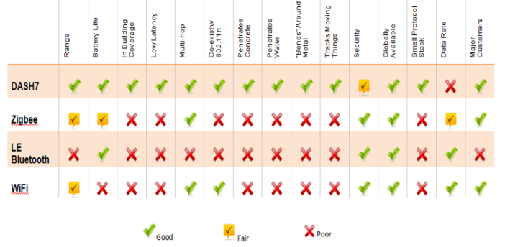
Protocol Comparison

Slide 14
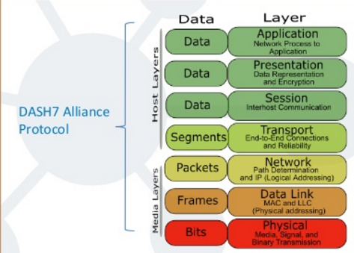
OSI Model
This protocol involves all 7 OSI layers

Slide 15
Application
Building Automation, Access Control, Smart Energy
Location-Based Services
Mobile advertising
Automotive
Logistics

Slide 16
COGNITIVE LIVING

Slide 17
Motivation
Increased use of Electronic devices for the household
Existing Home Automation systems are designed for specific purposes – comfort / security / cost saving
Need for an integrated system which serves all these purposes
Users’ needs change from time to time. So there is a need for self adapting system
Social – Comfort & Security; Environmental – CO2 emission; Economic – Cost saving
Social
Environmental
Economic

Slide 18




Goals
A comfortable environment – physiologically ambient environment for living
Safe and Secure living
Energy aware living & steps towards saving energy
Cost saving by reducing power consumption
A system that can automatically understand user’s needs

Slide 19


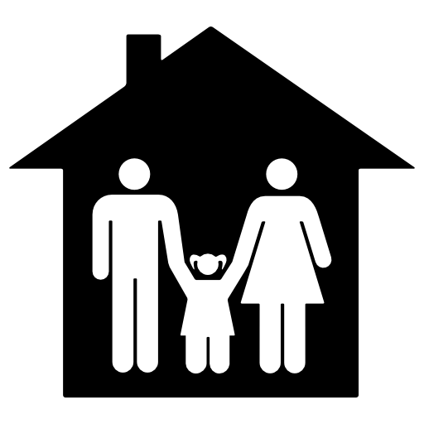









Our Idea
Initially set to preferences, but user can control
Child Safety & Security
When no one is at home!
Normal Mode
Child Mode
Shield Mode
Cognition System

Slide 20
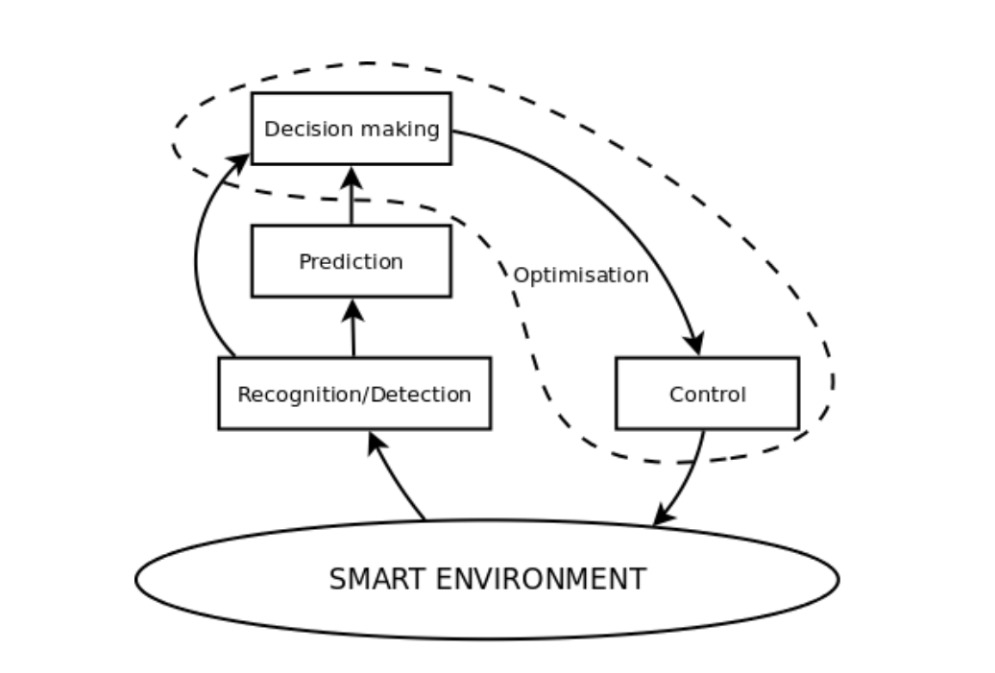
Self – Adapting System (Cognition)

Slide 21

What is FHEM?
Perl -based server program for home automation.
Open Source Project
Supports various protocols. FS20, HomeMatic etc.
Extensible with modules
Microsoft Windows , MacOS , and Linux - based computers support

Slide 22
Impressions
Robust & Platform independent
One platform to access multiple vendor home automation devices
Built in regular expressions for manipulating texts & strings
Difficult to find help with implementation
Documentation not clear
Very extensible

Slide 23
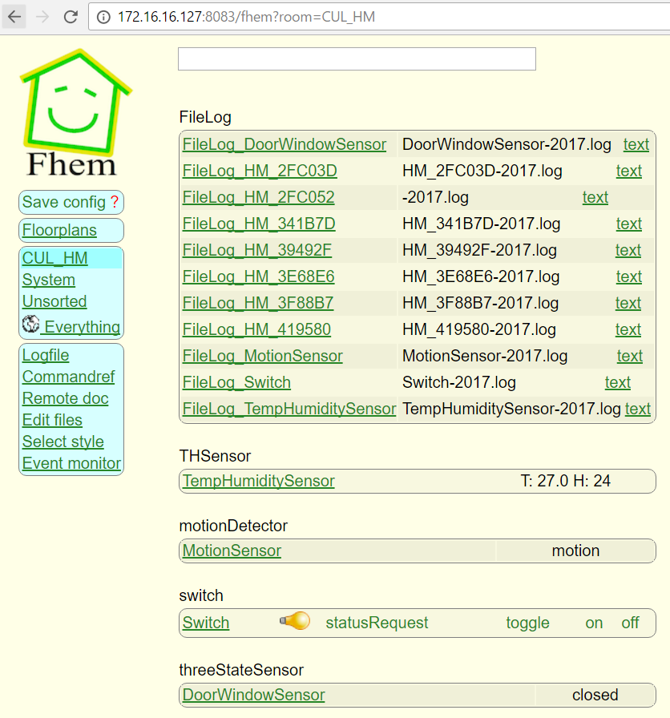
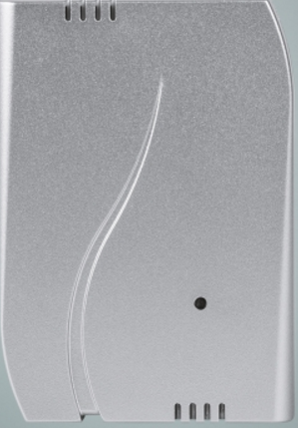
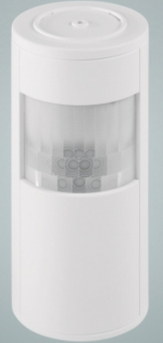
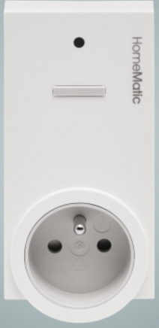

Implementation in Cognitive Living

Slide 24

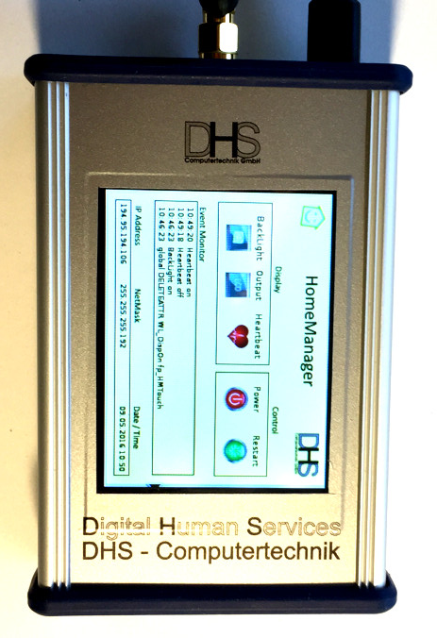
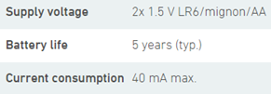
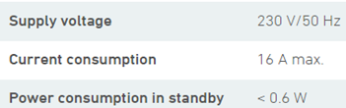
Components Used
Wireless Door/Window Sensor, optical
DHS HomeManager
4GB flash,
1GB RAM,
dual-core 1GHz processor,
100Mbit LAN,
HDMI,
USB host
Wireless Temperature/ Humidity sensor indoor
Wireless switch Actuator 1-channel
AXIS M1113 Network Camera
Image sensor Progressive scan RGB CMOS 1/4"
Lens Varifocal, 2.9-8.2 mm, F1.4
Horizontal angle of view: 65°-25°
Minimum illumination 0.6 lux, F1.4
Shutter time 1/8000 s to 1/6 s
Video compression
H.264 Baseline Profile (MPEG-4 Part 10/AVC), Motion JPEG

Slide 25




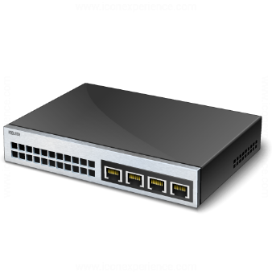
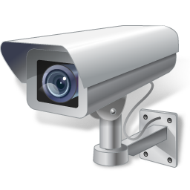






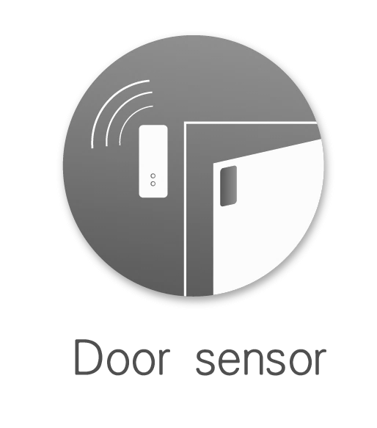




System Architecture
Switch
Axis M1113 IP Camera
Homematic Wireless Temperature/ Humidity sensor
DHS HomeManager
Homematic Wireless switch Actuator
Homematic Wireless Motion Sensor

Slide 26
Proof of Concept
COGNITIVE LIVING
Normal Mode
Shield Mode
Child Mode
Check T & H
Check T & H
Put OFF the AC
AC OFF
AC OFF
IF Door Open
AC ON
AC ON
IF Door Open
IF Door Open & AC ON
Notify to Close the Door
Notify to Close the Door
Notify to Close the Door

Slide 27
Motion Detection with AXIS M113
AXIS M113 supports motion detection with the application Motion Detector 3
The camera feed is integrated to Cognitive Living Interface
We defined the Include & Exclude areas in the captured frame
Configured the IP camera to send email notifications to the user
If there is any motion detected in the include area, the user is notified by email
If there is an attempt to tamper the camera, the user is notified immediately by email

Slide 28
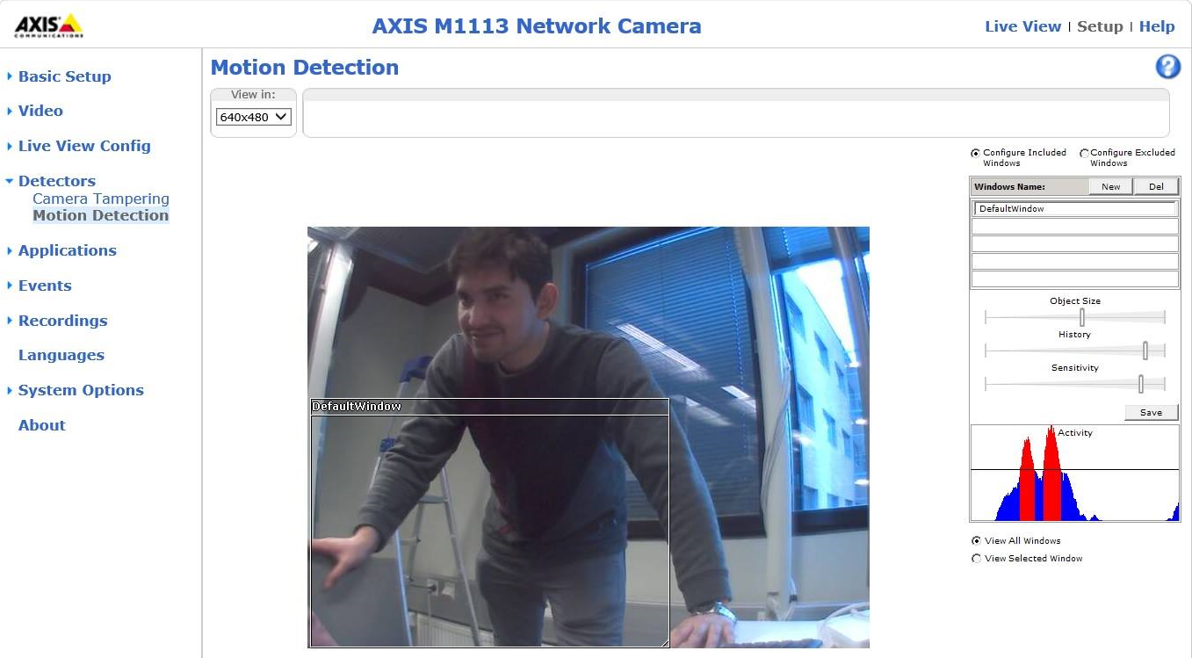
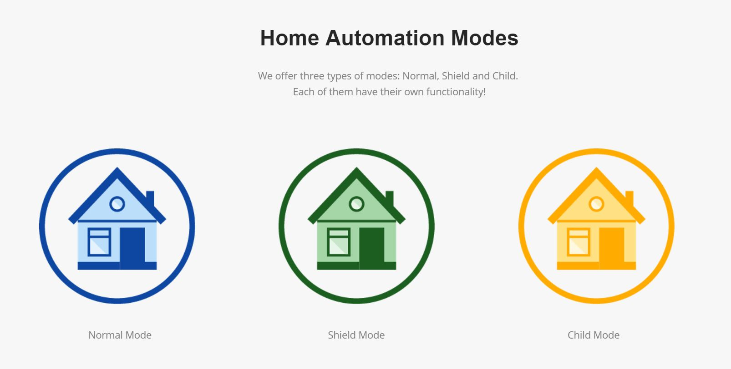
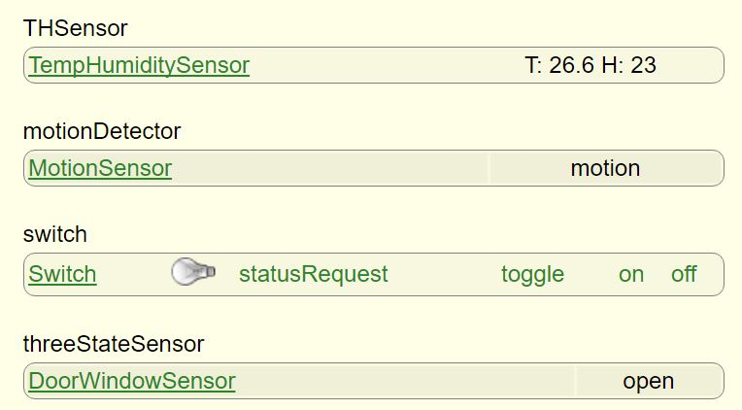
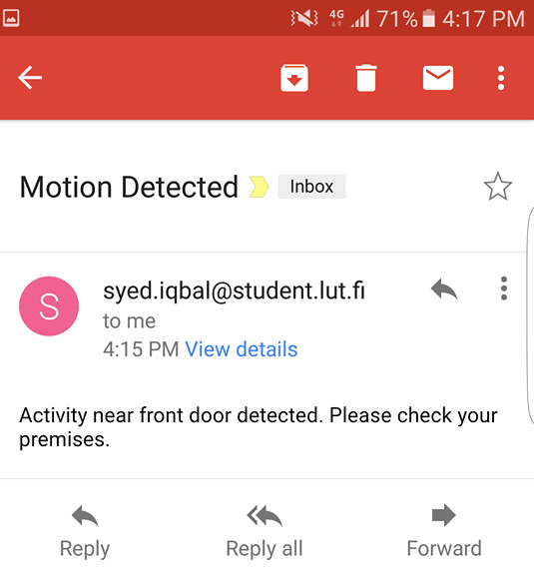
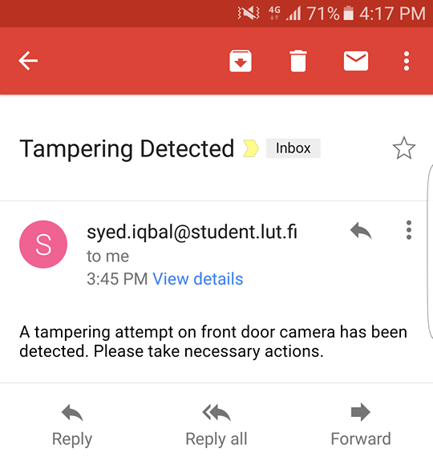
It Works!

Slide 29
Energy Analysis
Equipment | Energy consumption per hour(Watt)
LED TV | 0.3
Mobile Phone charger | 1
Computer Display, LCD | 1.13
Computer, desktop | 2.84
Computer, notebook | 4.42
Printer, laser | 4.5
Speakers, computer | 4.12
Washing machine | 3.2
Induction cooker | 7
Coffee maker | 1
Microwave oven | 3
Audio System | 10
Air Conditioner | 50
Total per hour usage | 92.51
Consumption weekdays(kW)
408.8942
Consumption in weekends(kW)
76.96832
Total Energy Consumption(kW)
485.86252
Total Energy Savings (0.155 euro/kw)
74.33696556
Carbon Footprint reduction(kg CO2)
106.8897544

Slide 30
Benefits
ICT for Greening – by reducing carbon footprint
Enhanced safety & security
Ambient environment for living
Cost saving

Slide 31
