Slide 1
LUT/Saimia CapGemini Code Camp 17.10.2012 Java EE Technologies
Lauri Naukkarinen
Tatu Kosonen
Kari-Matti Kangas

Slide 2
Objectives
What is Java EE
Why use Java EE
Examples

Slide 3
When you understand this, you understand Java EE
public abstract class AbstractSingletonProxyFactoryBean
extends ProxyConfig
implements FactoryBean, BeanClassLoaderAware, InitializingBean
Convenient proxy factory bean superclass for proxy factory beans that create only singletons.

Slide 4
Java EE Technology Specifications
Java API for RESTful Web Services (JAX-RS)
Web Services 1.3 JSR109
Java API for XML-Based Web Services (JAX-WS) 2.2 JSR224
Java Architecture for XML Binding (JAXB) 2.2 JSR222
Web Services Metadata for the Java Platform 2.1 JSR181
Java API for XML-based RPC (JAX-RPC) 1.1 JSR101
Java APIs for XML Messaging (JAXM) 1.3 JSR67
Java API for XML Registries (JAXR) 1.0 JSR93
Java Servlet 3.0 JSR315
JavaServer Faces (JSF) 2.0 JSR314
JavaServer Pages (JSP) 2.2 JSR245
Expression Language (EL) 2.2 JSR245
JavaServer Pages Standard Tag Library (JSTL) 1.2 JSR52
Enterprise JavaBeans (EJB) 3.1 JSR318 Lite
Java Persistence API (JPA) 2.0 JSR317
Contexts and Dependency Injection for Java 1.0 JSR299
Dependency Injection for Java 1.0 JSR330
Common Annotations for the Java Platform 1.1 JSR250
Java Message Service API (JMS) 1.1 JSR914
Java Transaction API (JTA) 1.1 JSR907
JavaMail API 1.4 JSR919
Java Authentication Service Provider Interface for Containers (JASPIC) 1.0 JSR196
Java Authorization Service Provider Contract for Containers (JACC) 1.4 JSR115
…

Slide 5
Introduction to Java EE
J2EE == Java EE
Vendor-specific implementation of interfaces
Apache, Oracle, IBM, etc
Java EE components work with Hollywood Principle ’Don’t call us, we’ll call you’
Java EE is a server-side programming environment
NOT Java Applets or JavaScript
Client side receives processed output
HTML, JSON, XML(SOAP)
Client is often a web browser
Could as well be a mobile client or another server side system

Slide 6
System Using Java EE
Characteristics
Usually massive and complex enterprise scale information systems
Comprise different Java EE components and legacy systems
Distributed
Long lifetime
Modules built with common patterns
Leads easy maintenance
High demand, high performance
SOA and BPM solutions

Slide 7
Traditional Java EE Users
Examples of use
Insurance companies
Online banks
Manufacturing industries
Public sector
’Cobol of the 21st century’

Slide 8
Java EE is not only Java
Many languages with seamless integration: you can share libraries, code, classes, etc.
Groovy
Object-oriented
Inspired by Java, Python, Ruby, Smalltalk
Scala
Functional, object-oriented
”Cutting away Java’s syntactic overhead, adding power”
Inspired by Java, Scheme, Erlang, Haskell, Lisp
JRuby: implementation of Ruby on JVM
Jython: implementation of Python on JVM

Slide 9
“Trendy” Java EE users: LinkedIn
Started with Java platform, using Java EE and extensions
Spring Framework
Grails
Now utilizing also Scala and JRuby
Scala for back-end processing
JRuby for integration interfaces

Slide 10
“Trendy” Java EE users: Twitter
Started with Ruby on Rails
Now using Java and Scala in back-end processing
Why?
Scalability and Performance
SOA
Encapsulation (re-use, maintenance)

Slide 11
“Trendy” Java EE users: Others
Google, Amazon and many others use Java EE
What about Facebook?
Writing PHP, which quickly lead to serious performance issues
Started compiling PHP to C++
Are now investigating using PHP on JVM

Slide 12
Pure Java isn’t always “too many lines”
Package fi.app.domain.courses;
import java.util.List;
import org.bson.types.ObjectId;
import org.springframework.data.mongodb.repository.MongoRepository;
import org.springframework.data.mongodb.repository.Query;
import org.springframework.data.querydsl.QueryDslPredicateExecutor;
public interface CourseRepository
extends MongoRepository<Course, ObjectId>, QueryDslPredicateExecutor<Course> {
// Interface implementation is generated run-time by Spring
@Query("{ 'name' : { $regex : ?0, $options: 'i' } }")
public List<Course> findByNameRegex(String name);
@Query("{ 'code' : { $regex : ?0, $options: 'i' } }")
public List<Course> findByCodeRegex(String code);
}

Slide 13
Technology Overview
Model-View-Controller(MVC)
Java EE System
bv
External Systems
Client
Request
Controller (Servlet)
Model (EJB)
DB
Response
View (JSP)
Web Server
Application Server

Slide 14
Technology Overview
Java EE is a specification that different vendors implement
Implementation details are hidden, only API is published
Concrete classes often also used via Proxy
Java EE Application Servers
For running full stack(Servlets, JSP, EJB)
jBoss, Oracle WebLogic, GlassFish, IBM Websphere …
Java WebServers
For running Servlets and JSP
Tomcat, Jetty,
EJB-only server
OpenEJB

Slide 15
Technology Overview: Controller
Servlet – Controller
Component for handling pre-processing of requests
Redirects to JSP in order to view the response
Uses Model to access business logic
@WebServlet( {”/mail/compose”, ”/mail/delete”, ”/mail/show”} )
public class MailServlet extends HttpServlet
// …
@Override
doGet( HttpServletRequest req, HttpServletResponse ) throws IOException, ServletException {
// … Some pre-processing logic …
RequestDispatcher rd = req.getRequestDispatcher( ”mail-view.jsp” );
MailBox mb = // …Fetch mailbox content from Model
req.setAttribute( ”mailbox”, mb );
rd.forward( req, resp); // Forward to View for further processing
}

Slide 16
Technology Overview: View
Java Server Pages (JSP) – View
XML/HTML –based documents which are compiled to Servlets at runtime
Servlets that spesialize on sending formatted response to client
Can contain JSP scripting elements/Expression Language(EL) statements for adding content dynamically
JSP pages done by UI Designer
Custom tags for more complex tasks (Controller logic) done by SW Developer

Slide 17
Technology Overview: View
<%@ page session="true“ import=“java.util.List” %>
<%@ taglib prefix="c" uri="http://java.sun.com/jsp/jstl/core" %>
<h1>Welcome ${username}</h1>
<c:if test=”${not empty requestScope.mailbox}”>
<p>You have ${requestScope.mailbox.newItems} unread mail</p>
</c:if>
<c:forEach items=”requestScope.mailbox.items” var=”mail”>
<p>${mail.sender} ${mail.title} ${mail.receivedDate}</p>
</c:forEach>
<p><a href=”/mail/compose”>Compose new Mail</a></p>

Slide 18
Technology Overview: Model
Enterprise Java Beans (EJB) – Model
Responsibilities
Transaction handling
Business logic
Stateless vs. Stateful
Remote - Uses either RMI or CORBA to expose interfaces
External App Server
Local – Used as any other Java class through interface and container generated proxy
Inside the same App Server as Controller

Slide 19
Technology Overview: Model
@Stateless
public class MailBean {
public MailBox getMail() {
// Get mail data from DB or external system
// Return as MailBox Transfer Object
return …;
}
}

Slide 20
Case Study: Online shop Example of using Core Java EE technologies in building an online shop
Why choose Core Java EE technologies
Scalability
Distributed Architecture
Security
Cost of Licenses
Support for Open and Closed Interfaces
Maintainability
Design Patterns
Interfaces

Slide 21
Case Study: Online shop Example of using Core Java EE technologies in building an online shop
Use cases:
List products
Searching for products
Adding a product to shopping cart/basket
View/modify shopping cart/basket contents

Slide 22
Case Study: Online shop Example of using Core Java EE technologies in building an online shop
Technologies
JSP 2.0
EJB 2.1
Servlet 2.x
Java EE 5
Core Java EE Design Patterns
Front Controller
View Helper
Dispatcher View
Business Delegate
Application Service
Business Object
(Data)Transfer Object, (D)TO, Value Object (VO)
Data Access Object (DAO)

Slide 23
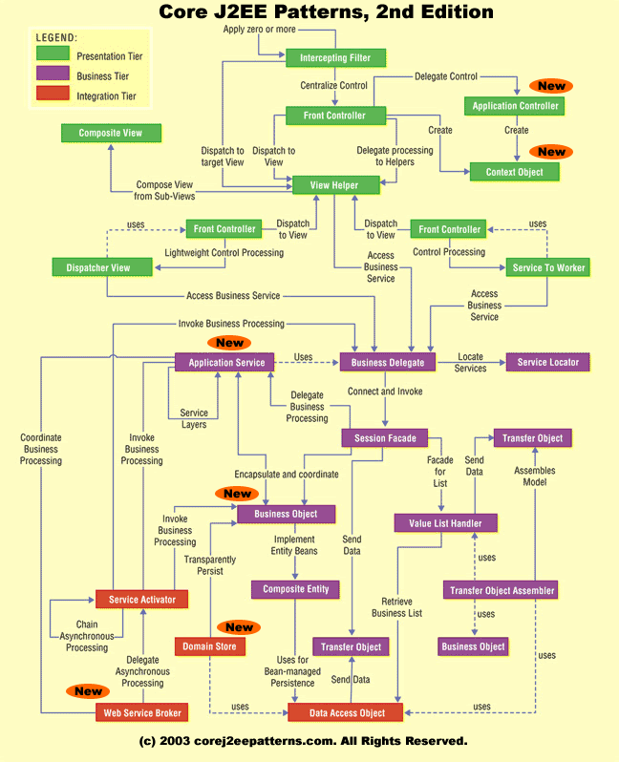
http://www.corej2eepatterns.com/Patterns2ndEd/index.htm

Slide 24
Extensions to Core Java EE
Grails (Groovy on Rails)
Interpreted script compiled to Java bytecode at runtime
Supports writing Java code directly
Java libraries, JPA models etc directly available
Spring / Spring MVC
Abstraction, no need to work directly with Servlets etc
XML-based configuration
IoC/DI
Java EE 6 based on Spring
JSF - Java Server Faces
Notation for generating JSF-pages (View), which communicate with managed beans(Controller)
Struts
Custom tag libraries
XML-based

Slide 25
Questions / Comments ?
Thank you!

