Slide 1
“A social learning and hacking experience”
Antti Knutas
“Hackathon basics for dummies”
Code Camps
Prof Jari Porras
LUT University

Slide 2
Background
Code camps (and hackathons) in LUT since 2003
Hackathons in software engineering education – lessons learned from a decade of events – ICSE SEEM 2018
  Based on own experiences
  Questions, Feedback, Critics about the literature and understanding of what hackathons mean
Code camps and hackathons in education – literature review and lessons learned – CSEET 2019
  Definitions
  (Educational) structures
  Skills and competencies

Slide 3
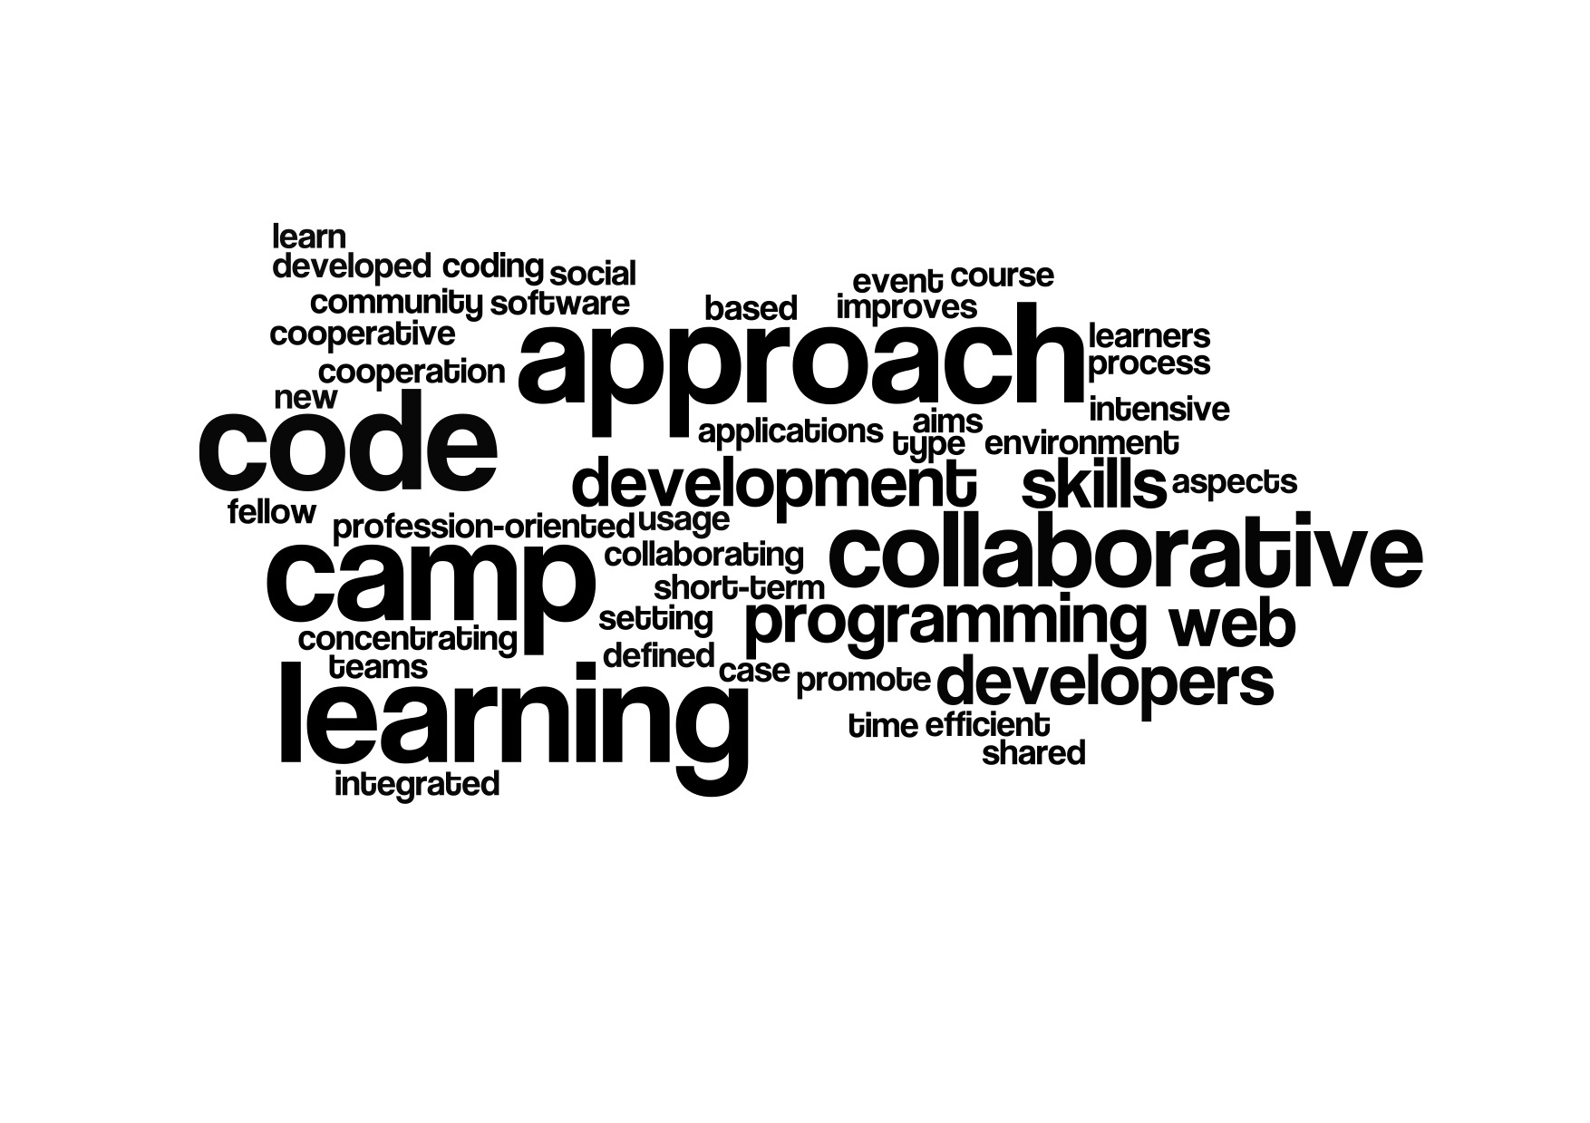

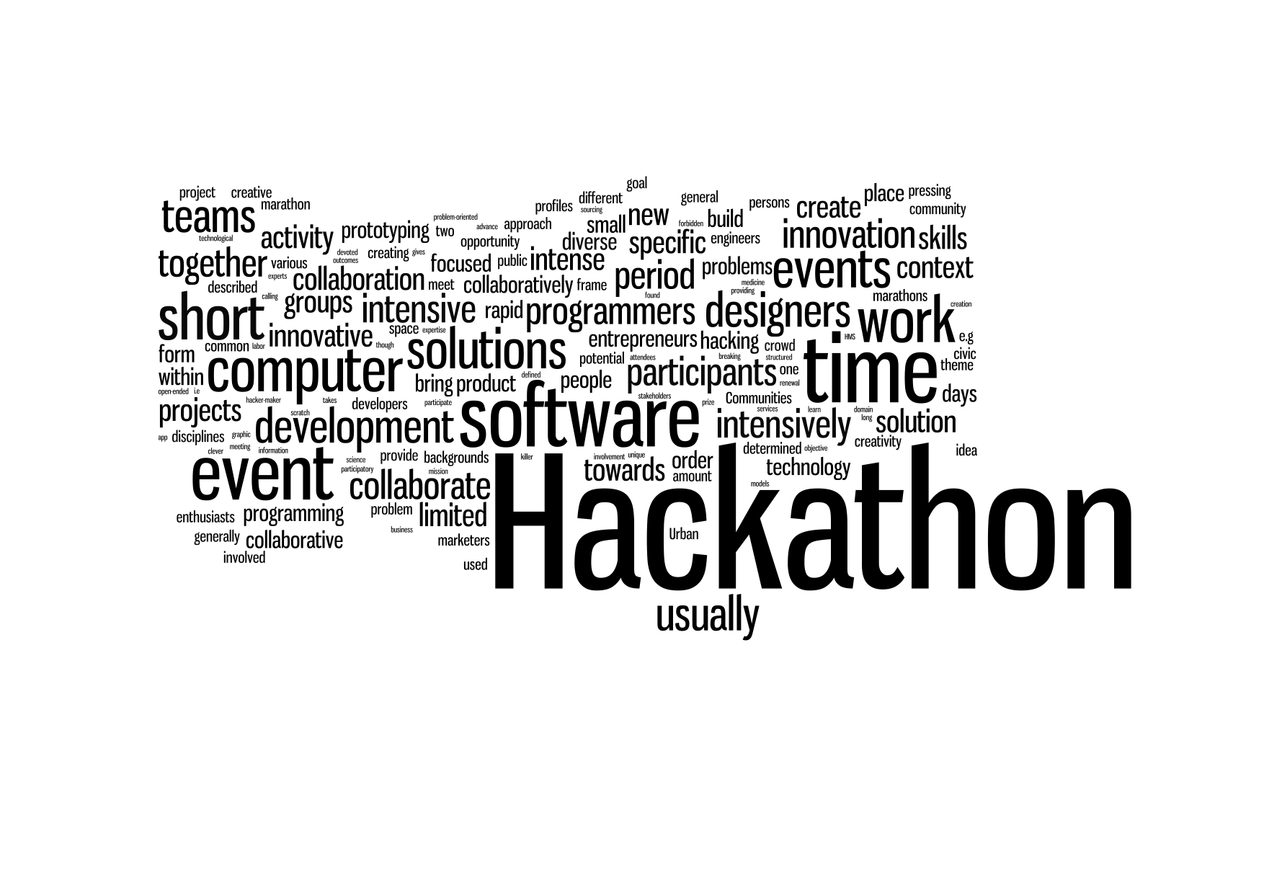
Defining code camps and hackathons

Slide 4
Hackathons in a Nutshell
A growing, world-wide phenomenon of short-time “innovation” events
There is no single recipe for a Hackathon
  Various names, structures, emphasized skills and cmpetencies, etc.

Slide 5
Hackathon structures
Typically – pre-event, event, post-event
  Innovation, tasks, team building
Themed events
  Innovation, collaborative work, pitches
(Very) Intensive

Slide 6
Skills and competencies
Pre-defined wishes for the outcomes
  Learning ?
Emphasis on soft skills
Not clearly described in papers
  Still not seen as a viable education approach ?
”Team got experience from the other team. Different working style can be brought from the other team if good practices were found.”

Slide 7
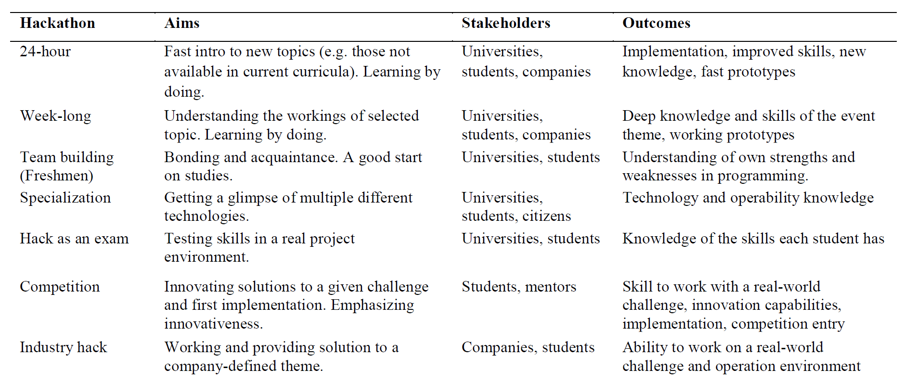
Different Hackathon, Code Camp, Innovation camp.. styles

Slide 8
Lessons learned
What is then important in Hackathon ?

Slide 9

Objective ?
Competition - winner
Innovation – new solutions
Education – learning outcomes
Networking – know new people, socializing
“Code Camp Spirit”

