Slide 1
Lunchpad
Meal listing in an innovative way
group: ThinkBad

Slide 2
overview
Easy and convenient way to see restaurants around campus and filter menus by diets and custom words
Useful tool for students and staff of LUT and Saimia
Scalable user interface and minimal network traffic

Slide 3
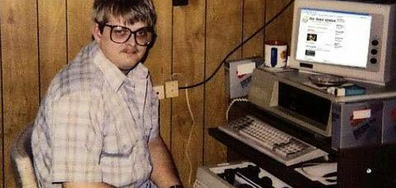
Developers
Ville raukola
Miikka mättölä
Roman hyvönen
Controller
React
User interface and design
Quality assurance
Data management
Backend

Slide 4
Results
Working React js service able to provide data for current day
Easy-to-use and scalable UI
Everyone learned something about React and JS in general + new techniques

Slide 5
Future
Support for multiple days
Even more filtering ways
Super easy-to-use UI
Email alarm on Nugget days (app notifications)!!
Saved preferences

